Slide 1

Winterizing Above Ground Pumps

Slide 2










Water
FREEZING WATER IN A CONFINED SPACE CAN EXERT UP TO
30,000 PSI
Liquid (friend) Solid (foe)
water
8.34 lbs.
ice
8.34 lbs.
weighs 8.34 lbs./gallon

Slide 3
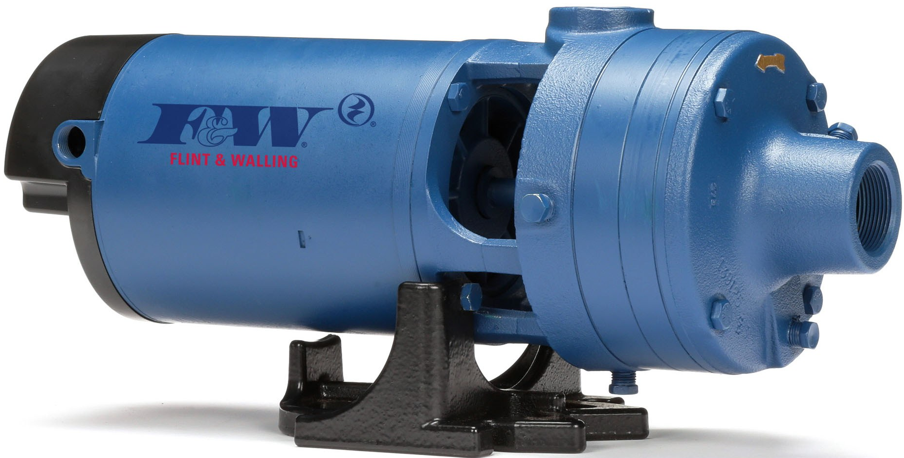
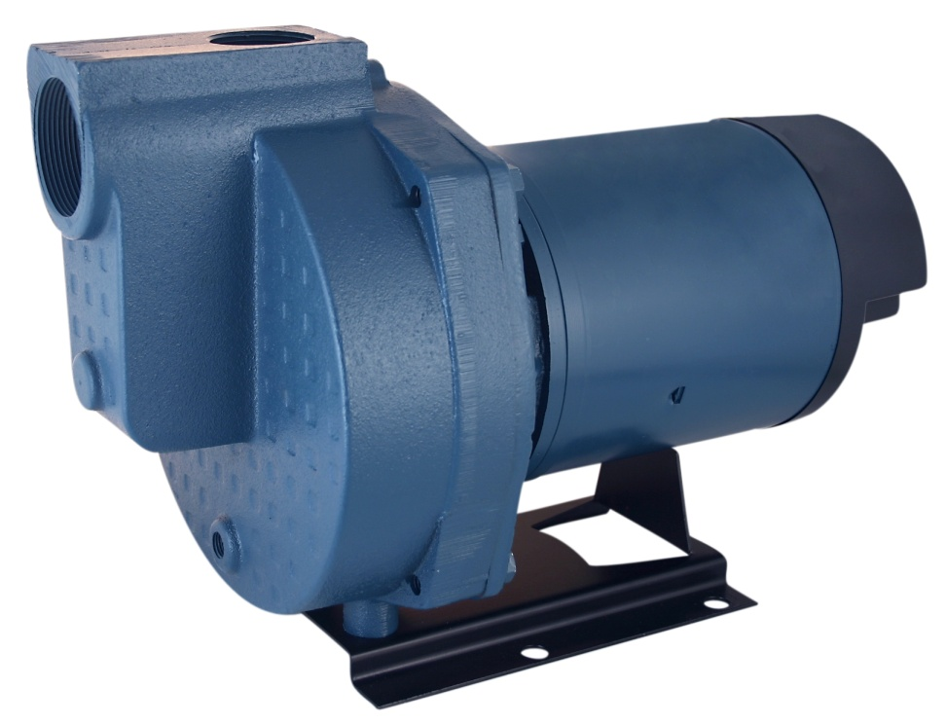
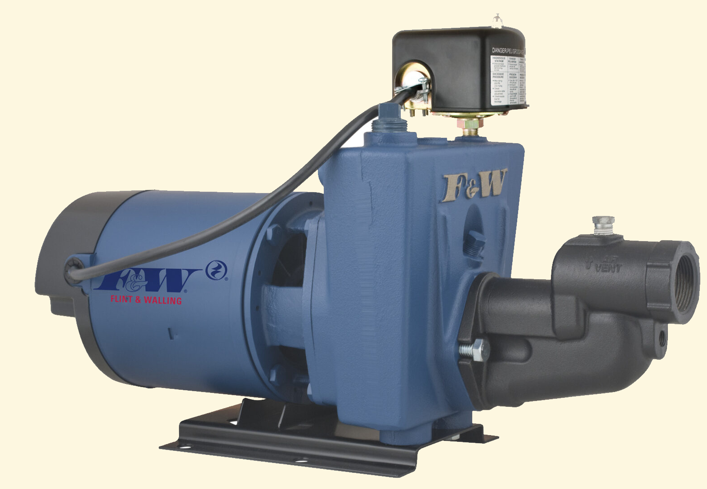
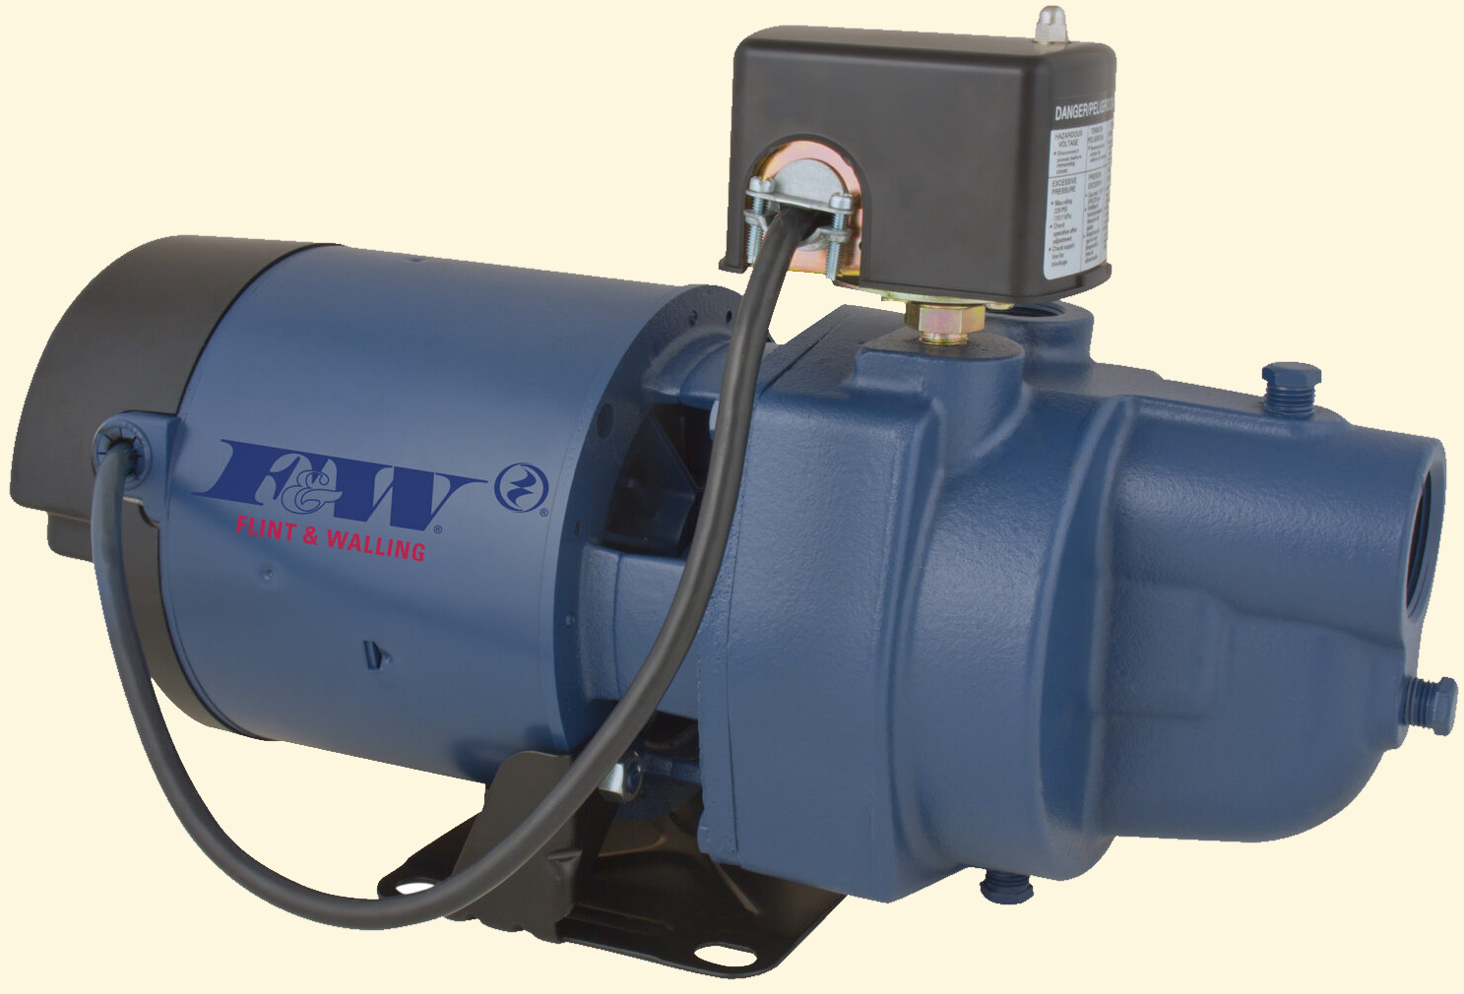
CAST IRON - has more strength than steel. It’s high hardness,
wear resistance and compressive strength makes
it ideal for pump housings, machine parts and
even engine blocks.

Slide 4
STEEL - on the other hand…steel has more tensile strength than
cast iron, which allows it to bend without necessarily
breaking.
To clarify, compressive strength makes iron very hard,
resistant to bending. On the downside, low tensile
strength causes cracking under excessive pressure.

Slide 5
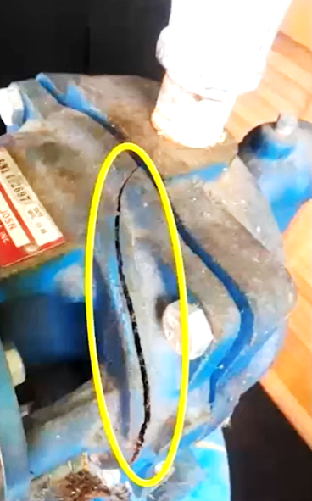
CAST IRON, while extremely strong, is
especially susceptible to freeze
damaged caused by water
expanding as it turns to ice. This
excessive pressure combined
with the contraction of cast iron
in cold weather leads to cracked
pump housings.

Slide 6
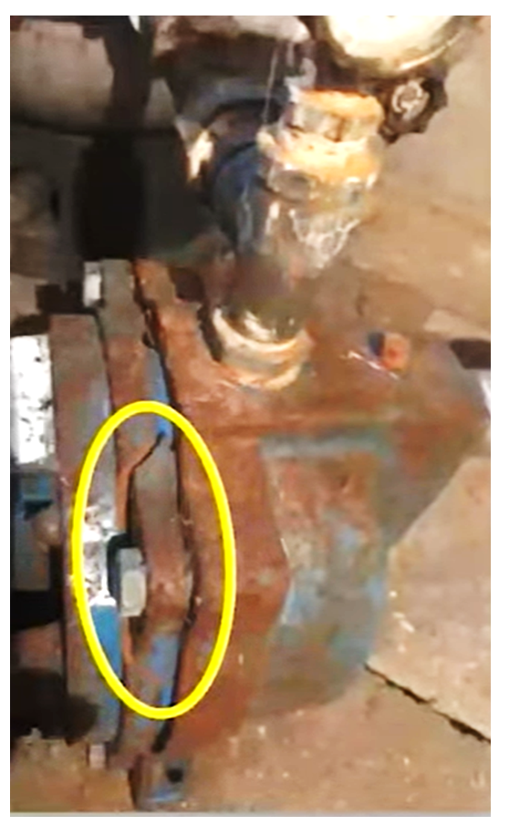
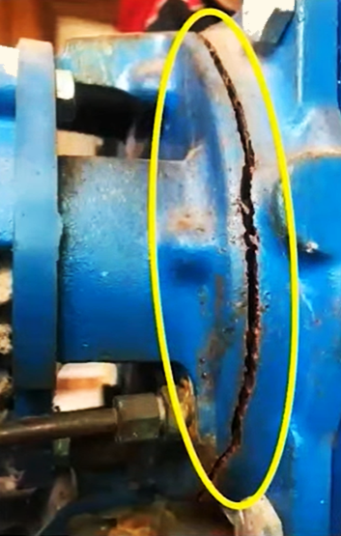
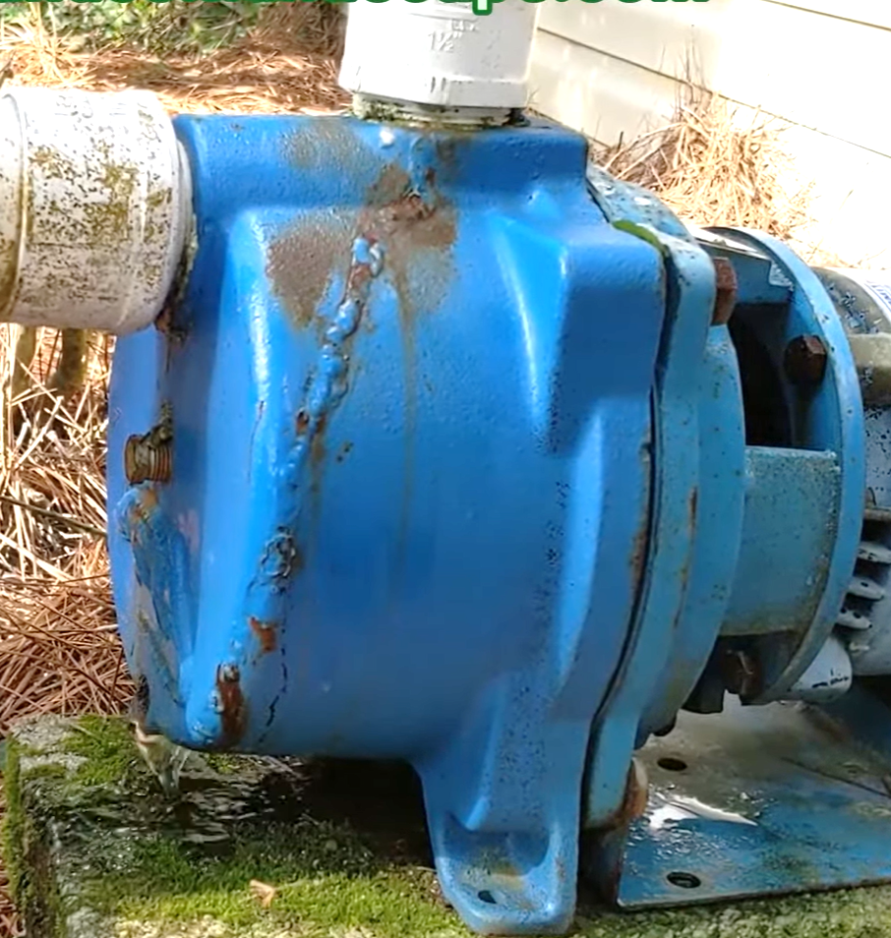

Slide 7
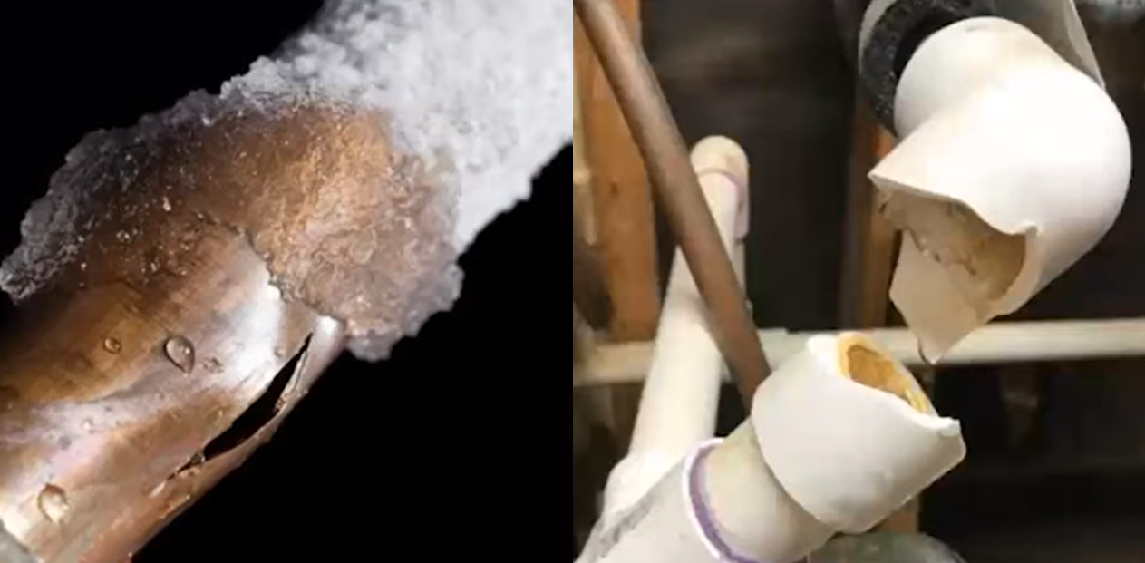

Slide 8
Irrigation
Home
Winterizing Above Ground Pumps
Centrifugals
Self-Primers
Jets

Slide 9
5 common methods
Winterizing Above Ground Pumps
Centrifugals
Self-Primers
Jets

Slide 10
5 common methods
° Drain
° Blow-out
° Antifreeze
° Heat
° Removal

Slide 11
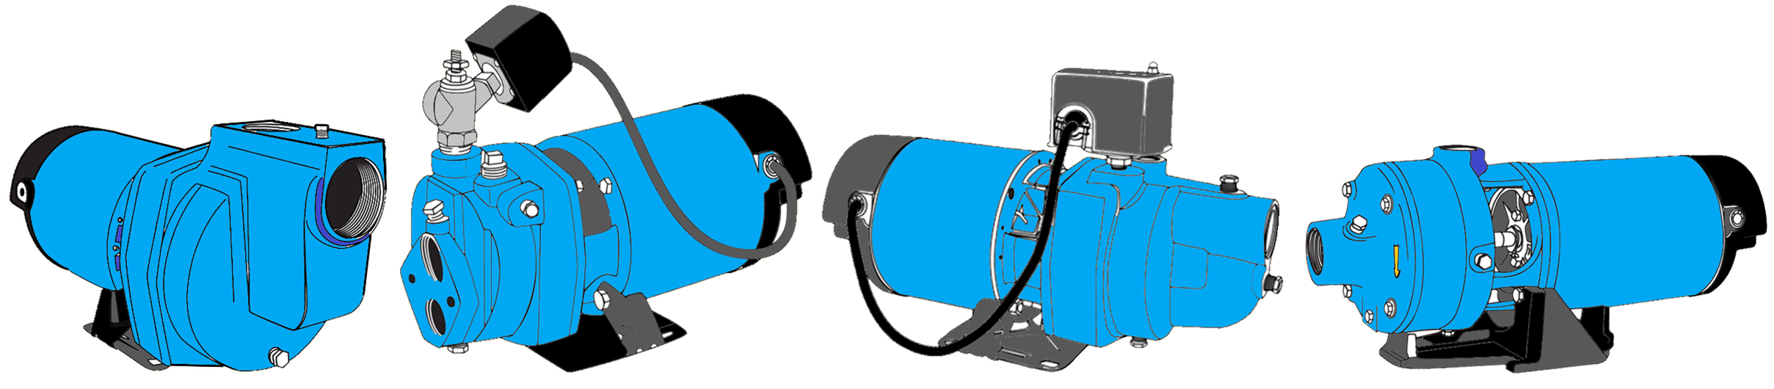



° Drain the pump
Step One Turn off power to the pump

Slide 12
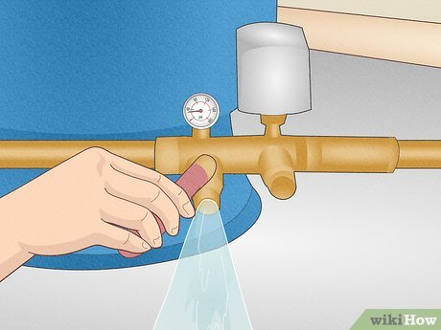
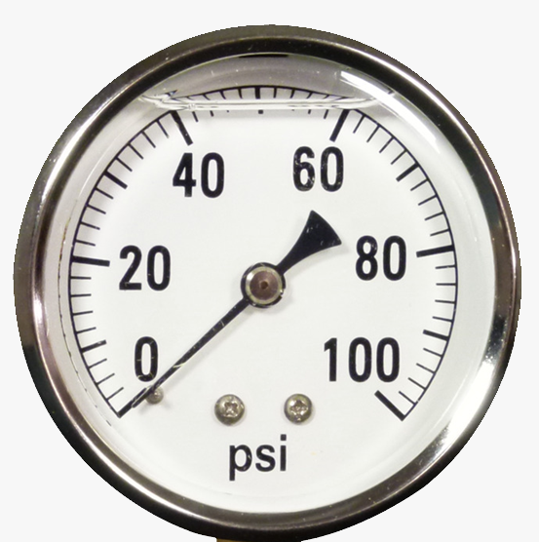
° Drain the pump
Step Two Open a valve or faucet to drain water from piping & tank

Slide 13
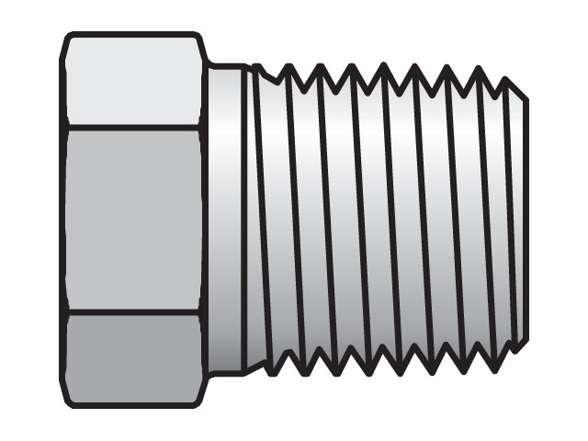
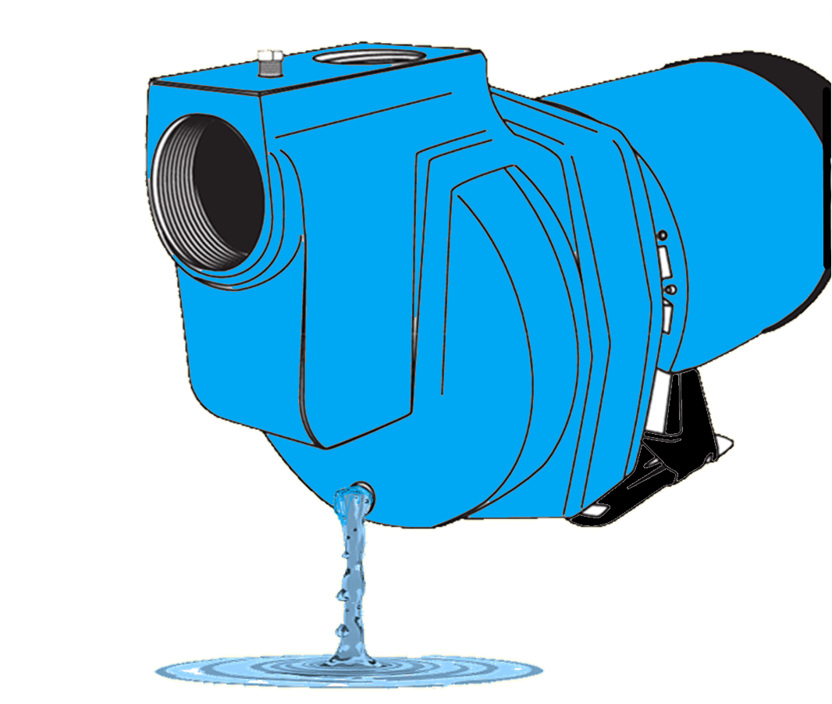
° Drain the pump
Step Three Remove drain plug(s) on the bottom of the pump

Slide 14
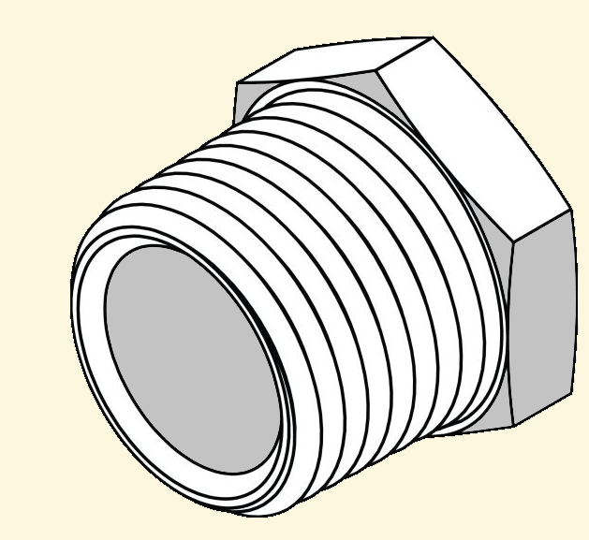
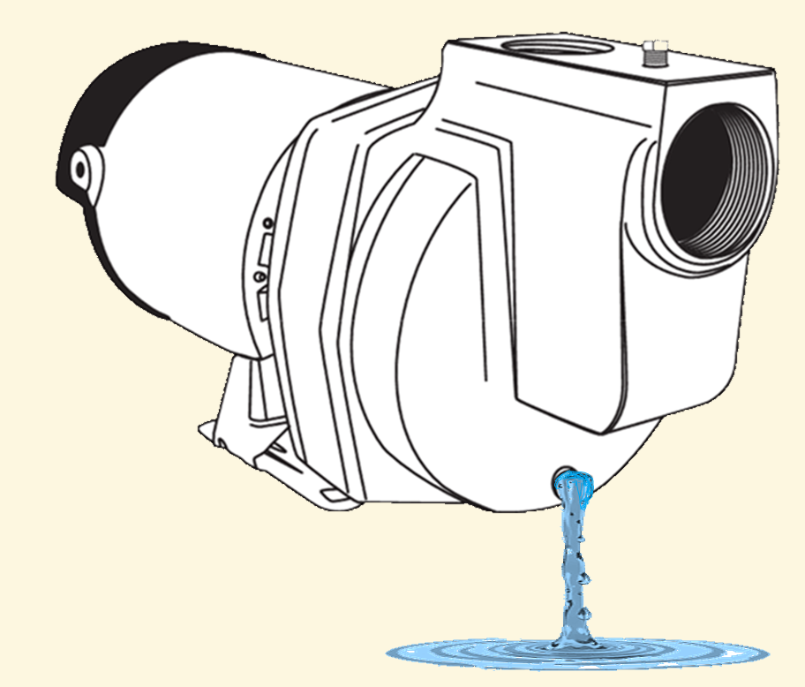



° Drain the pump

Slide 15
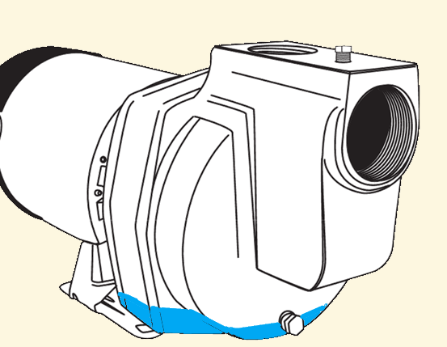
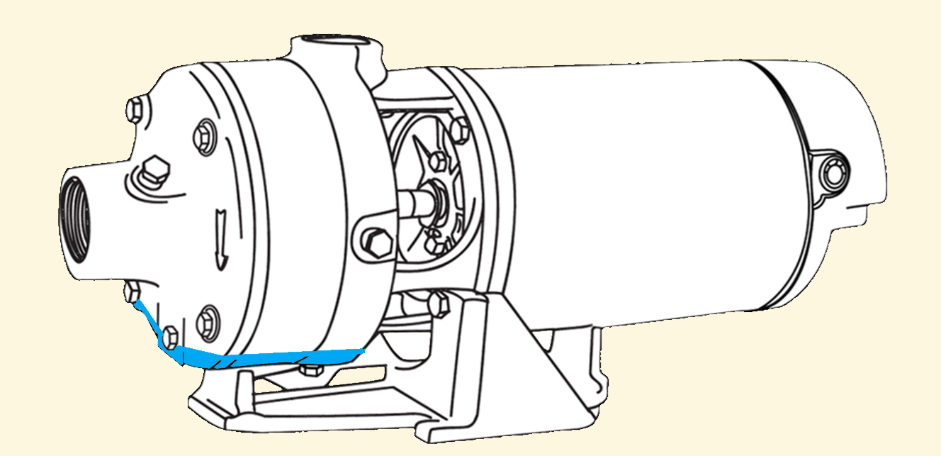
° Drain the pump

Slide 16
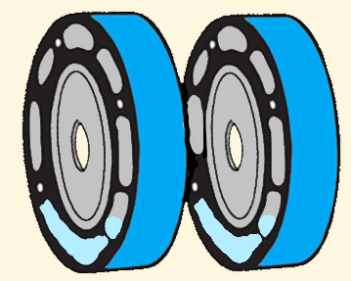
° Drain the pump
DOWNSIDE: Nearly impossible to get all the water out of the pump

Slide 17
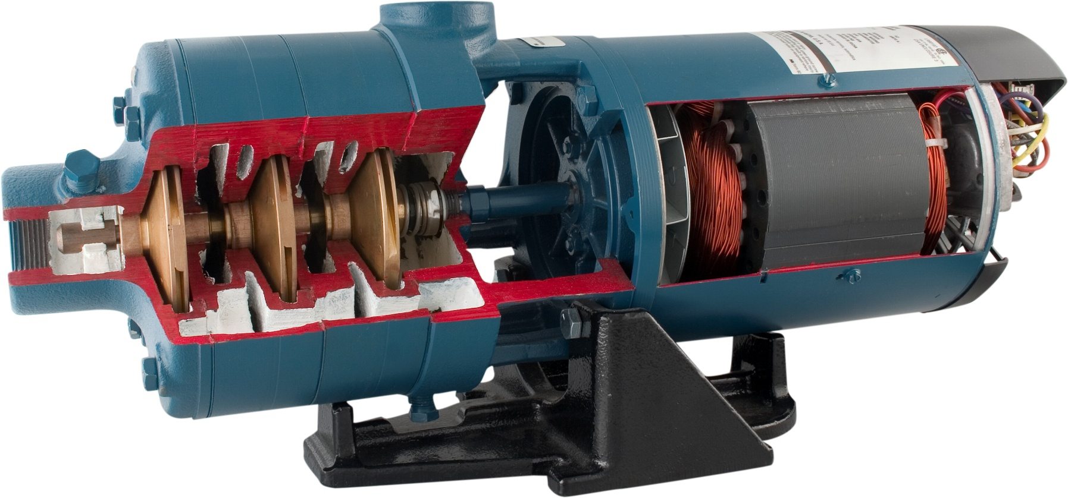
° Drain the pump

Slide 18
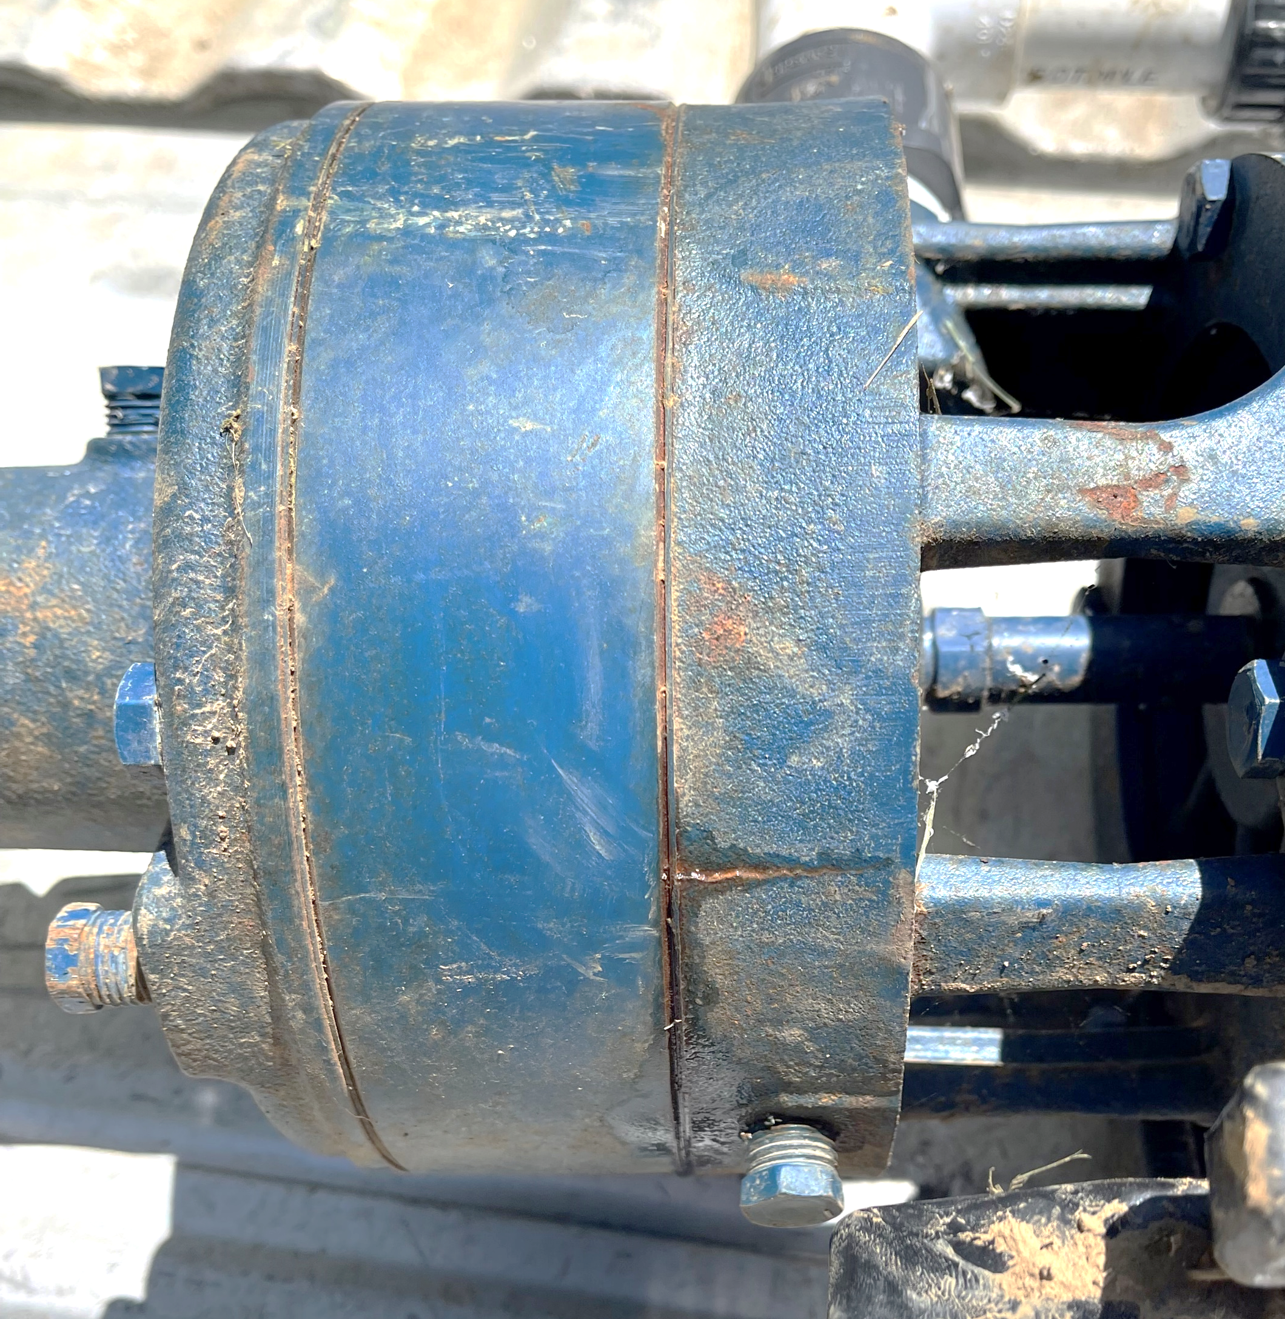
Hey guys, I have a contractor who purchased 2 of these last year. Both were drained and winterized.
He is trying
to figure how they could have
split and if there is any
help he could get to get them
replaced, fixed etc.
appreciate any feedback.
Thanks,

Slide 19
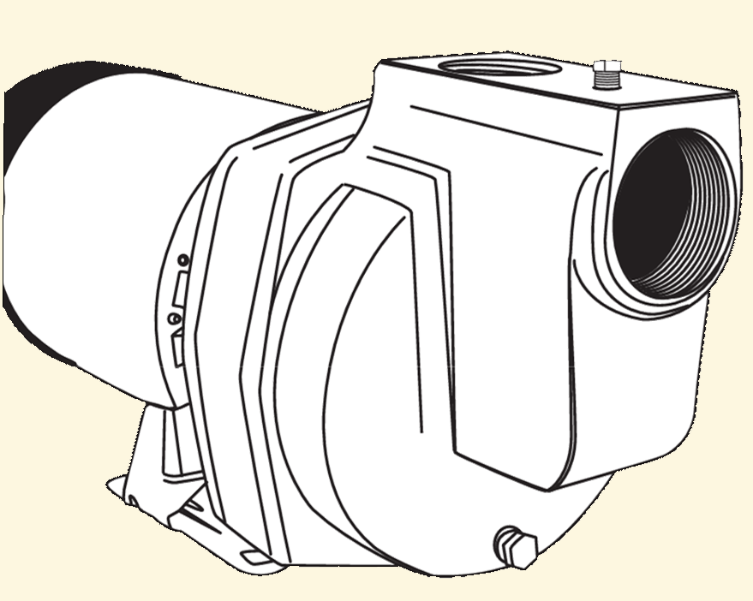
Complete previous Steps 1-3
° Blow-out
Use compressed air to blow-out the
pump body.

Slide 20
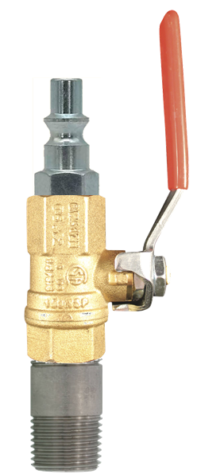
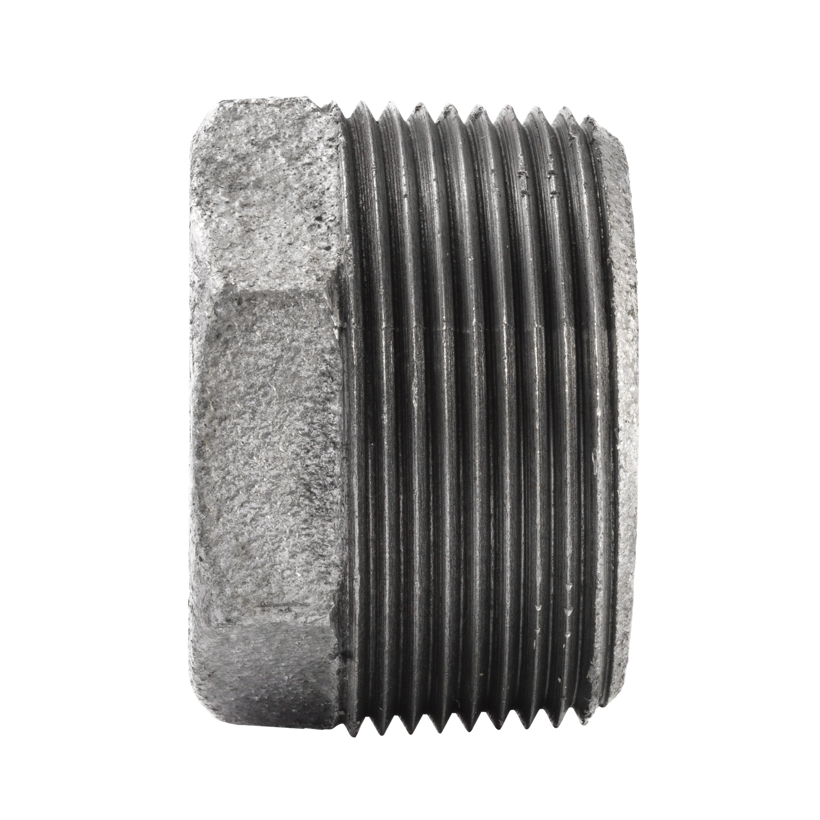
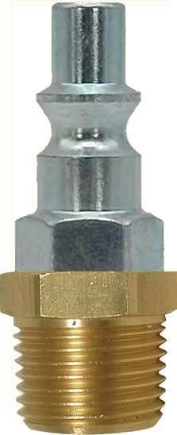
Set compressor to safe level, typically between 40-80 psi.
° Blow-out

Slide 21
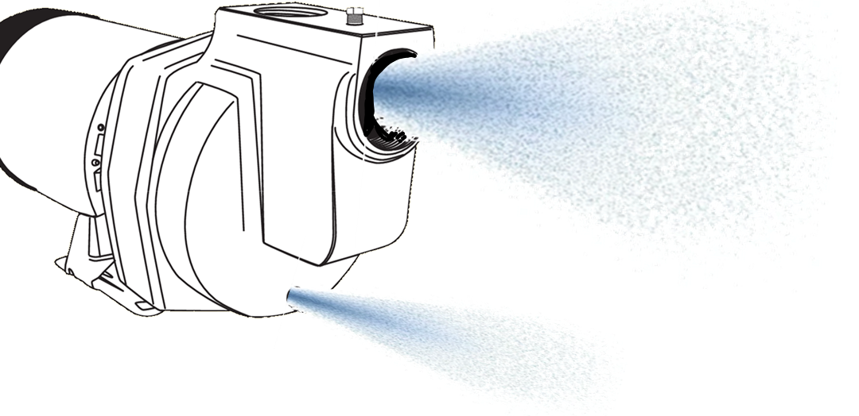
° Blow-out
Set compressor to safe level, typically between 40-80 psi.
Allow the compressor to run until you see a fog or mist coming out of the pump.

Slide 22
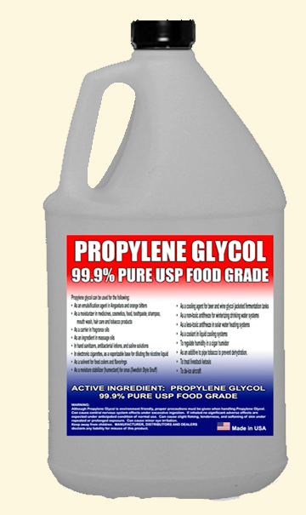
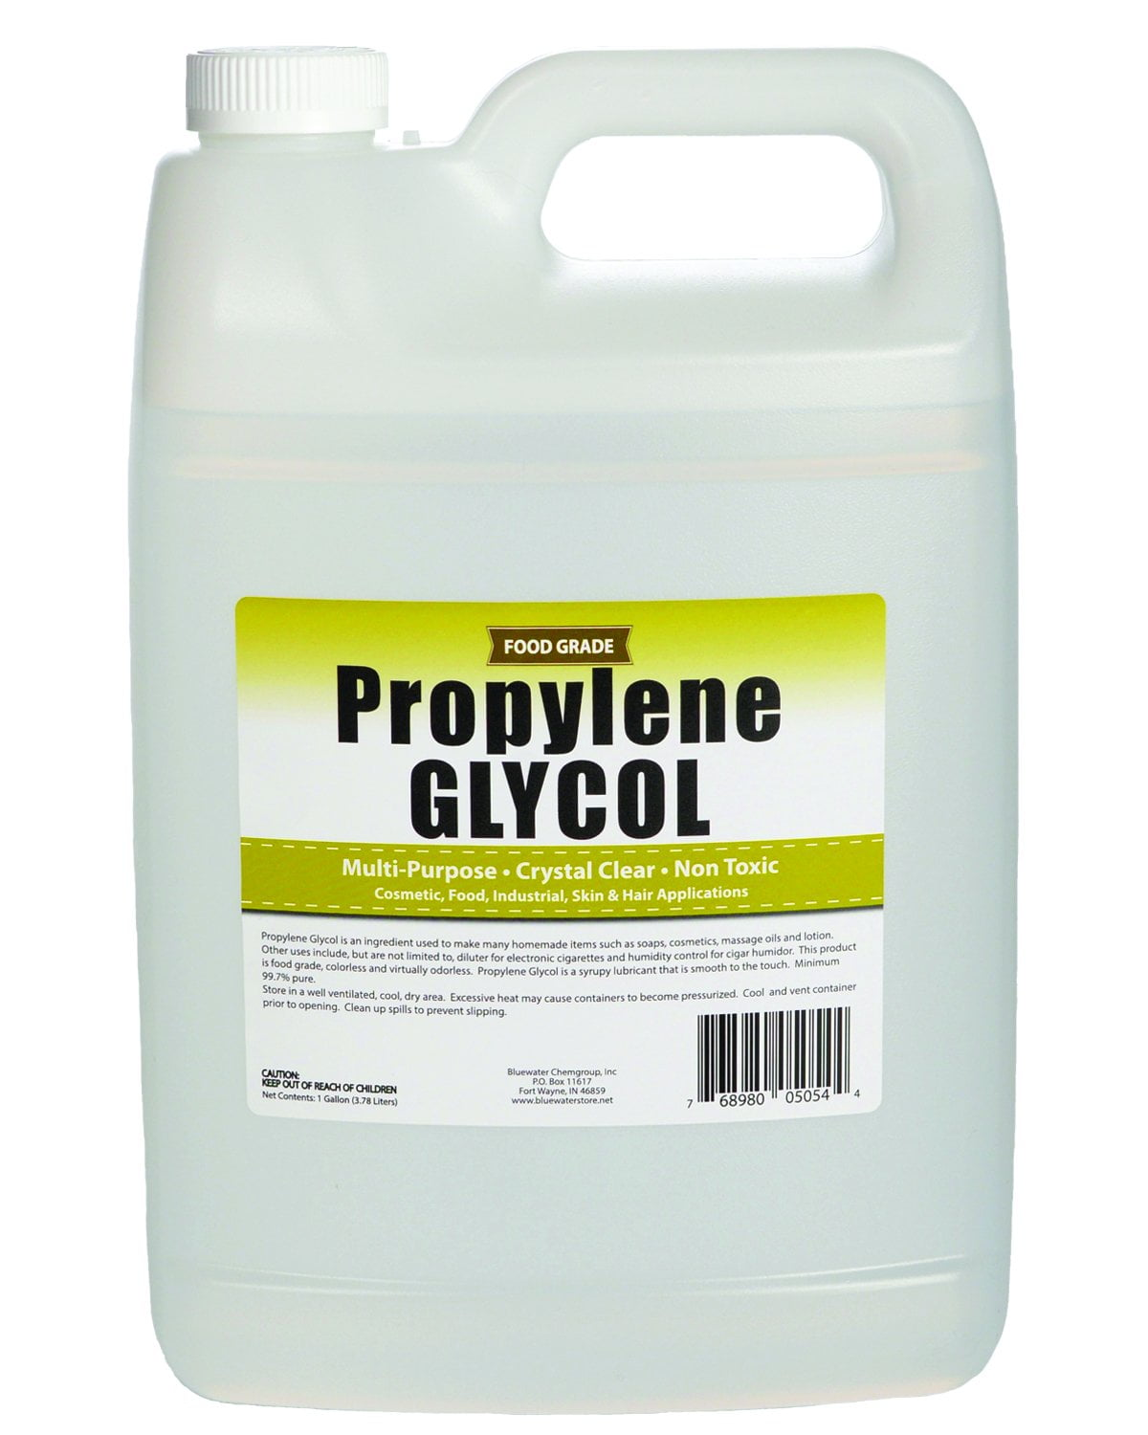
Complete previous Steps 1-3
° Antifreeze
Fill the pump with antifreeze

Slide 23
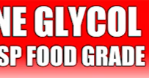
° Antifreeze
FOOD GRADE PROPYLENE GLYCOL

Slide 24
° Antifreeze
OFTEN MIXED WITH WATER

Slide 25

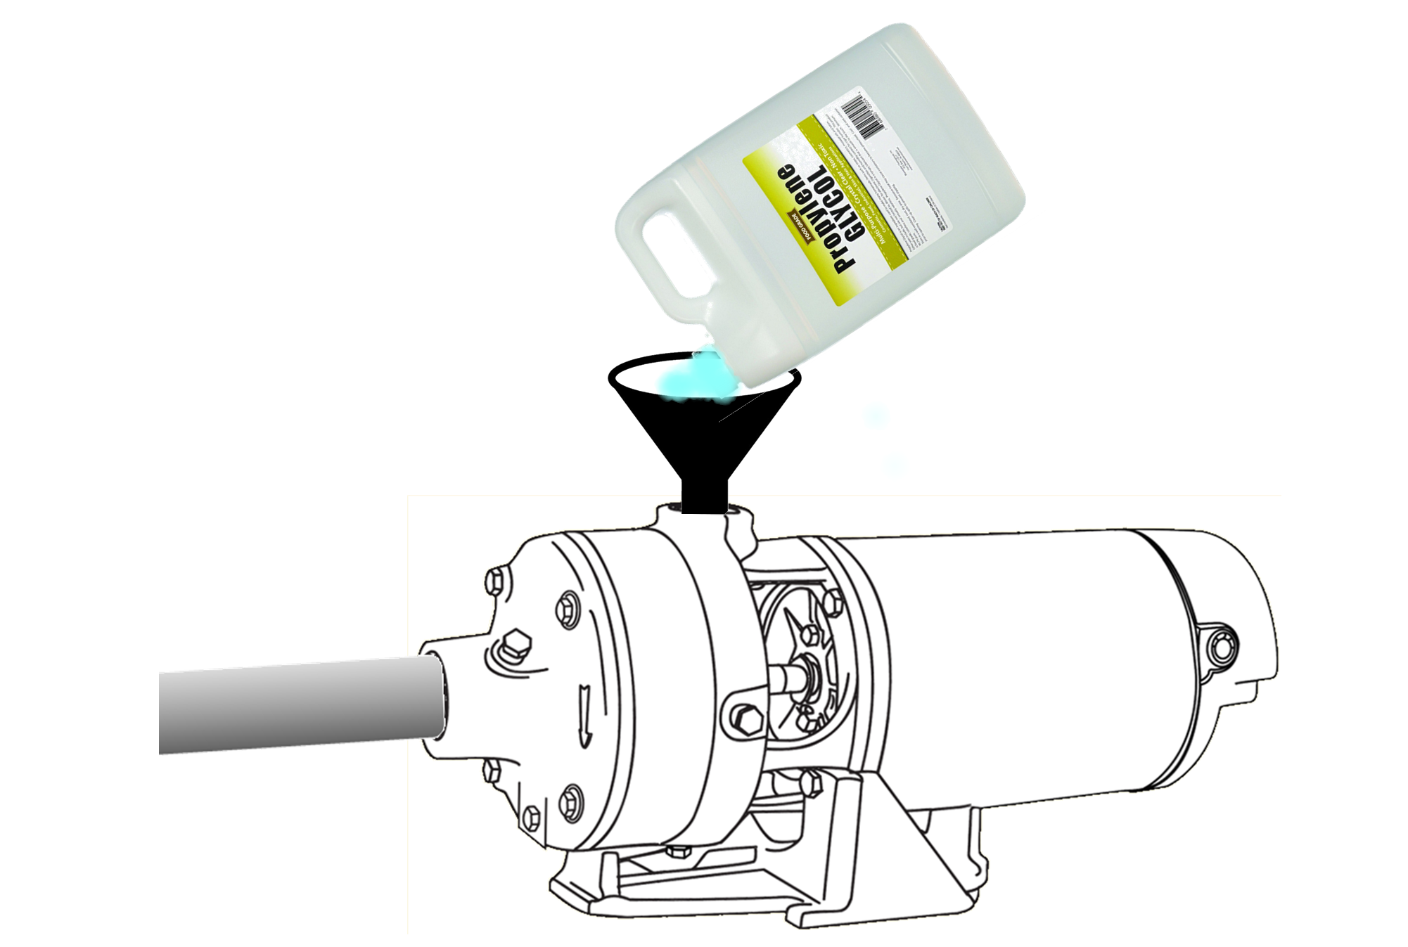
° Antifreeze
FOOD GRADE PROPYLENE GLYCOL
SHOULD NEVER BE CONFUSED WIT AUTOMOTIVE ANTIFREEZE USED IN RADIATORS WHICH IS CALLED ETHYLENE GLYCOL

Slide 26
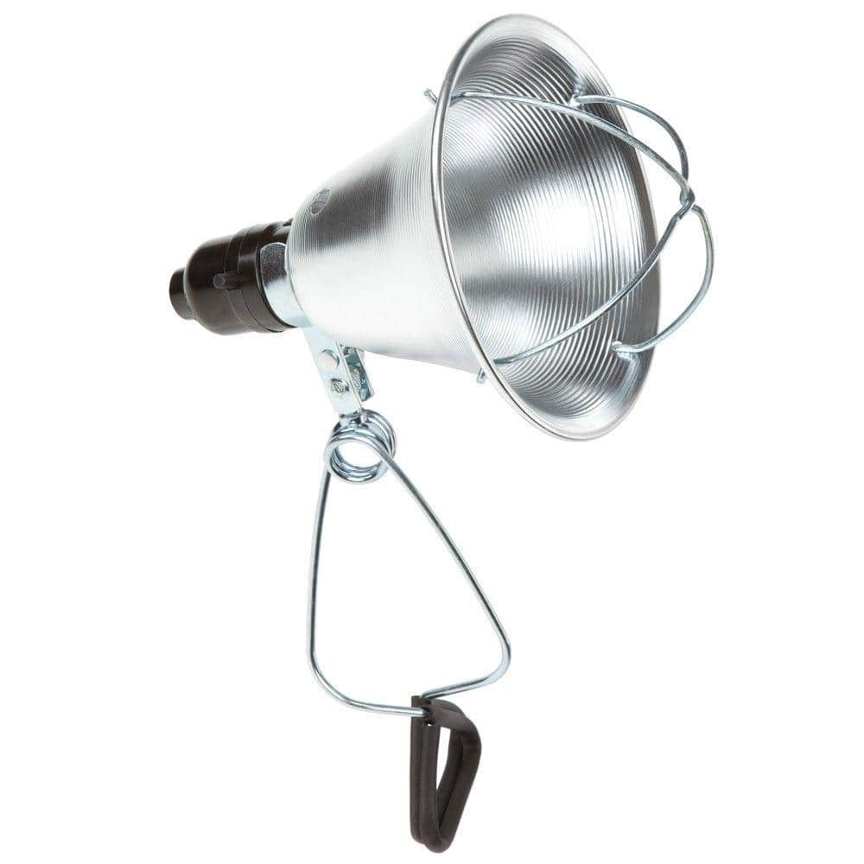
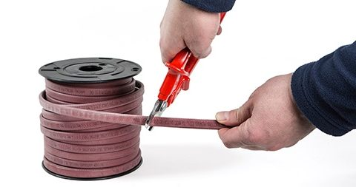
° Heat
Wrap pump and external piping with heat tape.
Heat lamp – thermostat controlled.

Slide 27
° Remove
Remove pump and store in a heated area.
100% GUARANTEE!

Slide 28
5 common methods
Drain
Blow-out
Antifreeze
Heat
GOOD
BETTER
Removal
BEST

Slide 29
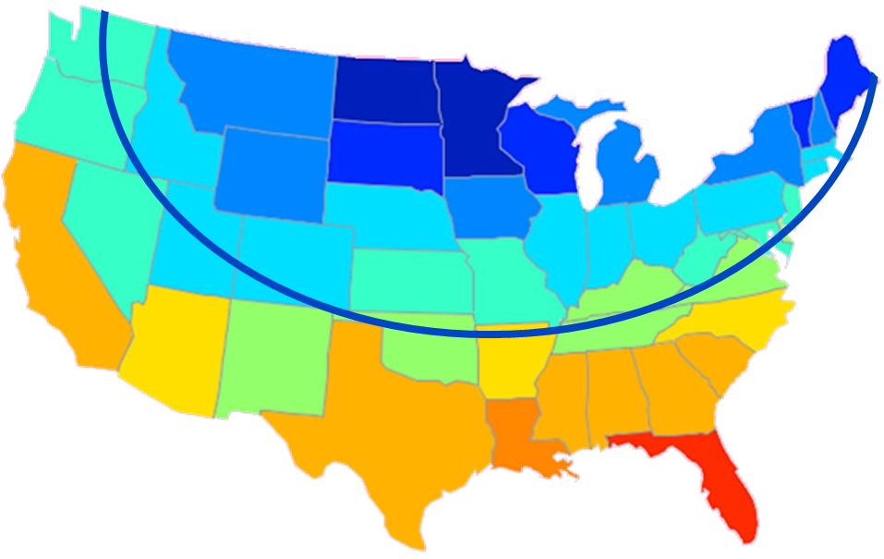
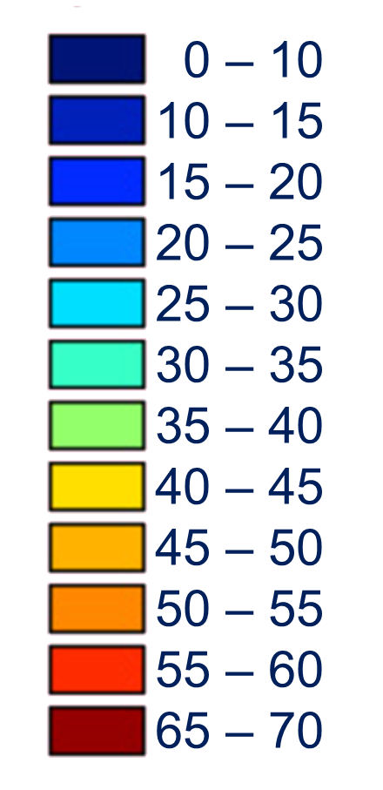
Average winter temperatures (F°) by state

Slide 30
subscribe
https://www.youtube.com/@flintandwalling
track 2B

