Slide 1

Water Systems & Accessories Fundamentals

Slide 2
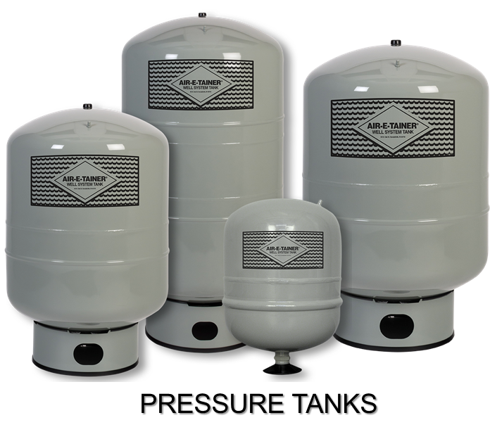
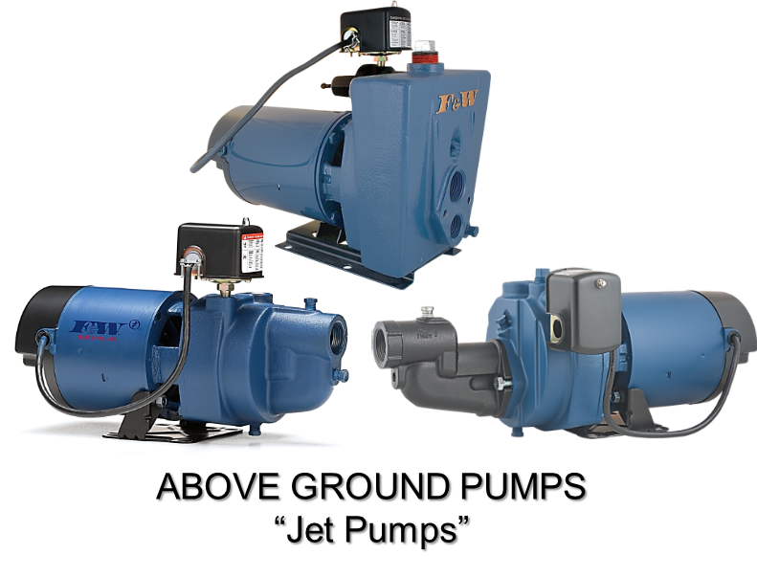
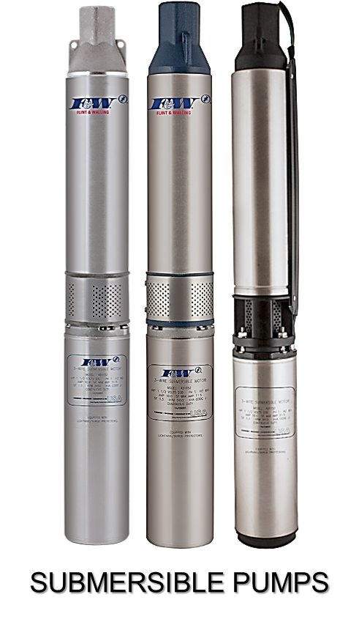
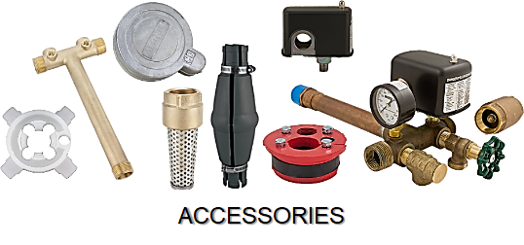

Slide 3
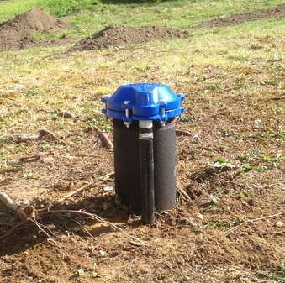
WATER SOURCE

Slide 4

WELL
Surface
Clay
Sandstone
Shale
Limestone
Sand
Granite
Underground Aquifers

Slide 5
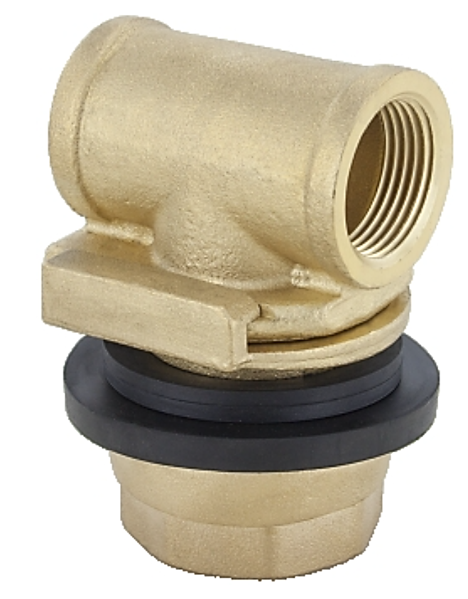




Static Water Level
Static Water Level refers to the level of water in a well under
Normal, undisturbed, no-pumping conditions. Static water level is best determined when the well has not been pumped for several hours prior to measuring.
AQUIFERS or UNDERGROUND RESERVOIRS

Slide 6


Slide 7
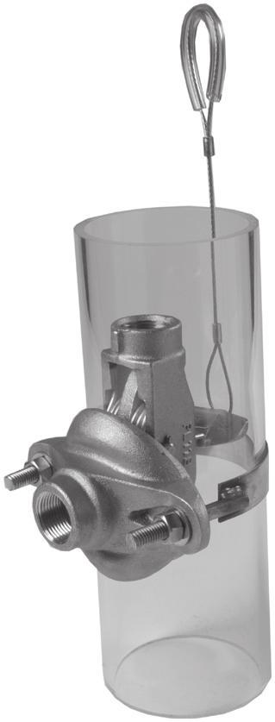
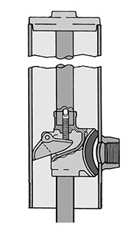
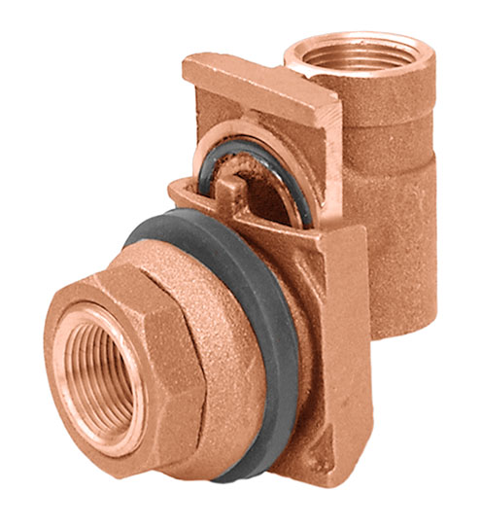
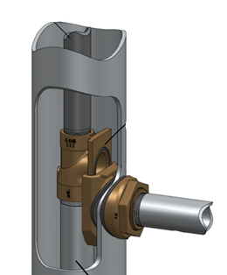
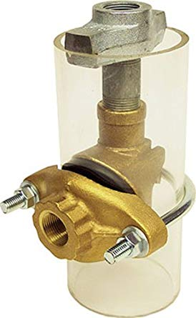
PITLESS ADPATERS

Slide 8
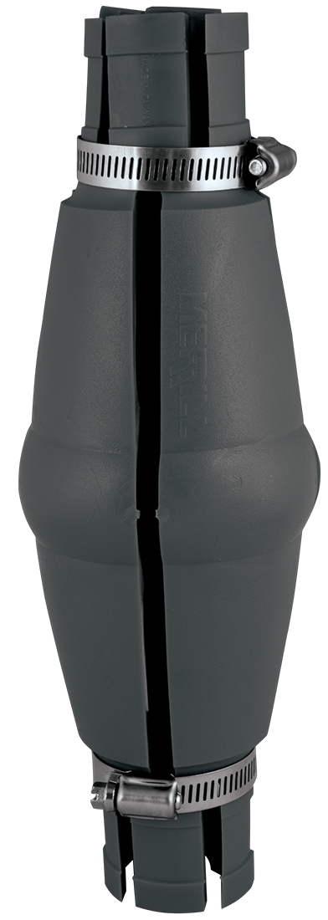
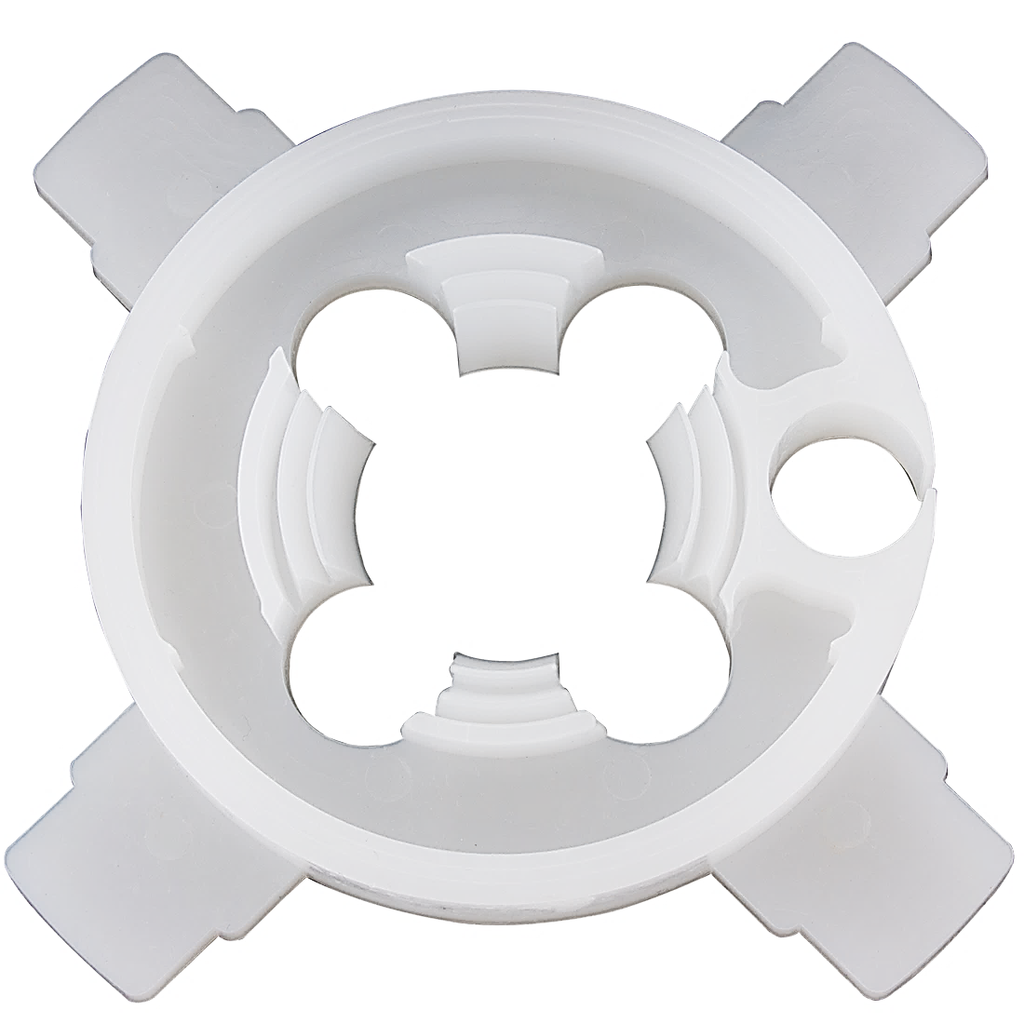
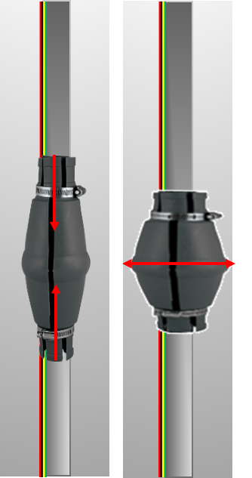
TORQUE ARRESTORS

Slide 9
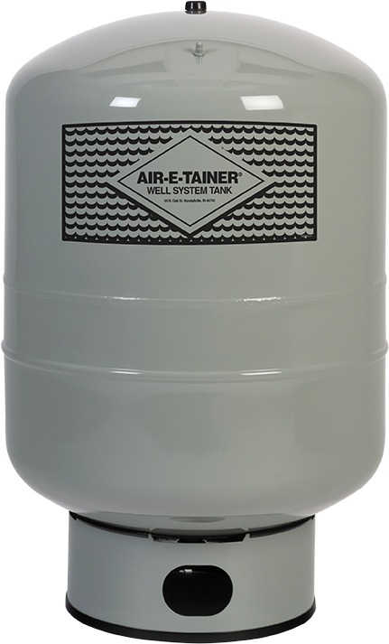

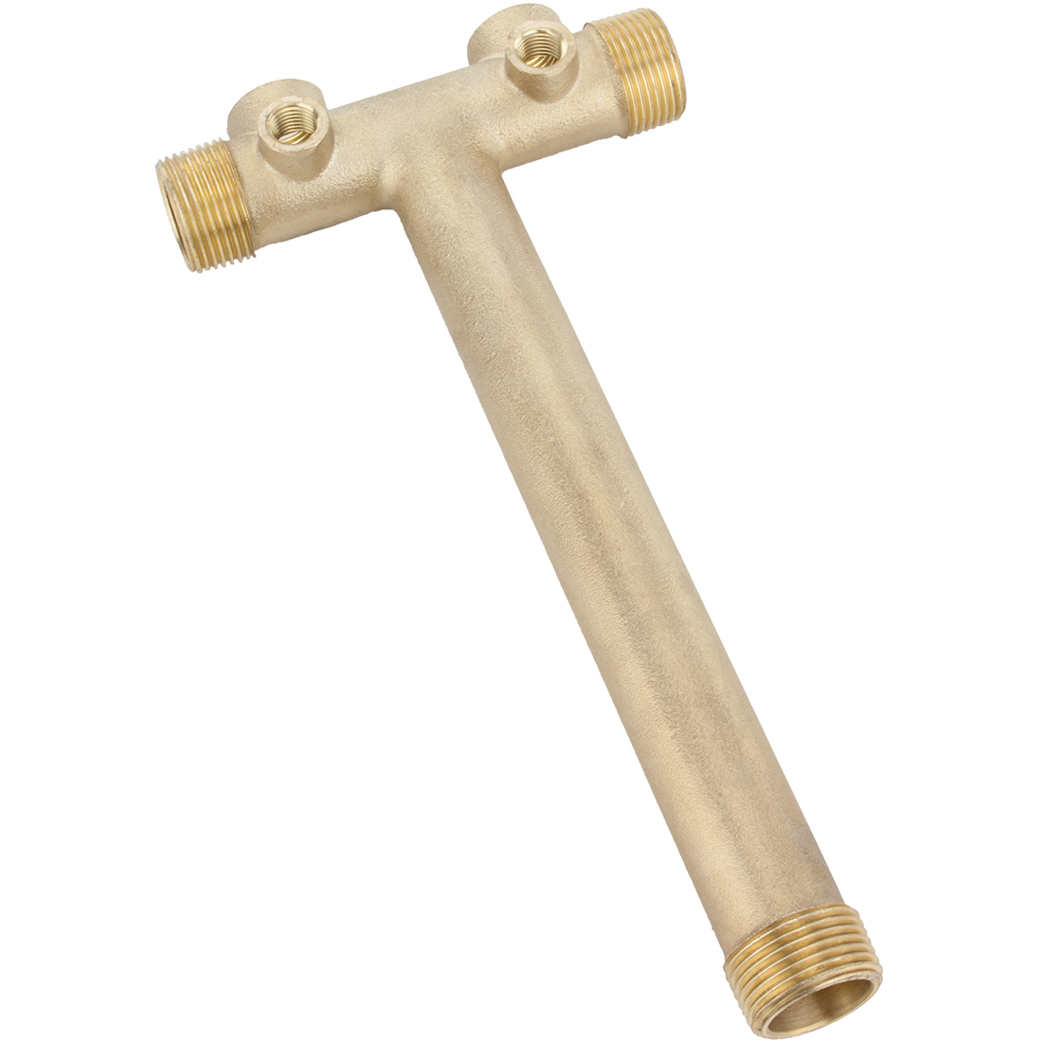
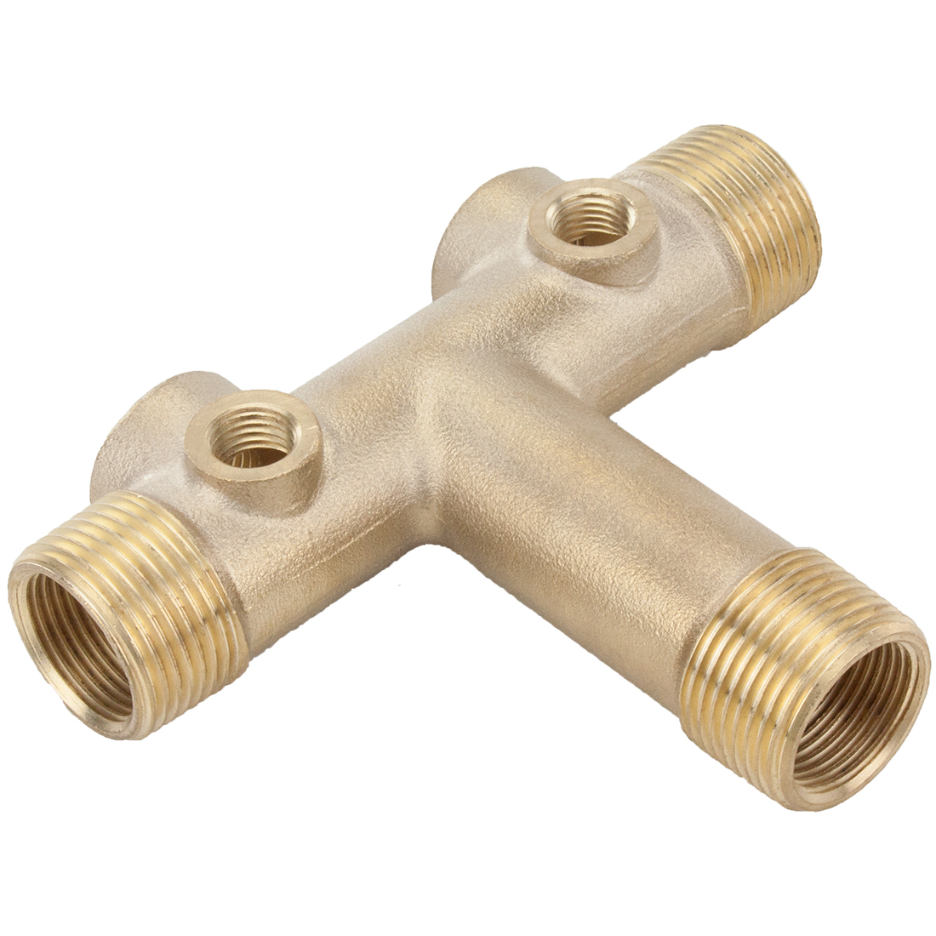


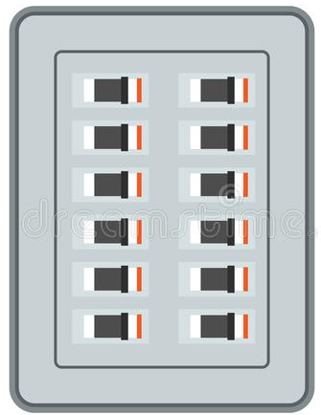


Slide 10
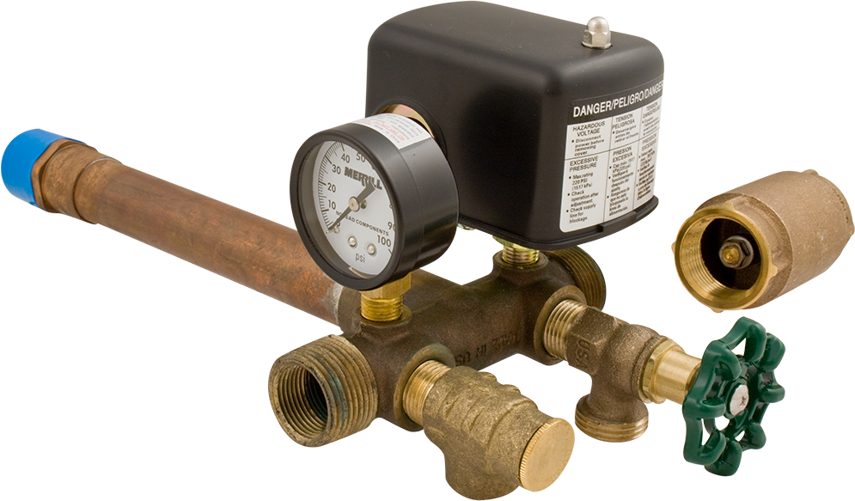
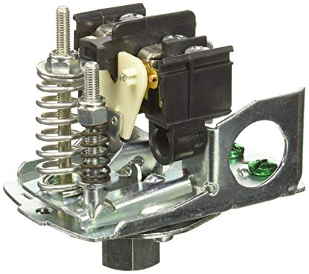
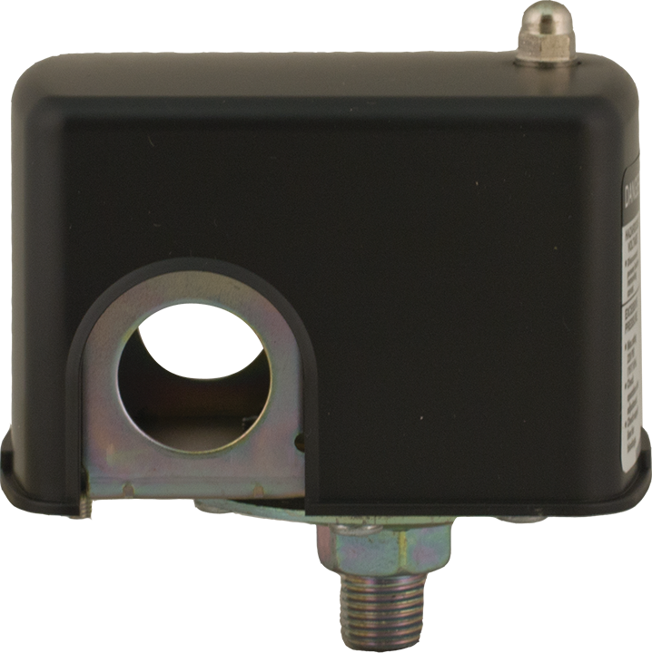
WELL
Tank Tees
Pressure Switch
20 psi – 40 psi
30 psi – 50 psi
40 psi – 60 psi

Slide 11
WELL
Terminals
Contacts
Pressure Switch
Grounding Screws
Pressure Adjustment
Differential Adjustment
Diaphragm

Slide 12
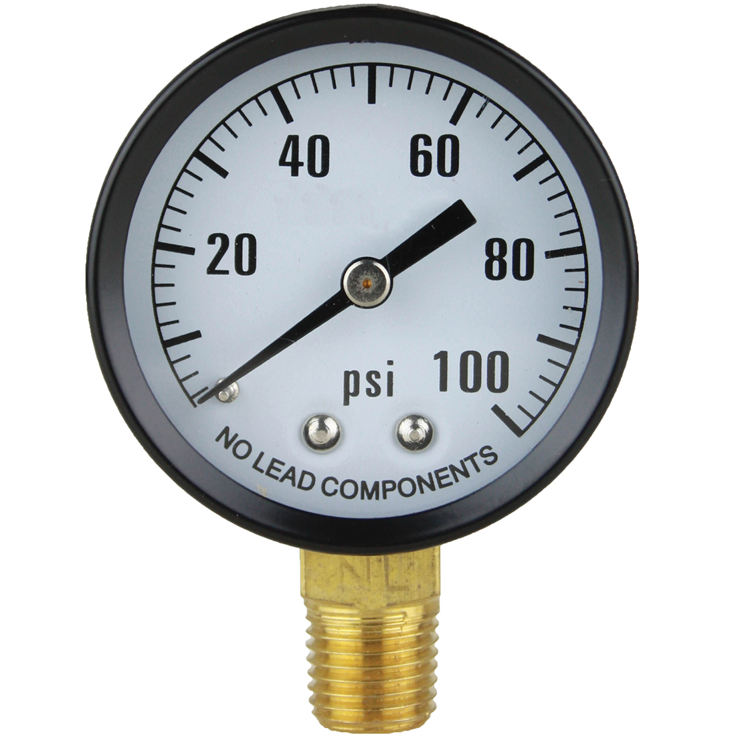
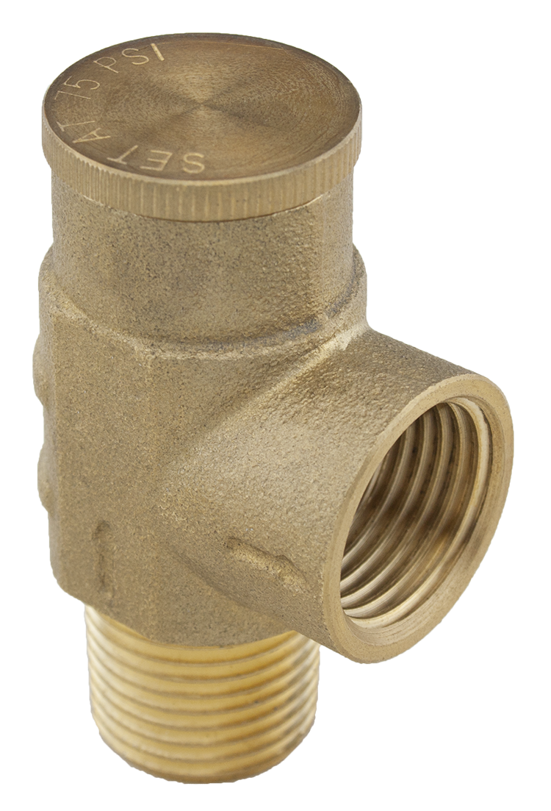
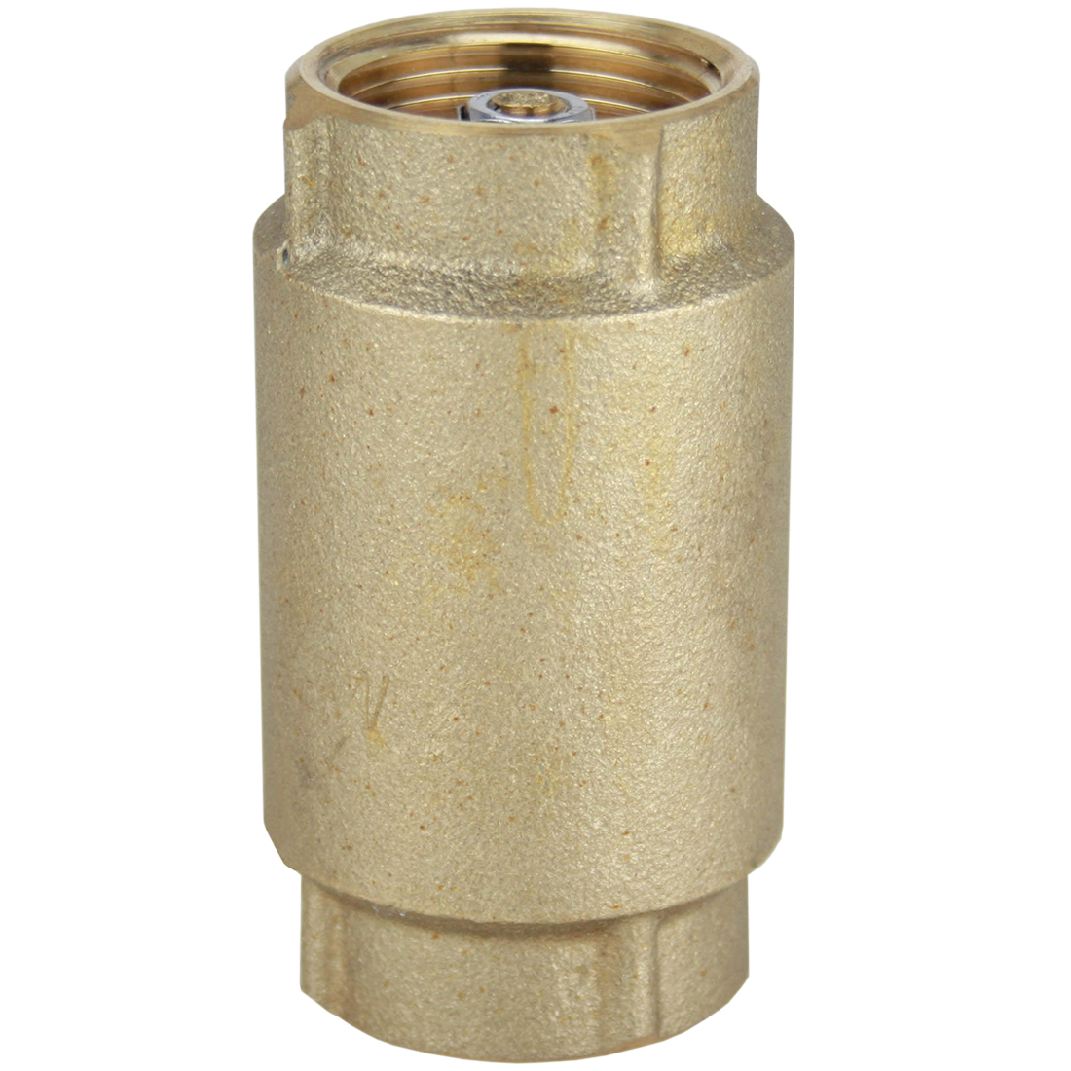
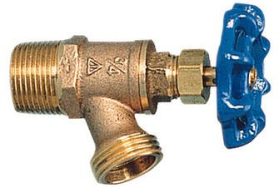
WELL
Tank Tees
Pressure Relief Valve
Pressure Switch
Pressure Gauge
Check Valve
Boiler Drain

Slide 13
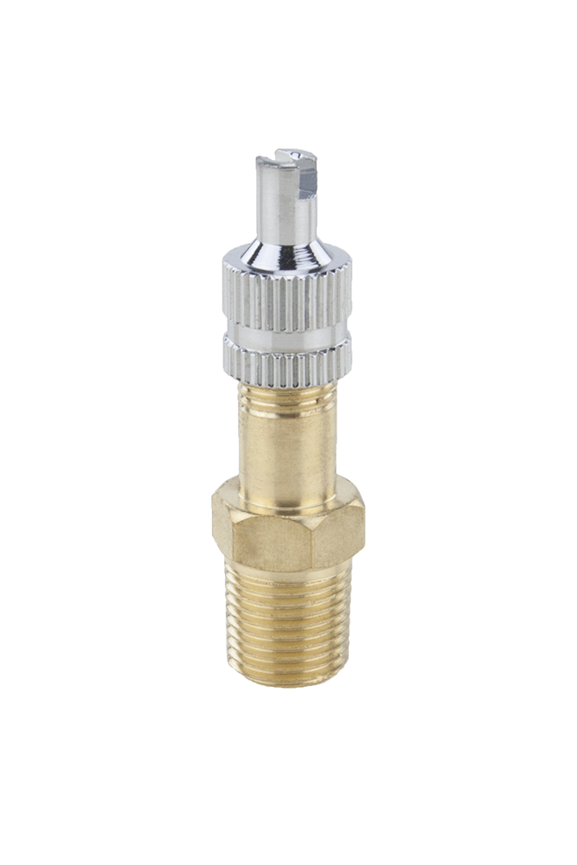
Air
Sealed Diaphragm
Water

Slide 14
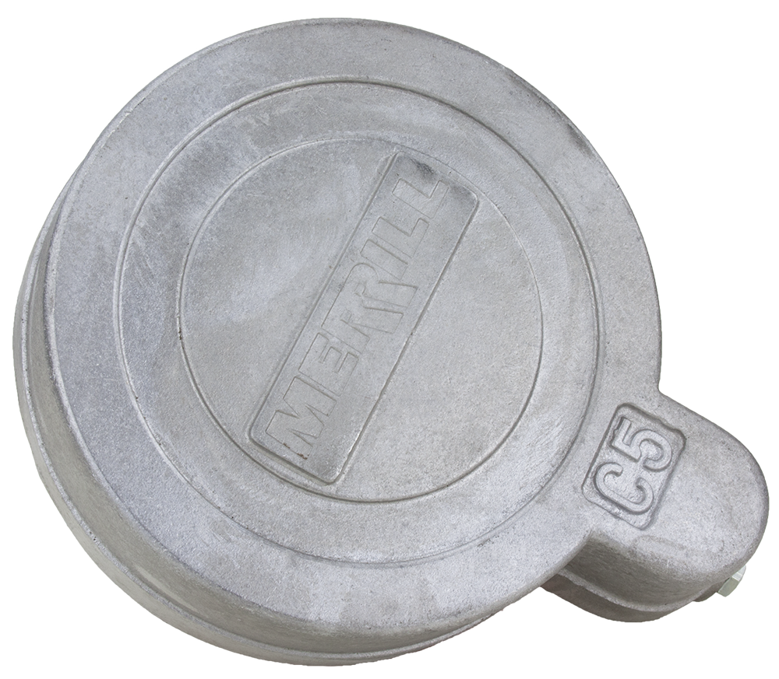
2-wire Submersible Pump

Slide 15
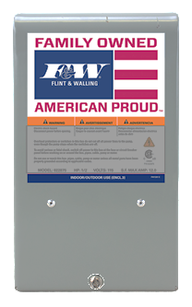
3-wire Submersible Pump

Slide 16
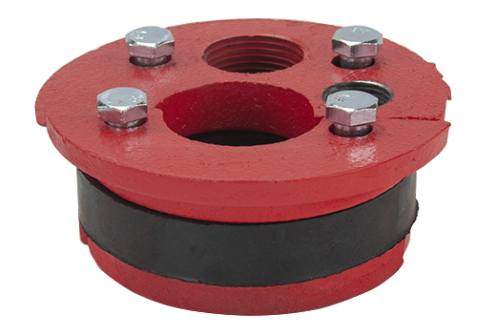
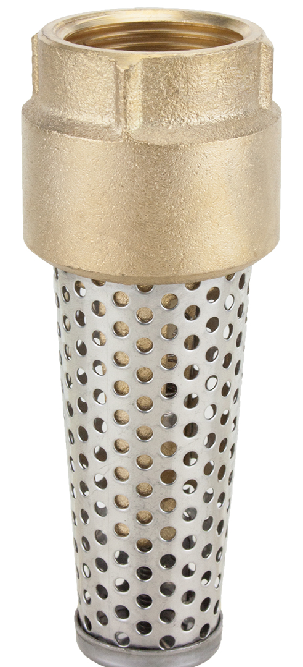

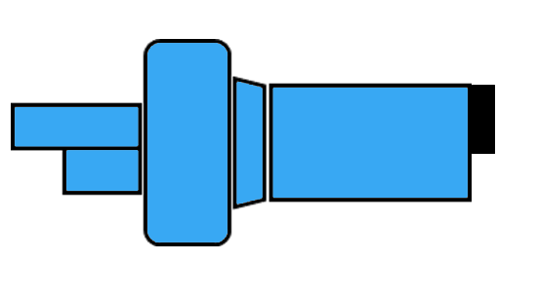

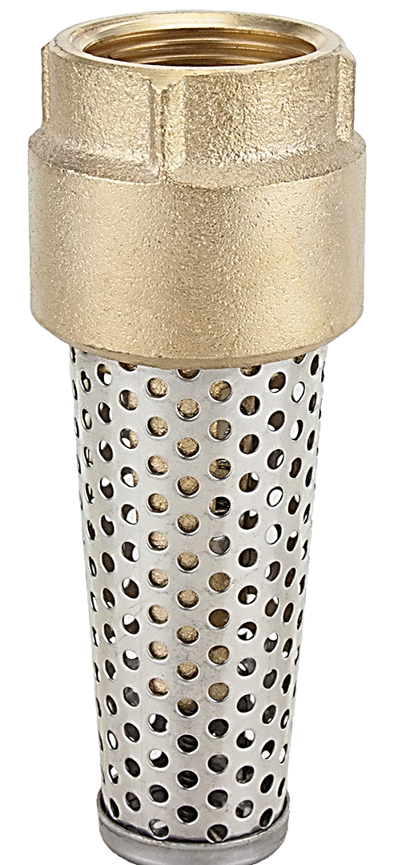
Shallow Well Jet Pump

Slide 17
Shallow Well Jet Pump
25’ or less

Slide 18
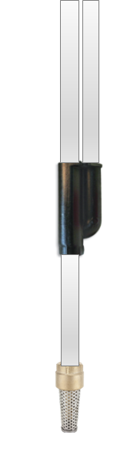

Deep Well Jet Pump
more than 25’

Slide 19
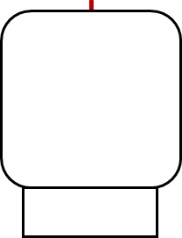
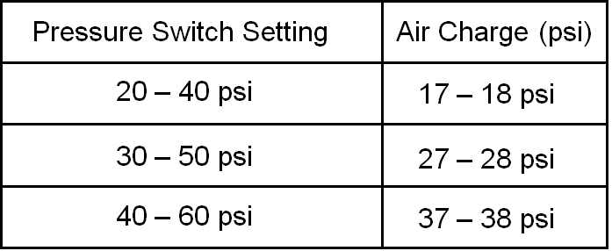
RULE of THUMB
What does the Pressure Tank do?
With no water in the pressure tank.
Air pressure in the tank needs to be 2-3 lbs. below the “cut in” pressure of the pressure switch..
It makes the water system i.e. pump cycle “automatic”
Air pressure can be checked and adjusted through the snifter valve
Air
Sealed Diaphragm
Water

Slide 20
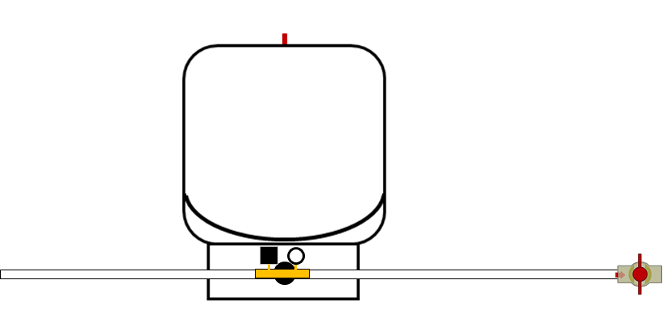
28 psi
Empty Tank
From Pump / Water source
To House / Service
30/50 Pressure Switch
Off

Slide 21
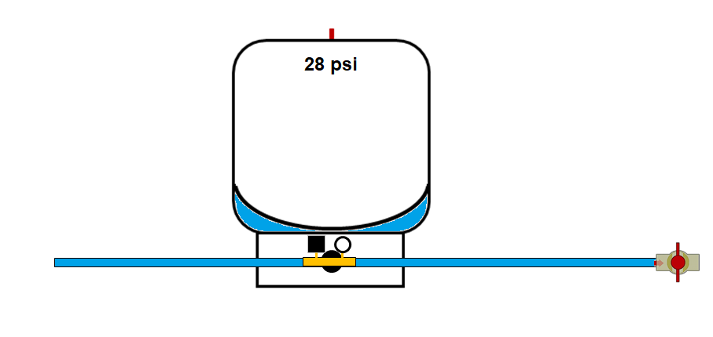
28 psi
Pump Starts
To Service
30/50 Pressure Switch
Off

Slide 22
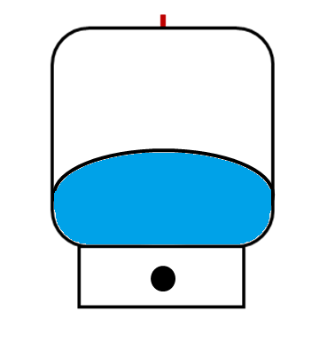

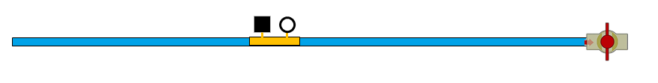
Pressure Tank… How does it work?
38 psi
Pump Running
To Service

Slide 23
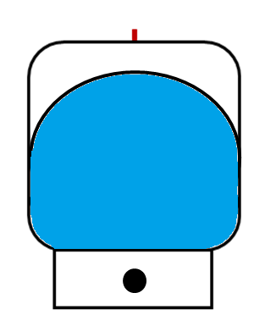
48 psi
Pump Running
To Service

Slide 24
50 psi
Pump Shut- off
To Service

Slide 25
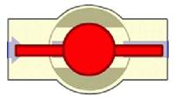
50 psi
Pump Shut- off
To Service
Demand for water

Slide 26

38 psi
Pump Shut- off
To Service
Demand for water

Slide 27
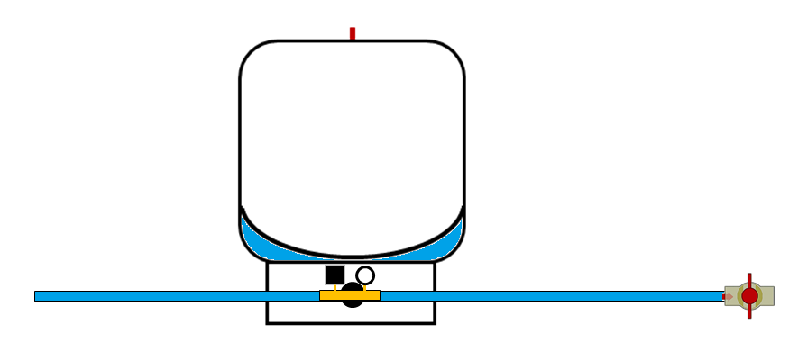
30 psi
Pump Starts
To Service
Demand for water

Slide 28
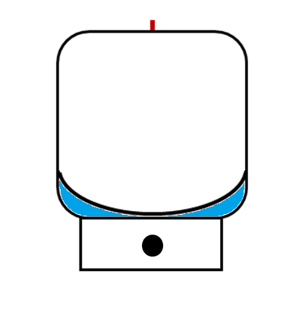
Drawdown (gals)
Amount of water tank provides between pump cycles
Drawdown will vary based on switch settings i.e. Lower the pressure switch setting the more the drawdown

Slide 29
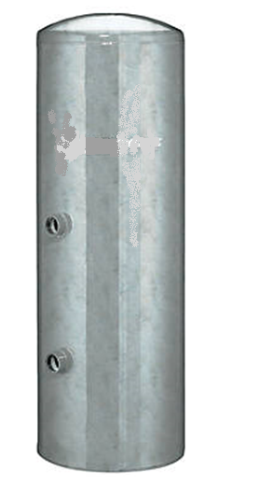
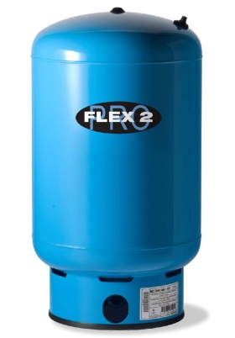
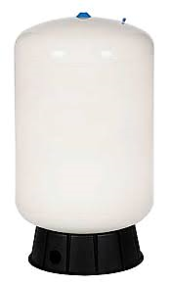
42 gallon Galvanized Pressure Tank
20 gallon Captive Air Pressure Tank
30/50 Switch
6.0 gal
6.2 gal

Slide 30
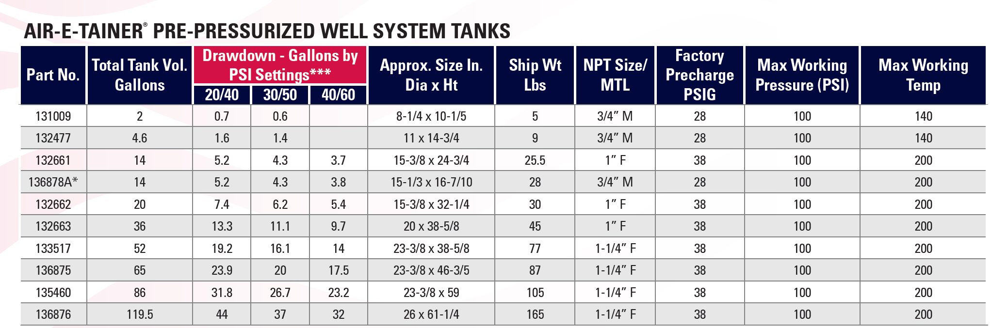
A simple way to size a pressure tank…
Example:
8 gpm x 3 = 24 gallons
Multiply the system requirement (gpm) x 3, then go to the next largest tank.
Part No. 132663 36 gal. tank

