Slide 1

CommanderPro® Variable Frequency drives

Slide 2
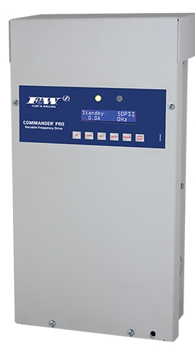

COMMANDER PRO VFD
3 wire three phase
& 3 wire single phase
TVS15
TVS20
TVS30

Slide 3
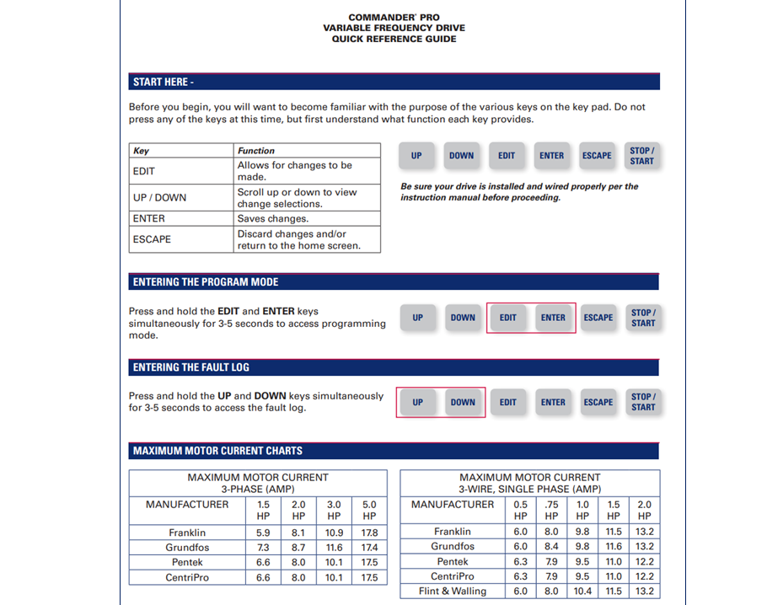
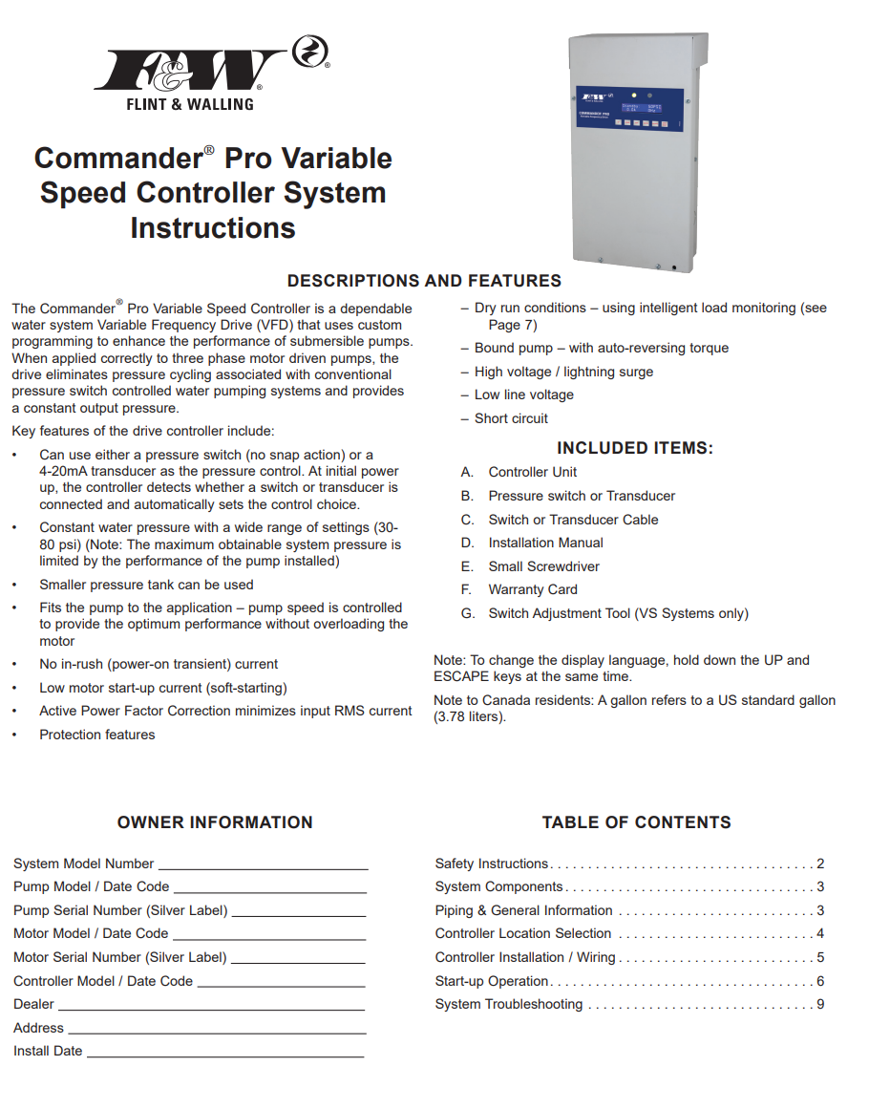
COMMANDER PRO INITIAL SETUP

Slide 4
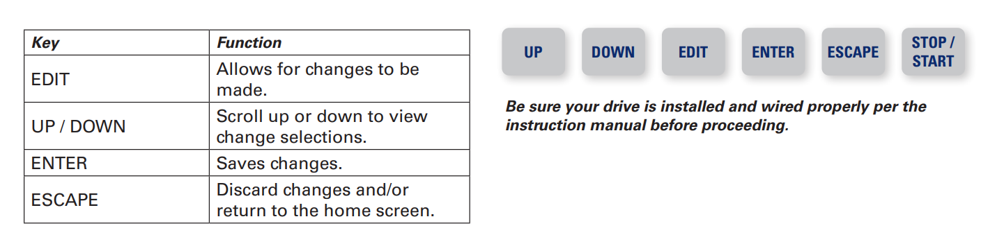
COMMANDER PRO INITIAL SETUP

Slide 5
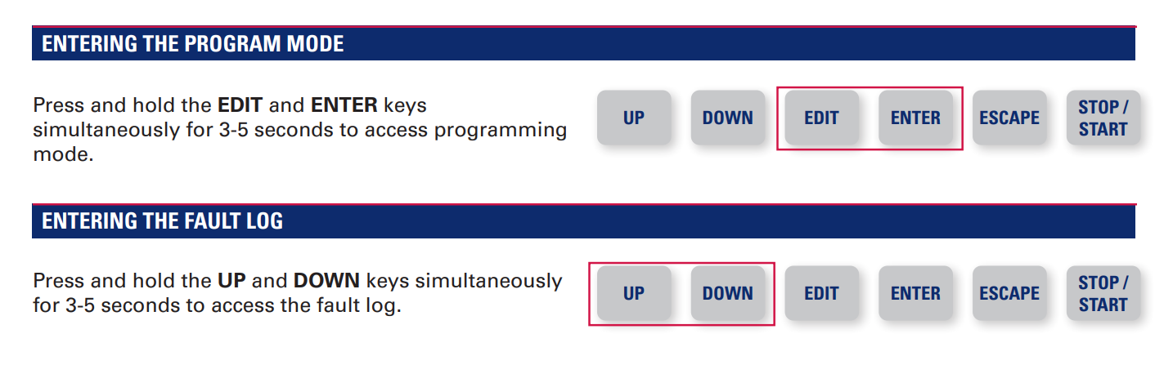
COMMANDER PRO INITIAL SETUP

Slide 6
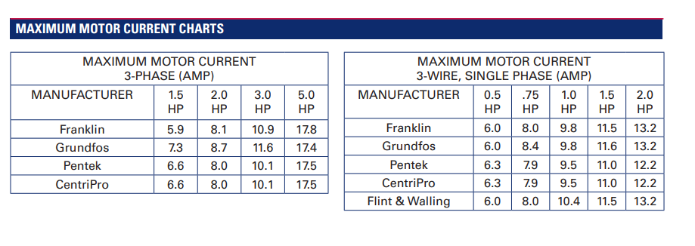
COMMANDER PRO INITIAL SETUP

Slide 7
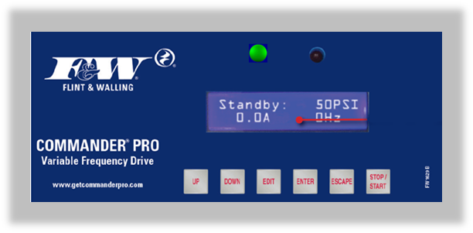
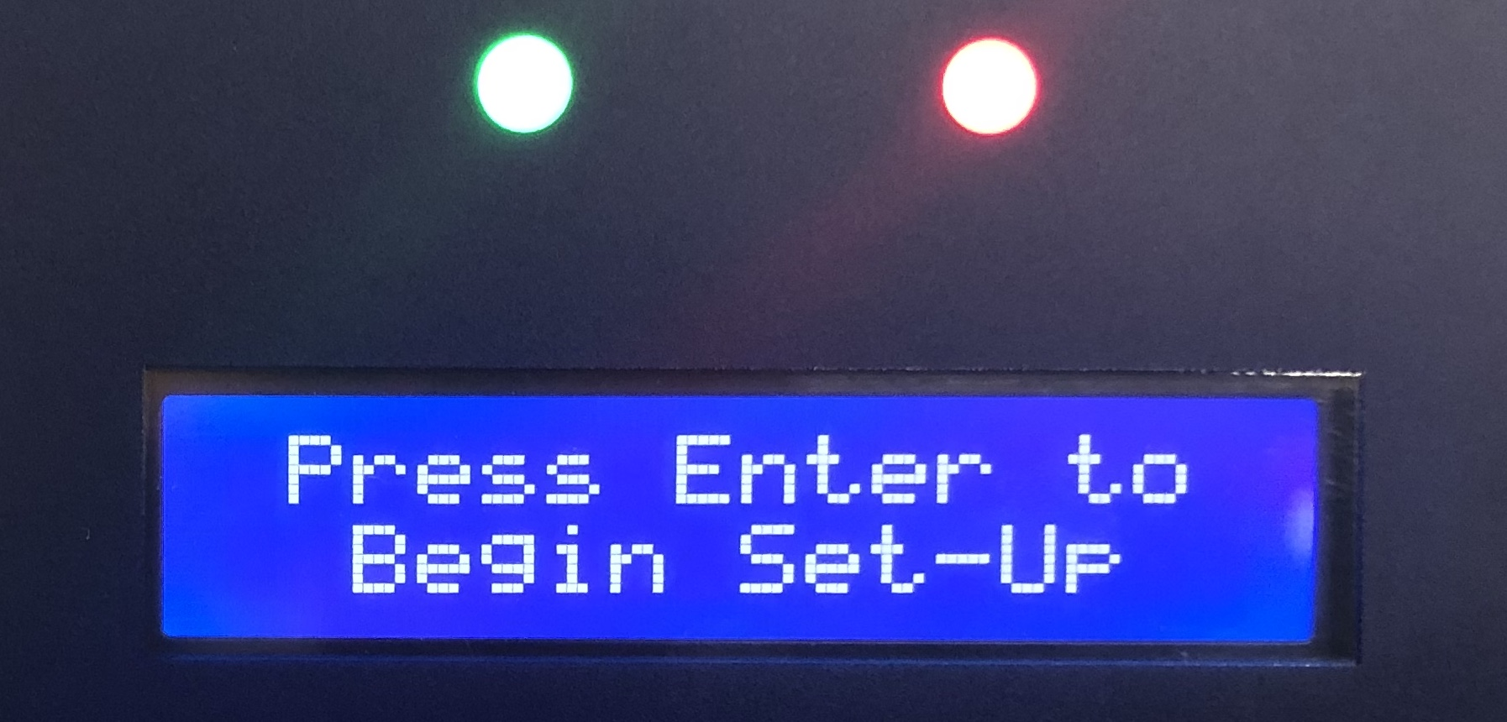
COMMANDER PRO INITIAL SETUP

Slide 8
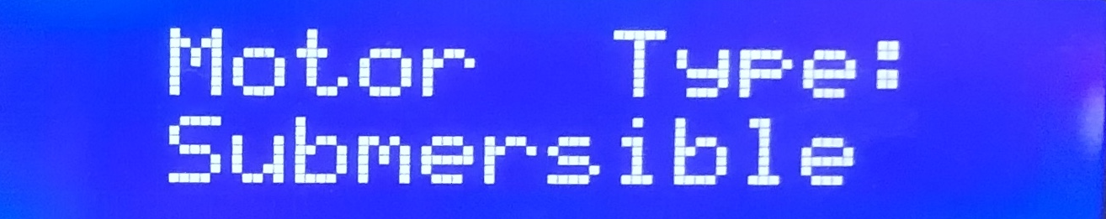
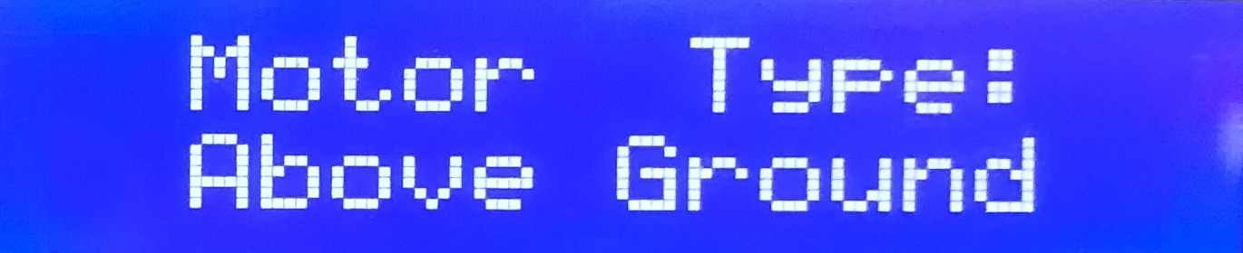
COMMANDER PRO INITIAL SETUP

Slide 9
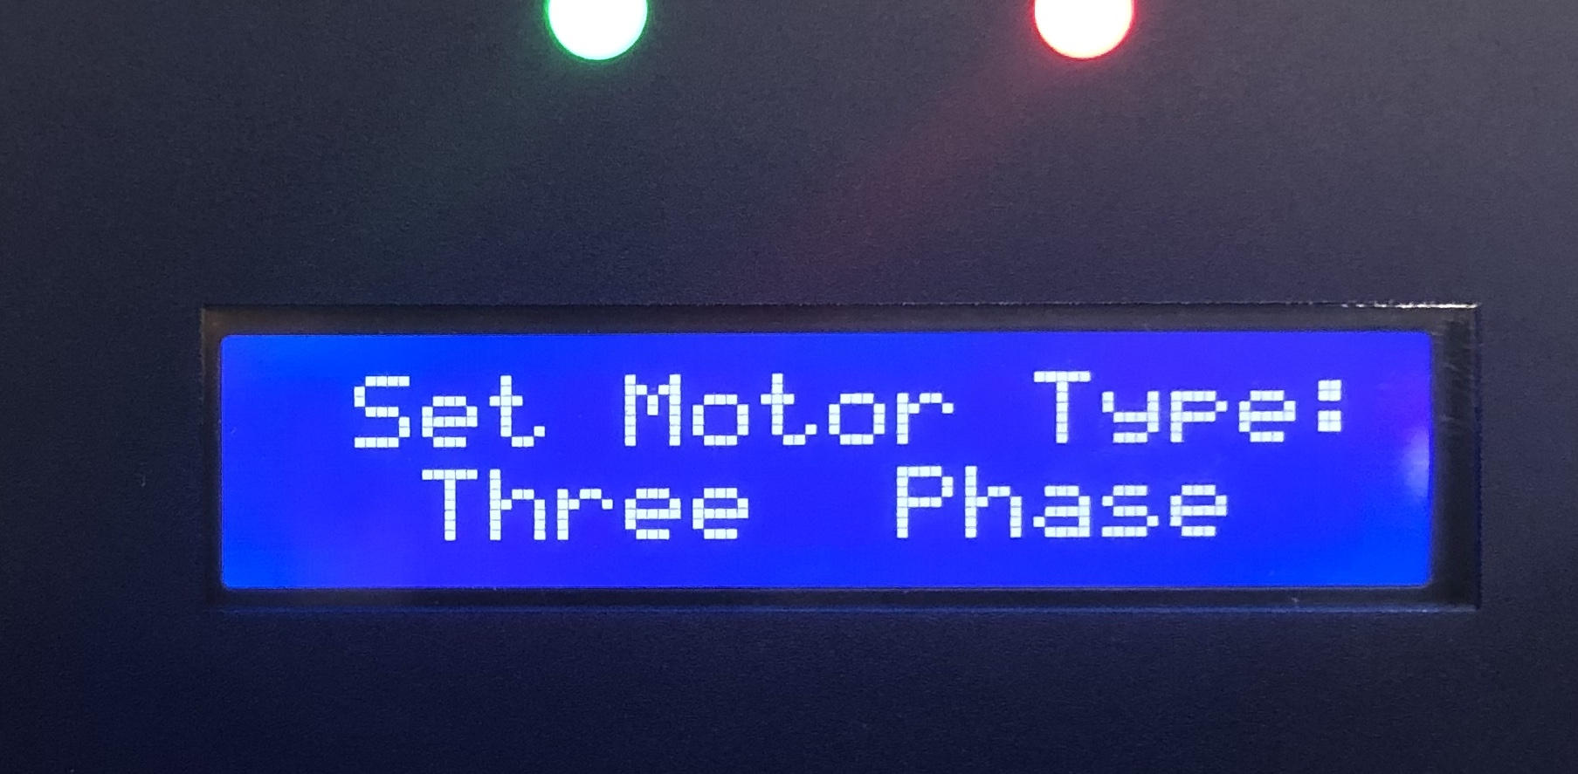
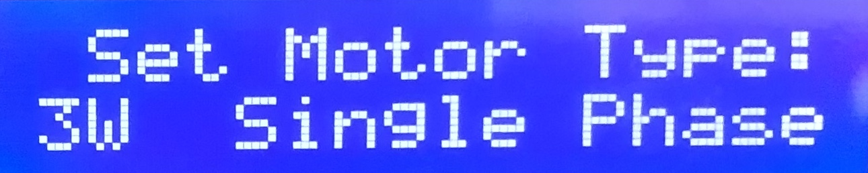
COMMANDER PRO INITIAL SETUP

Slide 10
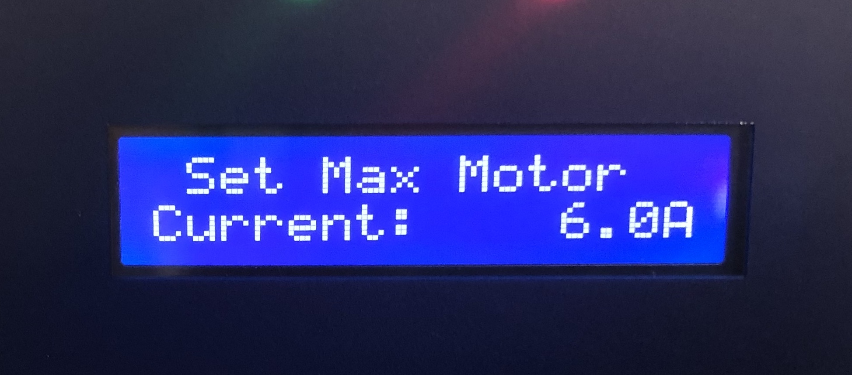
COMMANDER PRO INITIAL SETUP
¾ HP 1 HP 1½ HP 2 HP
8.0 10.4 11.5 13.2

Slide 11
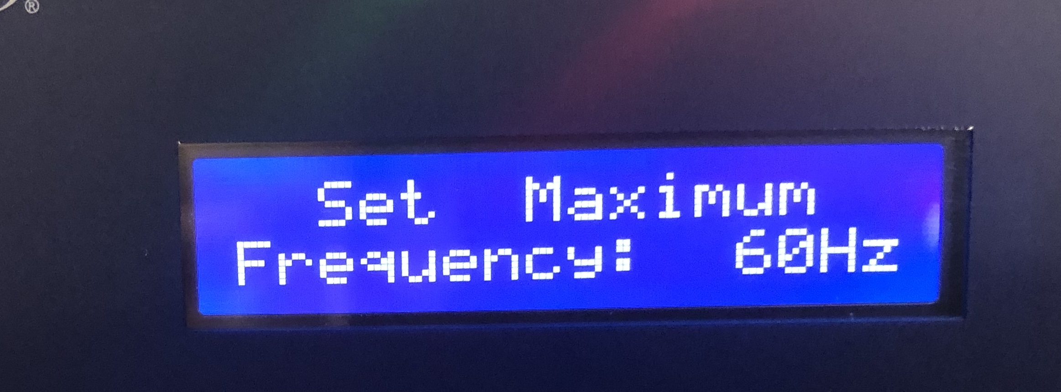
COMMANDER PRO INITIAL SETUP

Slide 12
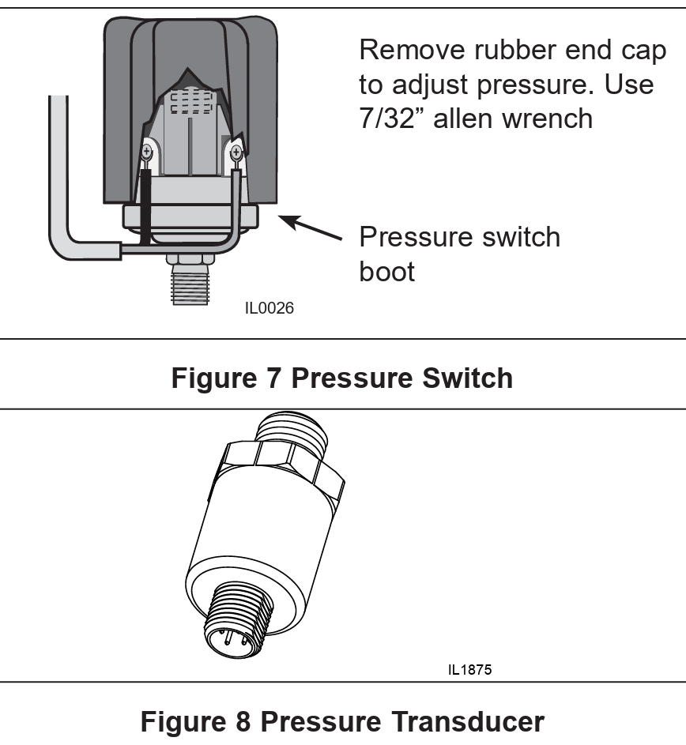
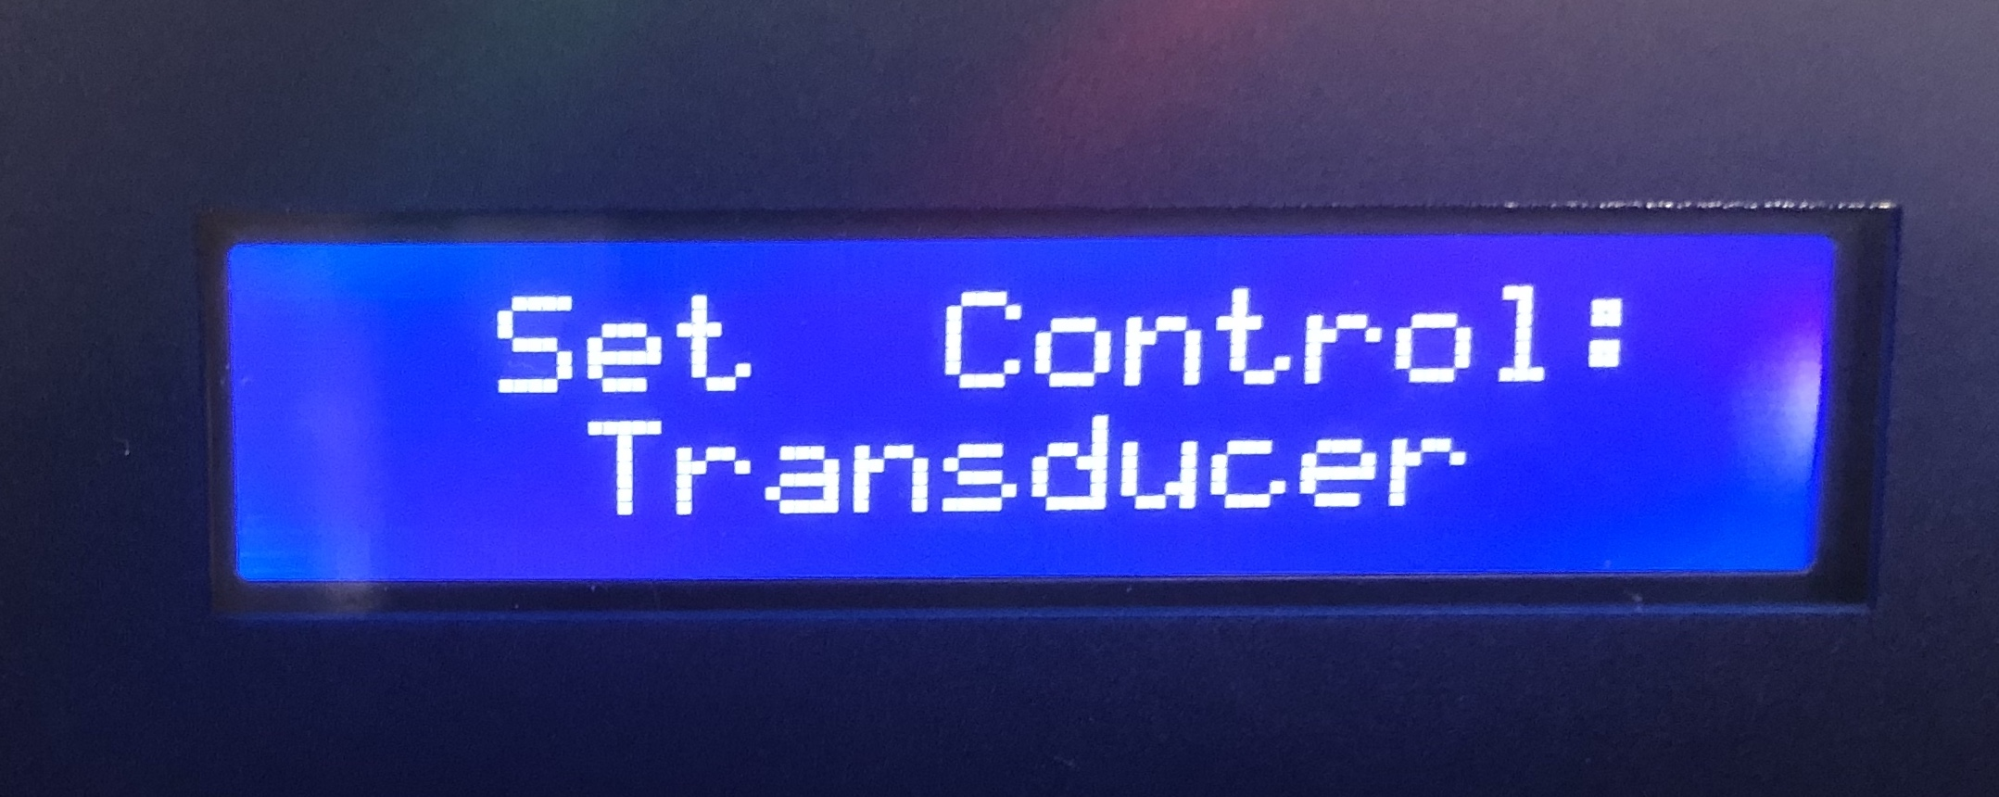



COMMANDER PRO INITIAL SETUP

Slide 13
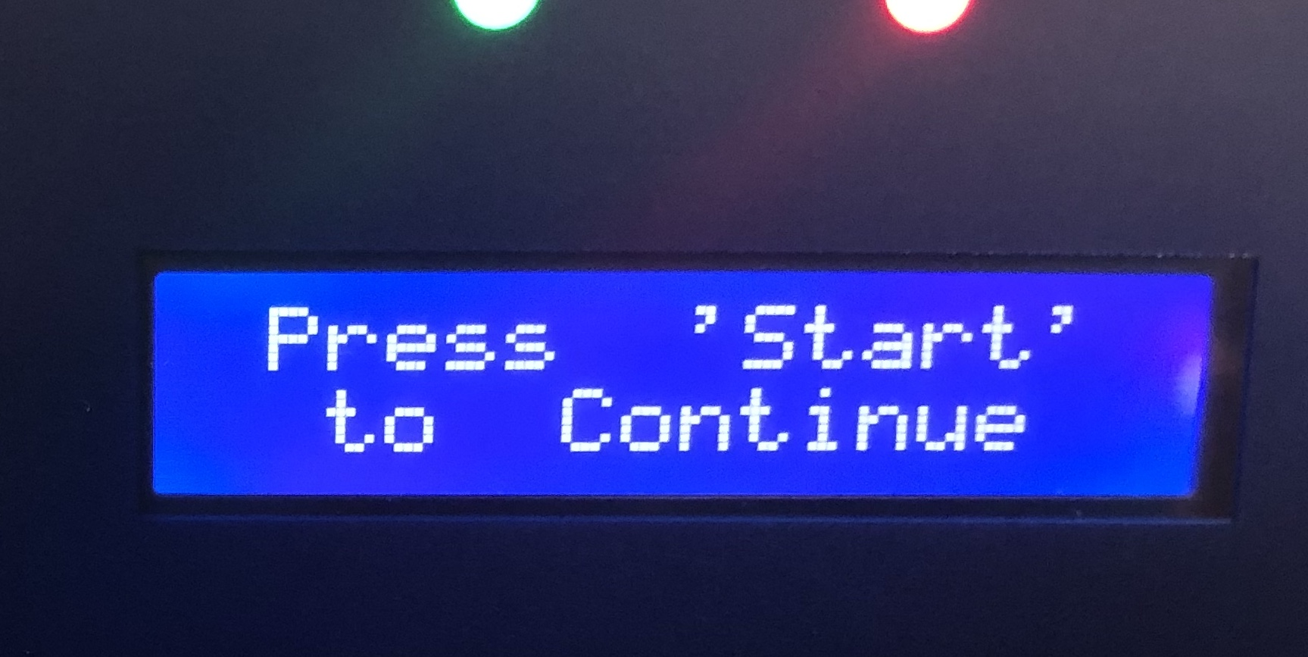
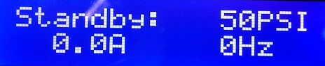
COMMANDER PRO INITIAL SETUP

Slide 14
COMMANDER PRO MENU OPTIONS
1. Control
  switch or transducer
  set transducer range, drawdown, overpressure, psi setpoint

Slide 15
COMMANDER PRO MENU OPTIONS
1. Control
  switch or transducer
  set transducer range, drawdown, overpressure, psi setpoint
2. Maximum Motor Current

Slide 16
COMMANDER PRO MENU OPTIONS
1. Control
  switch or transducer
  set transducer range, drawdown, overpressure, psi setpoint
2. Maximum Motor Current
3. Maximum Frequency
  50 – 80 Hz

Slide 17
COMMANDER PRO MENU OPTIONS
1. Control
  switch or transducer
  set transducer range, drawdown, overpressure, psi setpoint
2. Maximum Motor Current
3. Maximum Frequency
  50 – 80 Hz
4. Pass Code Enable

Slide 18
COMMANDER PRO MENU OPTIONS
1. Control
  switch or transducer
  set transducer range, drawdown, overpressure, psi setpoint
2. Maximum Motor Current
3. Maximum Frequency
  50 – 80 Hz
4. Pass Code Enable
5. Underload Protection

Slide 19
COMMANDER PRO MENU OPTIONS
1. Control
  switch or transducer
  set transducer range, drawdown, overpressure, psi setpoint
2. Maximum Motor Current
3. Maximum Frequency
  50 – 80 Hz
4. Pass Code Enable
5. Underload Protection
6. Standby Sensitivity

Slide 20
COMMANDER PRO MENU OPTIONS
1. Control
  switch or transducer
  set transducer range, drawdown, overpressure, psi setpoint
2. Maximum Motor Current
3. Maximum Frequency
  50 – 80 Hz
4. Pass Code Enable
5. Underload Protection
6. Standby Sensitivity
7. Broken Pipe
  (1/2 – 48) Hours

Slide 21
COMMANDER PRO MENU OPTIONS
1. Control
  switch or transducer
  set transducer range, drawdown, overpressure, psi setpoint
2. Maximum Motor Current
3. Maximum Frequency
  50 – 80 Hz
4. Pass Code Enable
5. Underload Protection
6. Standby Sensitivity
7. Broken Pipe
  (1/2 – 48) Hours
8. Advanced Features

Slide 22
COMMANDER PRO MENU OPTIONS
1. Control
  switch or transducer
  set transducer range, drawdown, overpressure, psi setpoint
2. Maximum Motor Current
3. Maximum Frequency
  50 – 80 Hz
4. Pass Code Enable
5. Underload Protection
6. Standby Sensitivity
7. Broken Pipe
  (1/2 – 48) Hours
8. Advanced Features
9. Reset to Factory Defaults

Slide 23
COMMANDER PRO MENU OPTIONS
1. Control
  switch or transducer
  set transducer range, drawdown, overpressure, psi setpoint
2. Maximum Motor Current
3. Maximum Frequency
  50 – 80 Hz
4. Pass Code Enable
5. Underload Protection
6. Standby Sensitivity
7. Broken Pipe
  (1/2 – 48) Hours
8. Advanced Features
9. Reset to Factory Defaults
10. Control Settings
  Ramp rate adjustments, transducer calibration

Slide 24
COMMANDER PRO MENU OPTIONS
1. Control
2. Maximum Motor Current
3. Maximum Frequency
4. Pass Code Enable
5. Underload Protection
6. Standby Sensitivity
7. Broken Pipe
8. Advanced Features
9. Reset to Factory Defaults
10. Control Settings

Slide 25
The VFD is operating from and reacting to a short list of measurables:
Voltage
Motor Running Amps
System Pressure (PSI)
Motor Frequency (Hz)
Internal Temp
Cycle Run Time

Slide 26
What is Underload Protection?
Underload protection/fault is normally caused by over-pumping (dry well) condition or pumping against a closed valve.
Underload is triggered by two measurables:
MOTOR FREQUENCY
MOTOR AMPS

Slide 27
What is Underload Protection?
Underload protection/fault is normally caused by over-pumping (dry well) condition or pumping against a closed valve.
Underload is triggered by two measurables:
REDUCED RUNNING AMPS
MAXIMUM MOTOR FREQUENCY

Slide 28
What is Underload Protection?
Underload protection/fault is normally caused by over-pumping (dry well) condition or pumping against a closed valve.
Underload is triggered by two measurables:
REDUCED RUNNING AMPS
MAXIMUM MOTOR FREQUENCY

Slide 29
What is Underload Protection?
When the motor is running at full speed (maximum frequency setpoint) AND below the underload amp threshold the drive will display an Underload Fault.
For example:
TVS15 –
Max Frequency set @ 60Hz
Max Motor Current @ 5.9
Underload Amps default set @ 3.9 (roughly 65% of max, self adjusting)
Underload occurs when motor is running at full frequency of 60Hz and below the 3.9amp threshold.

Slide 30
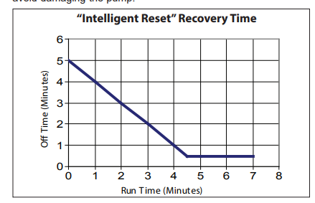
What is Underload off time?
When Underload Fault occurs, the VFD will reset based on the programmed off time in option #5.
This setting is on by default which automatically resets based on run time prior to fault:
The auto reset can be overridden with a specified amount of time –
  15 – 240 minutes, 12hrs or 24hrs

Slide 31
What is Standby Sensitivity?
MOTOR
AMPS
MOTOR FREQUENCY
SYSTEM
PRESSURE

Slide 32
What is Standby Sensitivity?
The following parameters allow the drive to go into standby.
PSI
Motor Amps
Motor Frequency
All three data points are preset with the assumption that below setpoint operation indicates no flow so drive should go into standby.
PSI – maintained within ½ psi of setpoint
Motor Amps – set @ 3.3 (default for 1.5hp w/max set @ 5.9, self adjusting)
Motor Frequency - below 50 Hz
Conversely, if any one of the data points is higher than preset, the VFD continues to run the system as it recognizes the higher data points correlate to water usage.

Slide 33
What is Standby Sensitivity?
For example, TVS15 setup on a three phase 1.5hp sub motor set with max current @ 5.9 amps. This preset point (5.9 amps) will automatically generate a standby current in option #6:
PSI – 0.5
  This data point tells the drive that when pressure is within 1/2psi of set point to begin standby operation.
Motor Amps - 3.3 A
  This data point tells the drive that when current is at or below 3.3 amps & pressure is within 1/2 psi of set point to continue standby operation
Motor Frequency – 50Hz
  This data point tells the drive that when motor is operating at or below 50Hz, at or below 3.3 amps and with ½ psi of setpoint to continue standby.

Slide 34
What is Standby Sensitivity?
A situation can arise where the VFD continues to run at a low load while no water is being used. This will usually result in a broken pipe trip.
There are several contributing factors that cause the drive to run higher than the preset points:
System was sized incorrectly and requires more from pump/motor to make shutoff.
System has changed, such as depleting water table resulting in lower pumping level.
Pump is damaged and not operating at full efficiency
System has developed a leak.

Slide 35
What is Standby Sensitivity?
System is installed and was sized for 50 psi. End user required more pressure and setpoint is adjusted to 70 psi adding 46’ of TDH.
Default System Parameters:
Frequency below 50Hz
PSI within – 0.5 of setpoint
Current below – 3.3 A
Water is not being used and the display on the VFD shows:
Pressure 70 psi
3.5 A
47 Hz

Slide 36

What is Standby Sensitivity?
Standby Parameters:
Frequency 50Hz
PSI – 0.5
Current – 3.3 A
Pressure 70 psi
3.5 A
47 Hz
In this case, the standby current needs to be raised above the 3.5 amps required to satisfy pressure setpoint.
Standby current should be raised to 3.7 A

Slide 37


VFD SYSTEM TROUBLESHOOTING
Groundwater Support Line
Tony Depew
1-800-628-2313
gwtech@flintandwalling.com

