Slide 1

Testing Submersible Motors w/ Meters & Meggers
track 1A

Slide 2
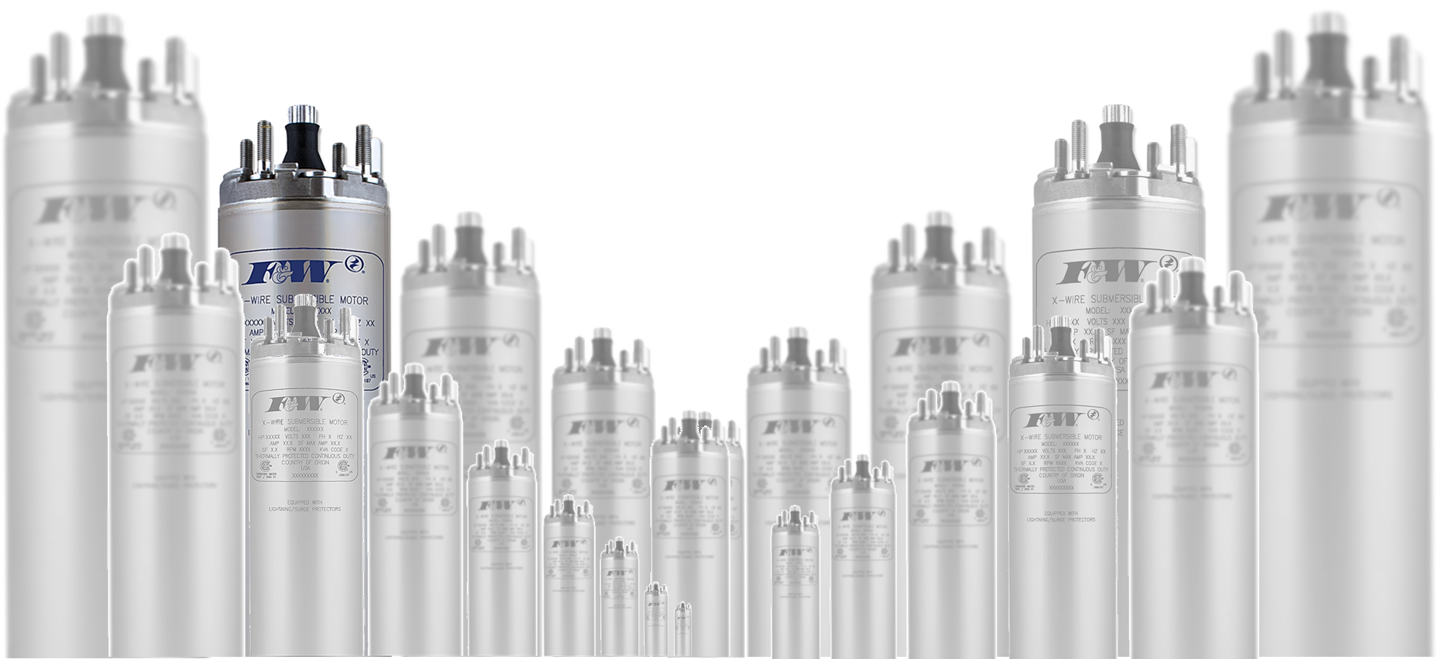
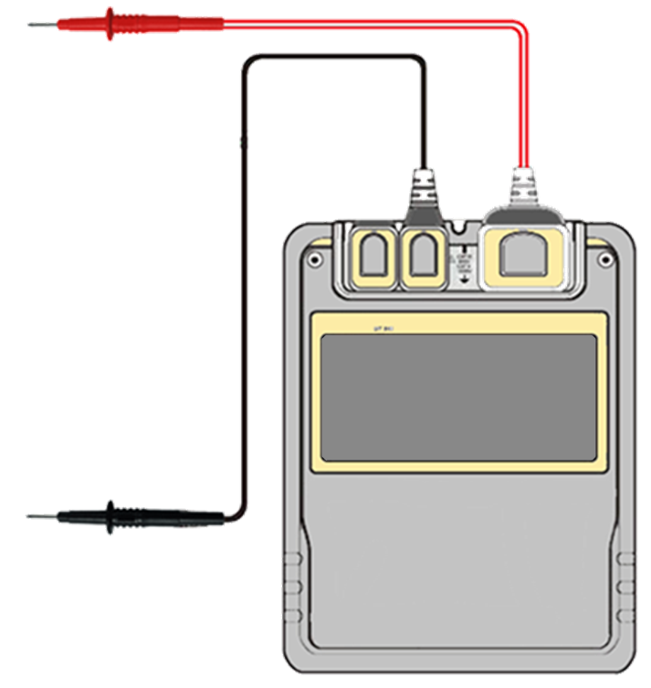
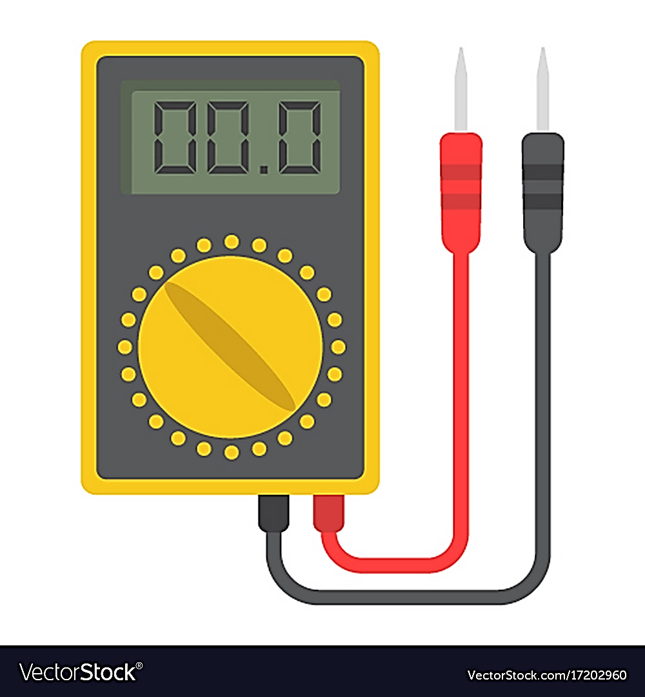

Testing Submersible Motors
w/ Meters
& Meggers

Slide 3


Testing Submersible Motors
w/ Meters
& Meggers
Infinity, dependent upon meter, will be displayed one of two ways
Meters measure resistance and displays it in “ohms”
“0” Ohms equals “Infinity”
Infinity
No resistance equals “0” Ohms

Slide 4
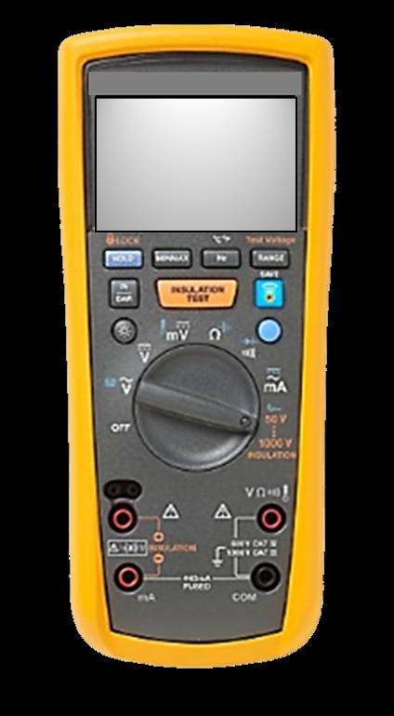
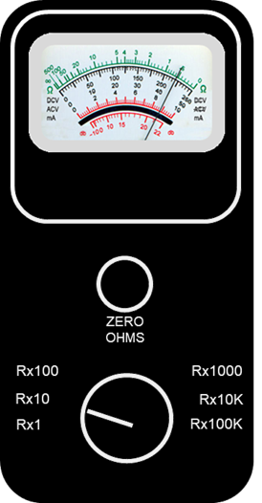
Two types of meters
Analog
Digital
have auto-ranging features,
no need to zero-out
a dial to “zero” out the meter.
an adjustable scale, set prior to taking the measurement.

Slide 5
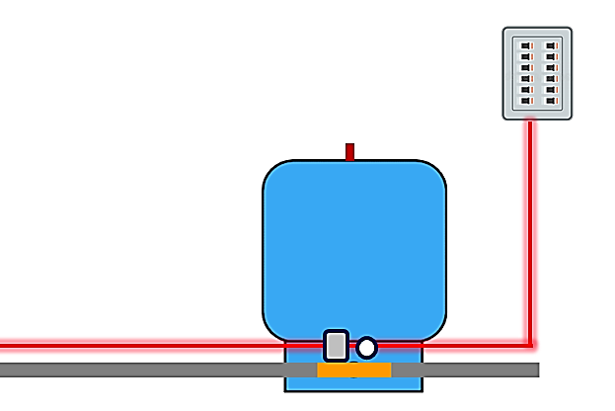

Testing Submersible Motors
w/ Meters
Short
Open Winding
Mixed Leads
Cut Power to pressure switch / motor
Lead Identification
Ground

Slide 6
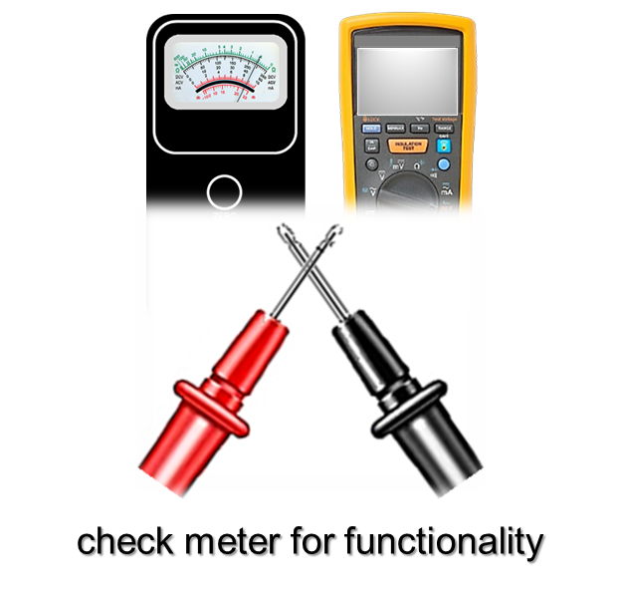
Testing Submersible Motors
w/ Meters
Short
Open Winding
Mixed Leads
Lead Identification
Ground

Slide 7
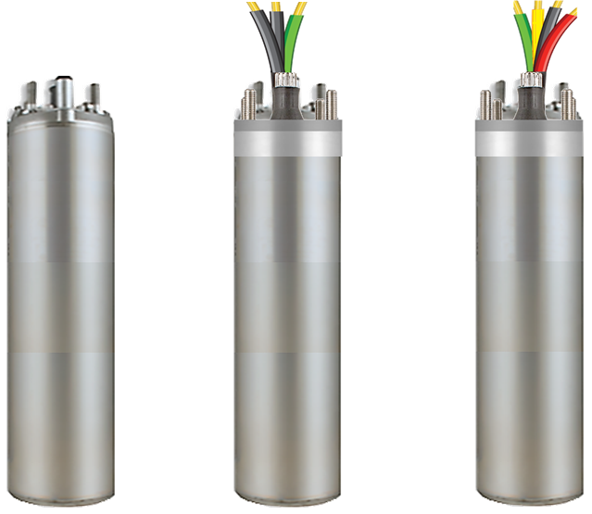
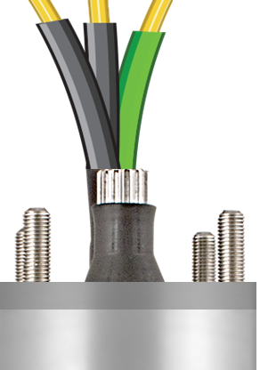
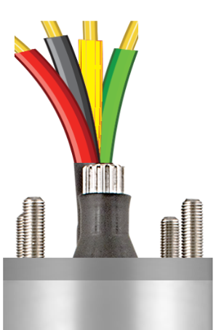
Motor Types
3W Motors
2W Motors
Start Winding
Lead A
Run Winding
Lead B
Common
Ground
Ground

Slide 8
Testing Submersible Motors
w/ Meters
Short
Open Winding
Mixed Leads
Lead Identification
Ground

Slide 9
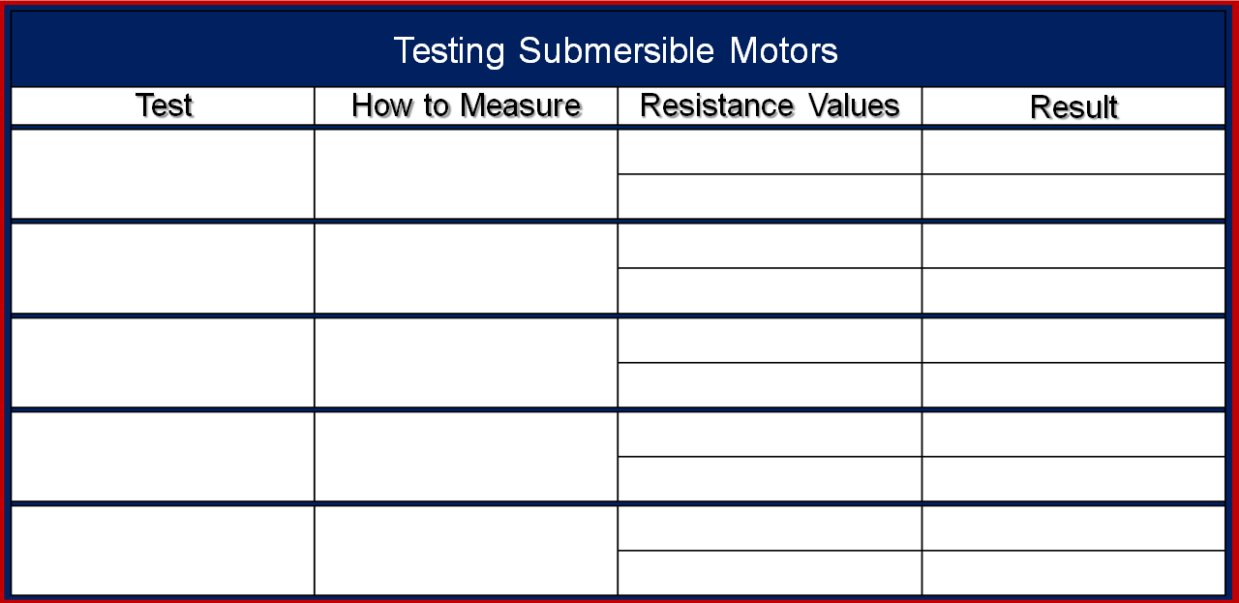
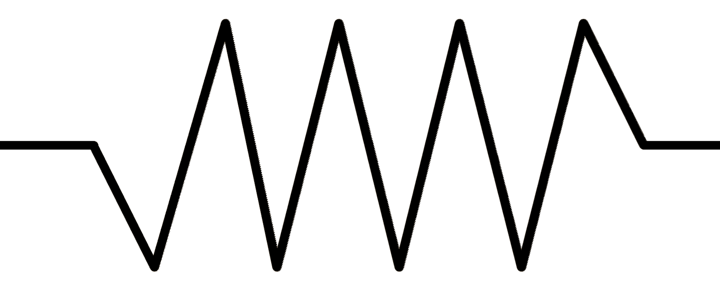
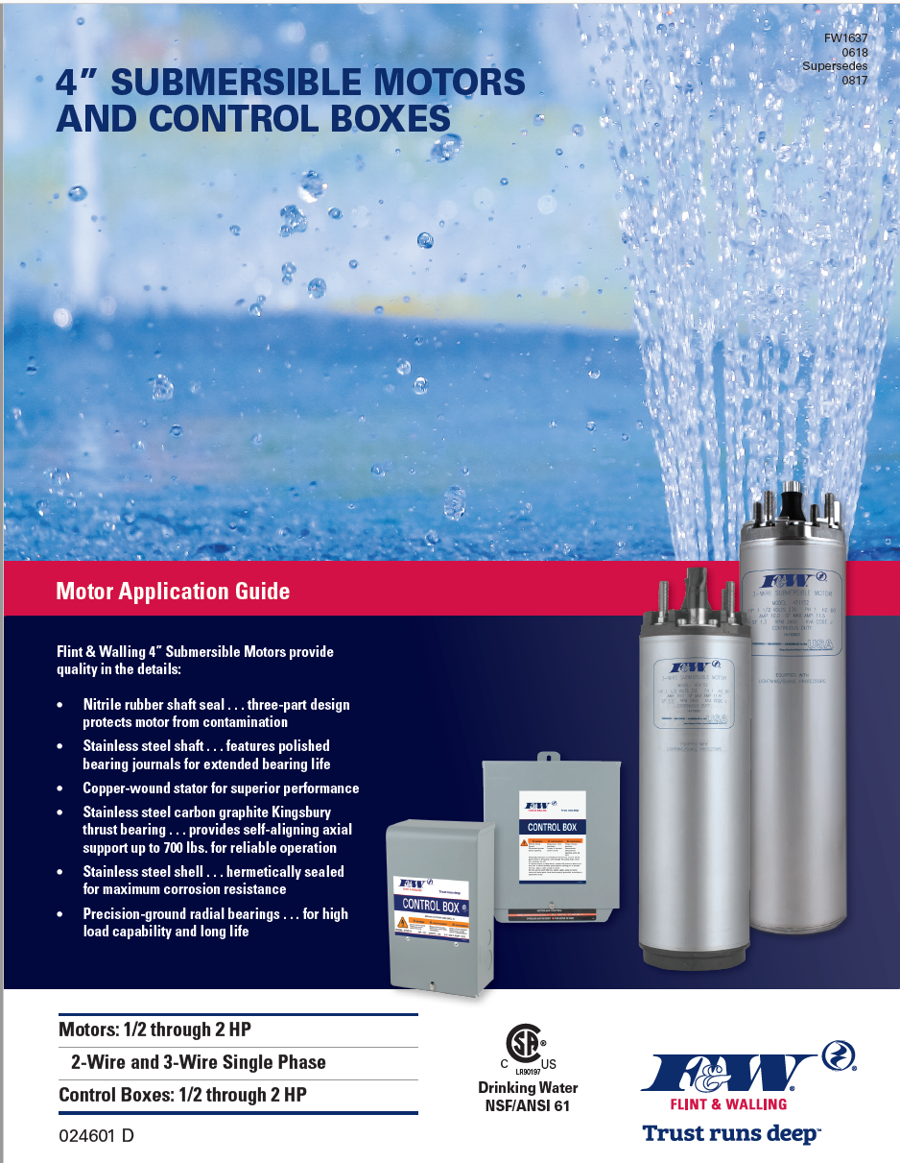
?
Short
Each Lead to Lead
Open Winding
Each Lead to Lead
Mixed Leads
Each Lead to Lead
Lead Identification
Each Lead to Lead

Slide 10
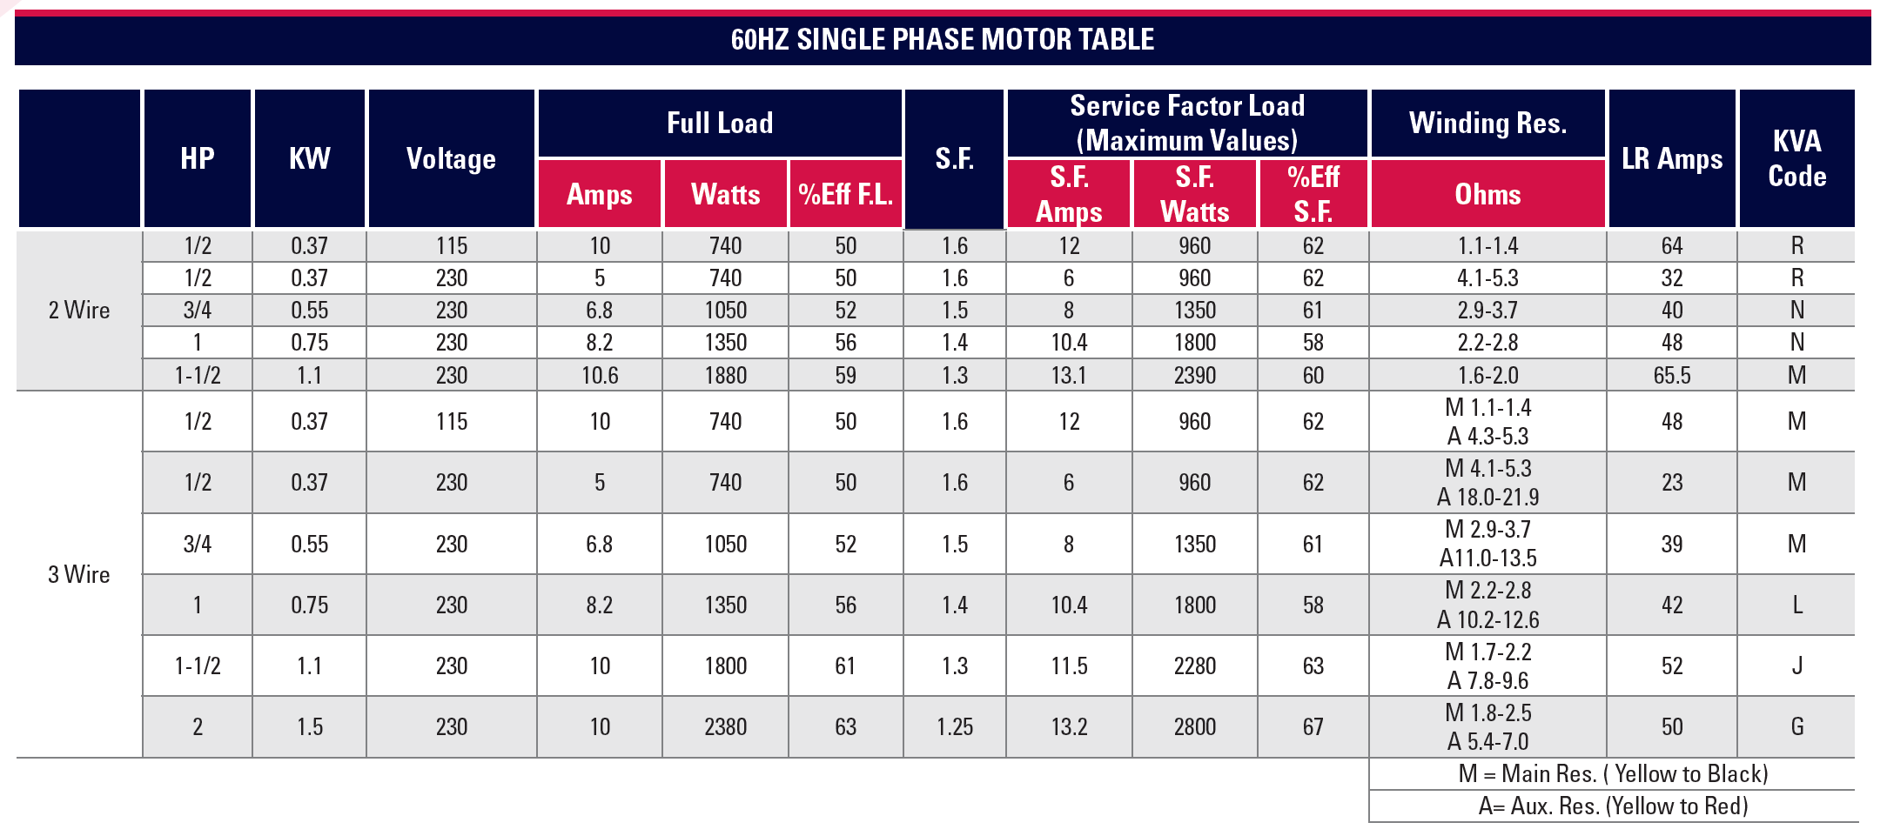



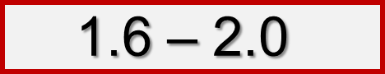
ohms

Slide 11
M 1.7 – 2.2
A 7.8 – 9.6
(Yellow to Black)
ohms
ohms
(Yellow to Red)

Slide 12
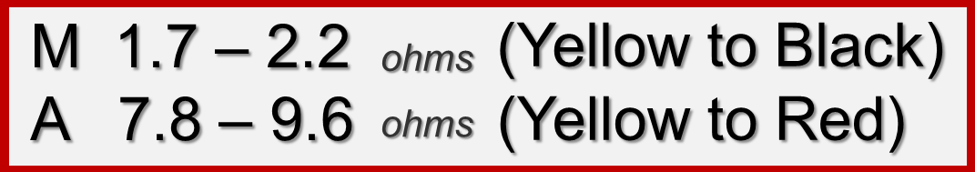
1½ hp 3-wire motor

Slide 13
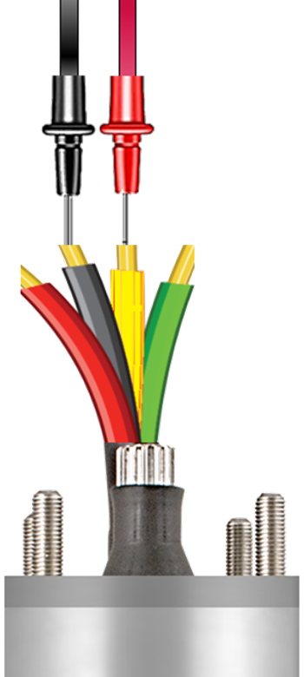
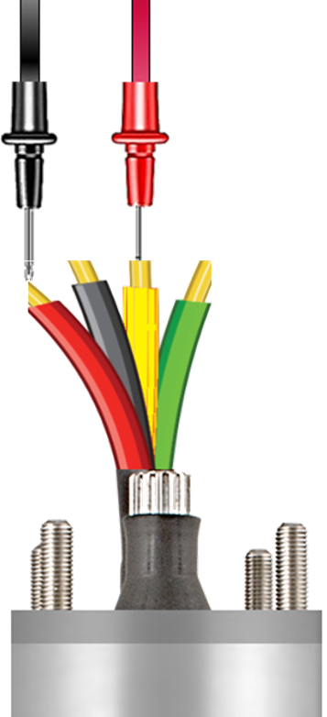
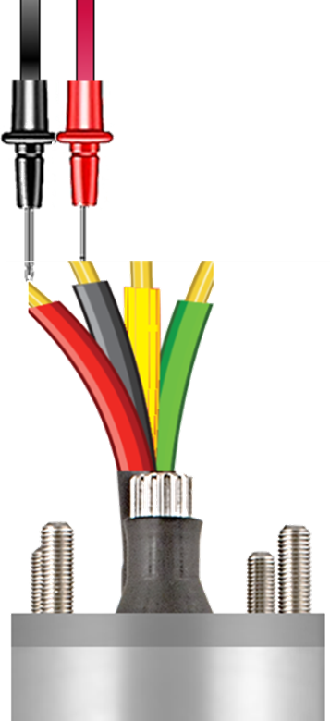
1½ hp 3-wire motor
Common / Run
+_________
Common / Start
Start / Run
+
=
Lowest Value
Intermediate Value
Highest Value

Slide 14
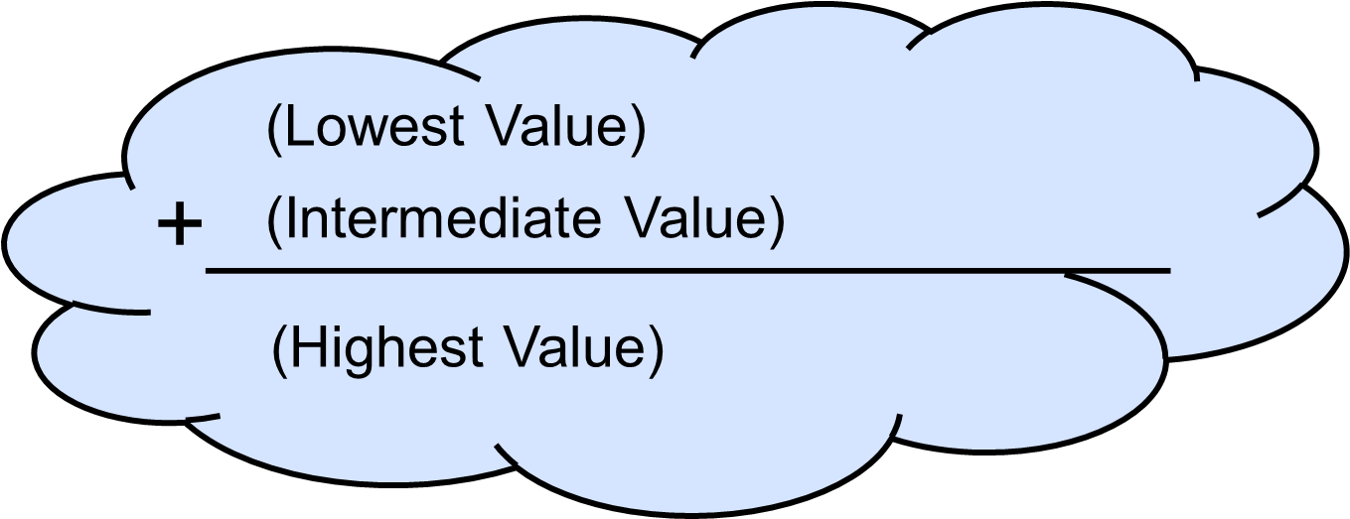
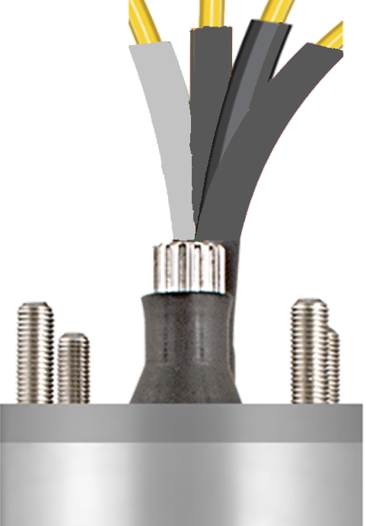
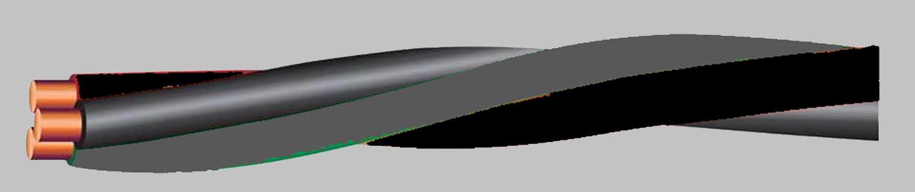
Testing Submersible Motors
w/ Meters
Short
Yellow / Black
Yellow / Red
Open Winding
Red / Black
Mixed Leads
Lead Identification
Ground

Slide 15
Testing Submersible Motors
w/ Meters
Short
Open Winding
Mixed Leads
Lead Identification
Ground

Slide 16

1½ hp 3-wire motor
1.8
1.7
OL.
Resistance Value
is Lower than published values

Slide 17
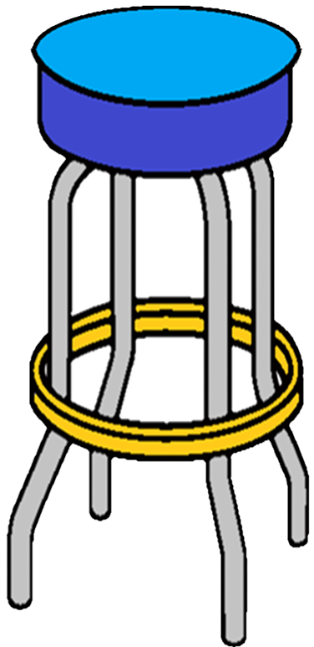
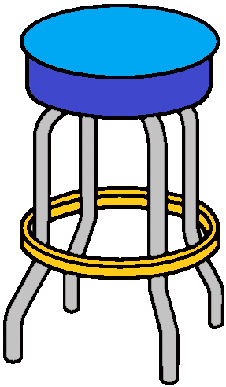
Published Values
Resistance Value
is Lower than published values
coming in “SHORT”

Slide 18
Within Range
Motor not shorted
Short
Each Lead to Lead
Lower than Range
Motor shorted
Open Winding
Each Lead to Lead
Mixed Leads
Each Lead to Lead
Lead Identification
Each Lead to Lead

Slide 19
1½ hp 3-wire motor
Red
Red
(Red to Black)
1.7

Slide 20
Testing Submersible Motors
w/ Meters
Short
Open Winding
Mixed Leads
Lead Identification
Ground

Slide 21
1½ hp 3-wire motor
9.4
8.0
OL.
Resistance Value
is Higher than published values

Slide 22



Up
Resistance Value
is Higher than published values
OPEN

Slide 23
1½ hp 3-wire motor
(Yellow to Black)
(Red to Black)
(Red to Black)
9.4

Slide 24
Within Range
Motor not shorted
Short
Each Lead to Lead
Lower than Range
Motor shorted
Within Range
Windings not open
Open Winding
Each Lead to Lead
Higher than Range
Open Windings
Mixed Leads
Each Lead to Lead
Lead Identification
Each Lead to Lead

Slide 25
Testing Submersible Motors
w/ Meters
Short
Open Winding
Mixed Leads
Lead Identification
Ground

Slide 26

1½ hp 3-wire motor
8.0
1.9
OL.
Mixed Leads

Slide 27
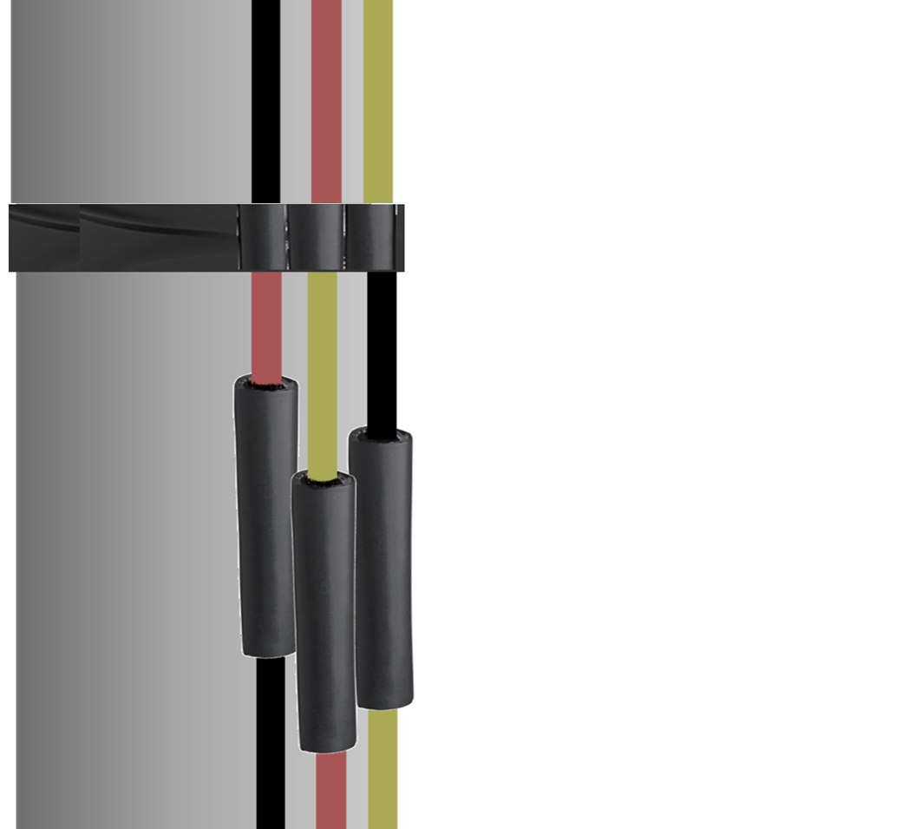
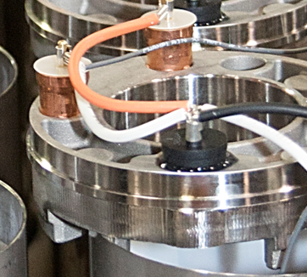
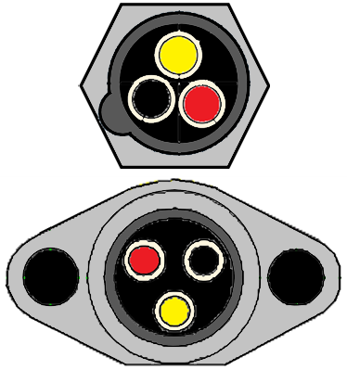
1½ hp 3-wire motor
…lead socket?
Mixed Leads
…Check Splice

Slide 28
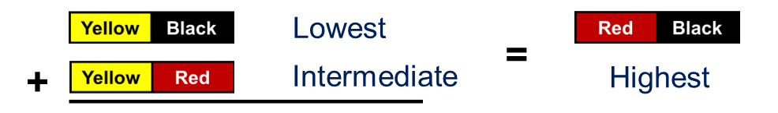
Within Range
Motor not shorted
Short
Each Lead to Lead
Lower than Range
Motor shorted
Within Range
Windings not open
Open Winding
Each Lead to Lead
Higher than Range
Open Windings
Within Ranges
No mixed leads
Mixed Leads
Each Lead to Lead
Higher / Lower
Mixed Leads
Lead Identification
Each Lead to Lead

Slide 29
Testing Submersible Motors
w/ Meters
Short
Open Winding
Mixed Leads
Lead Identification
Ground

Slide 30
Within Range
Motor not shorted
Short
Each Lead to Lead
Lower than Range
Motor shorted
Within Range
Windings not open
Open Winding
Each Lead to Lead
Higher than Range
Open Windings
Within Ranges
No mixed leads
Mixed Leads
Each Lead to Lead
Higher / Lower
Mixed Leads
Lead Identification
Each Lead to Lead
Each
Lead to Ground
Ground

Slide 31
1½ hp 3-wire motor
No resistance –
Motor not grounded
OL.
0.2
Any resistance at all–
Motor is grounded

Slide 32
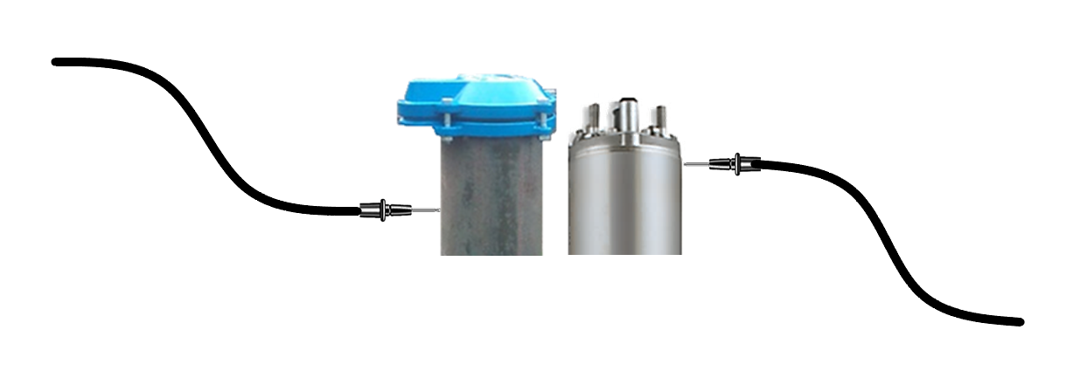
1½ hp 3-wire motor
A grounded motor in most cases, will show resistance on every lead.
If you test an old motor that doesn’t have a ground…
0.2
use the well casing or the S.S. motor shell to provide ground.

Slide 33
Within Range
Motor not shorted
Short
Each Lead to Lead
Lower than Range
Motor shorted
Within Range
Windings not open
Open Winding
Each Lead to Lead
Higher than Range
Open Windings
Within Ranges
No mixed leads
Mixed Leads
Each Lead to Lead
Higher / Lower
Mixed Leads
Lead Identification
Each Lead to Lead
Each
Lead to Ground
No resistance
Motor not grounded
Ground
Any resistance
Motor grounded

Slide 34
Testing Submersible Motors
w/ Meters
Short
Open Winding
Mixed Leads
Lead Identification
Ground

Slide 35
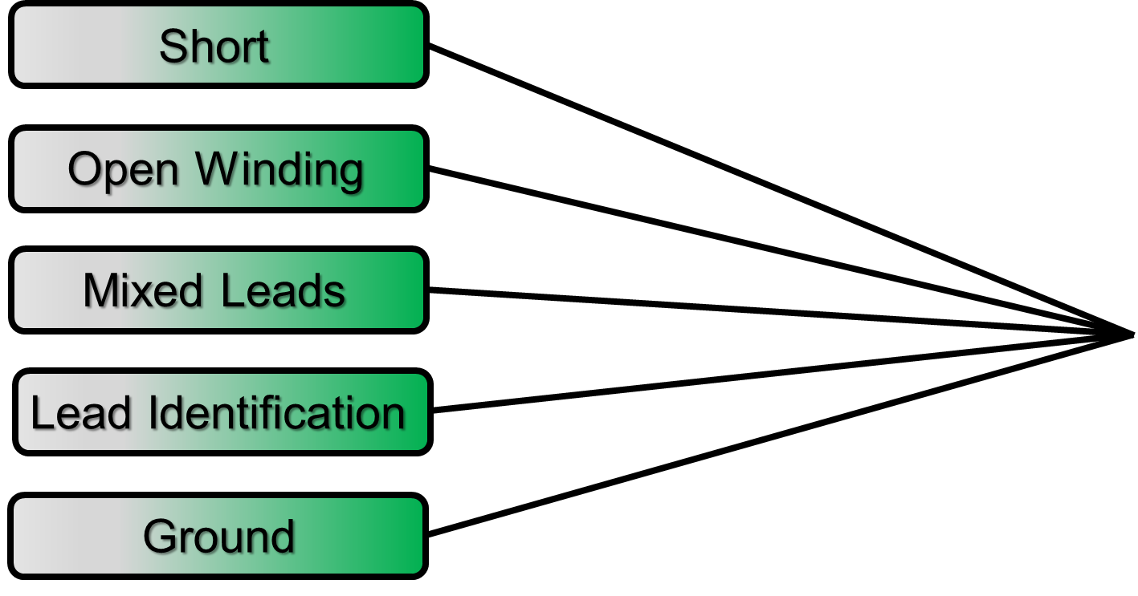
Testing Submersible Motors
w/ Meters

Slide 36

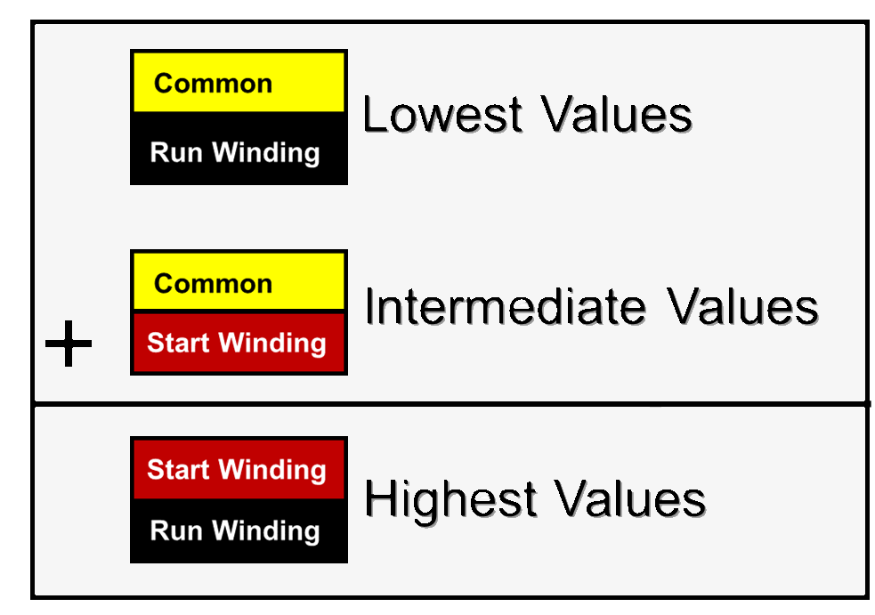
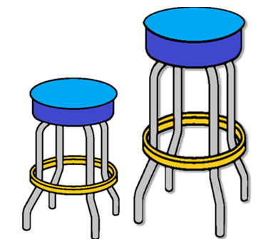
Testing Submersible Motors
w/ Meters
Take-a-ways
Open
Mixed
within specified range / good.
Short
Leads

Slide 37
Testing Submersible Motors
w/ Meters
& Meggers

Slide 38
Testing Submersible Motors
& Meggers
Insulation
Resistance

Slide 39
Testing Submersible Motors
w/ Meters
& Meggers
1-9 volts
500 -1000 volts
Ω
MΩ
ohms
megohms
1,000,000 ohms equals…
1 megohm
Is essential to keeping wires & motors working properly.
This test will determine the condition of the outer coating of the wire.

Slide 40
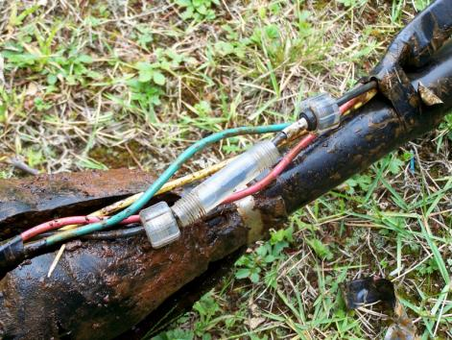
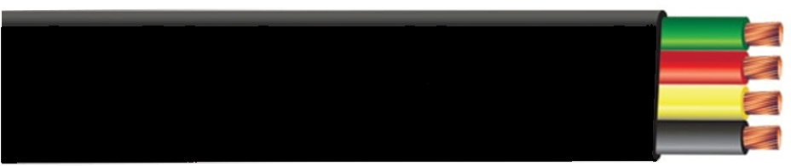
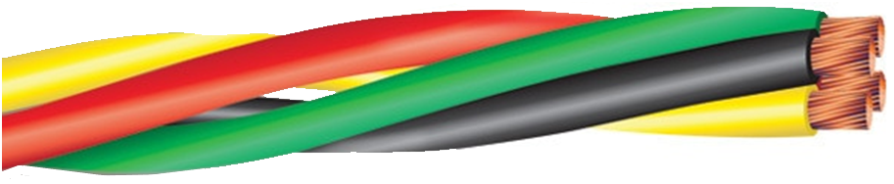
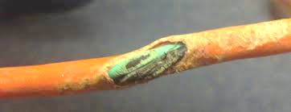
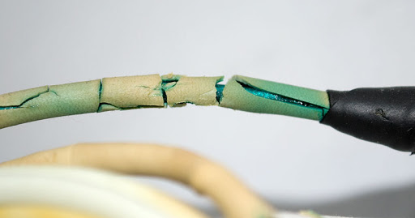
Test for insulation resistance
Meggers
nicks, thin insulation
cracks, pin holes, wear

Slide 41
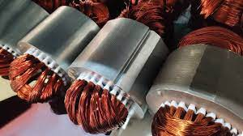
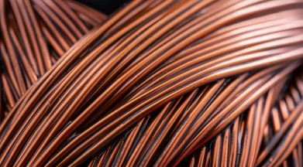
Test for insulation resistance
Meggers
windings
nicks, thin insulation
cracks, pin holes, wear
degrade over time

Slide 42
Test for insulation resistance
Meggers
Is copper wire and magnet wire the same?
windings
Both use a copper conductor. However, magnet copper wire has a thin high heat absorbing special coating or insulation (like an enamel or varnish)
This insulation protects the windings from contamination, shorting electrically.
degrade over time

Slide 43
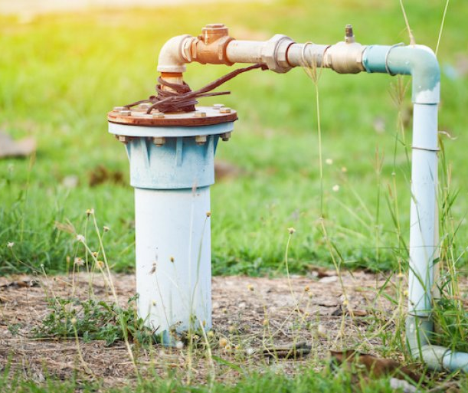
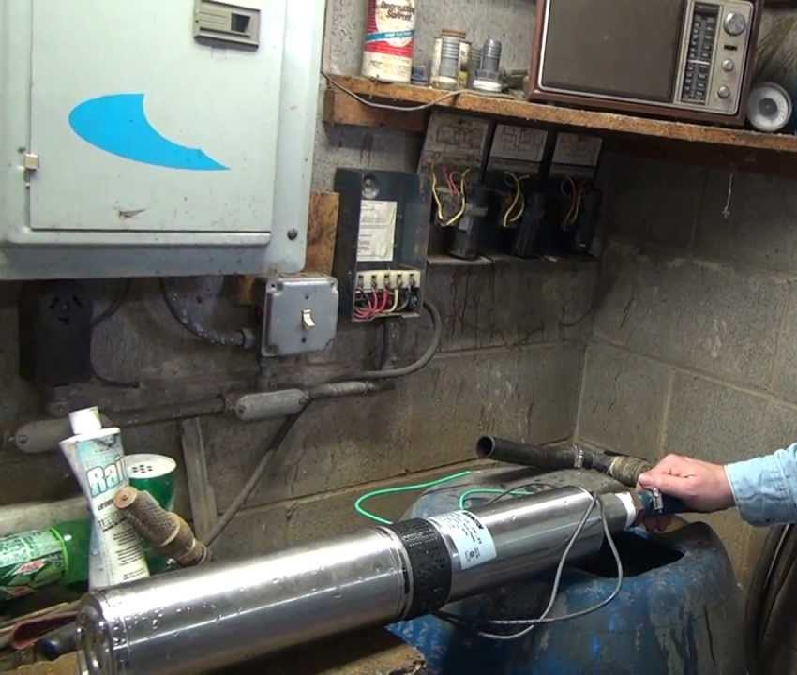
Test for insulation resistance
…good or bad?
Meggers
…measure each
lead to ground
In the well Out of well
NEW MOTOR
USED MOTOR
NEW MOTOR
USED MOTOR
2MΩ or more
0.5MΩ or more
20MΩ or more
10MΩ or more
If below above values… do not install
If below above values… do not install

Slide 44
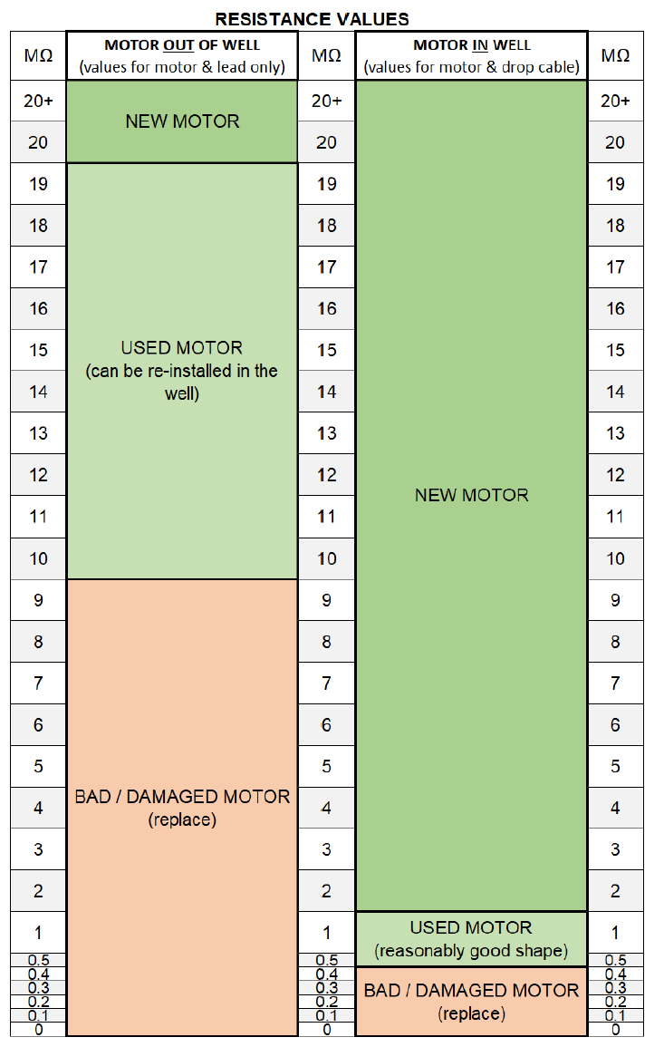
Testing Submersible Motors
w/ Meters
& Meggers

Slide 45
Testing Submersible Motors
w/ Meters
& Meggers
Motors of all horsepower, voltage & phase…
…will have very similar Insulation Resistance values.
Motors should be placed on a non-conductive surface when testing motor out of the well..

Slide 46
Testing Submersible Motors w/ Meters & Meggers
thank you
track 1A

