Slide 1

Irrigation Pumps 101
track 2A

Slide 2

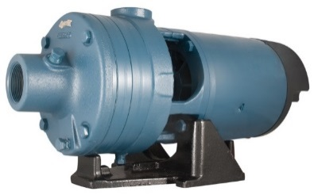
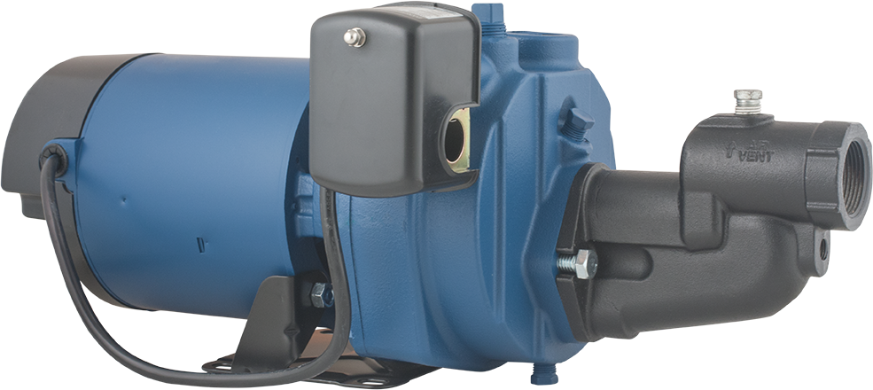
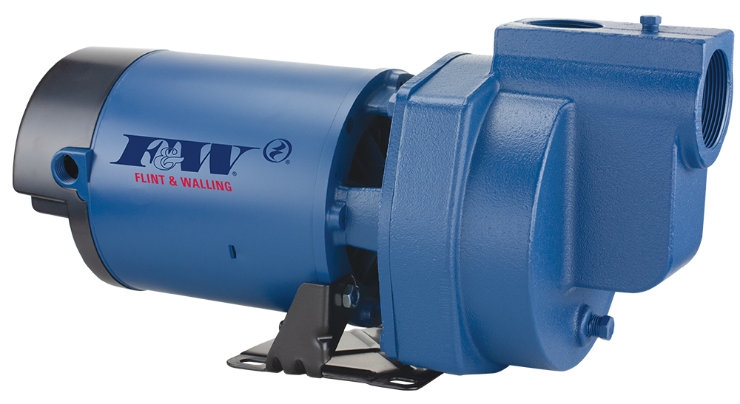
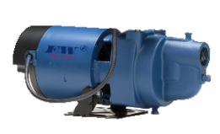
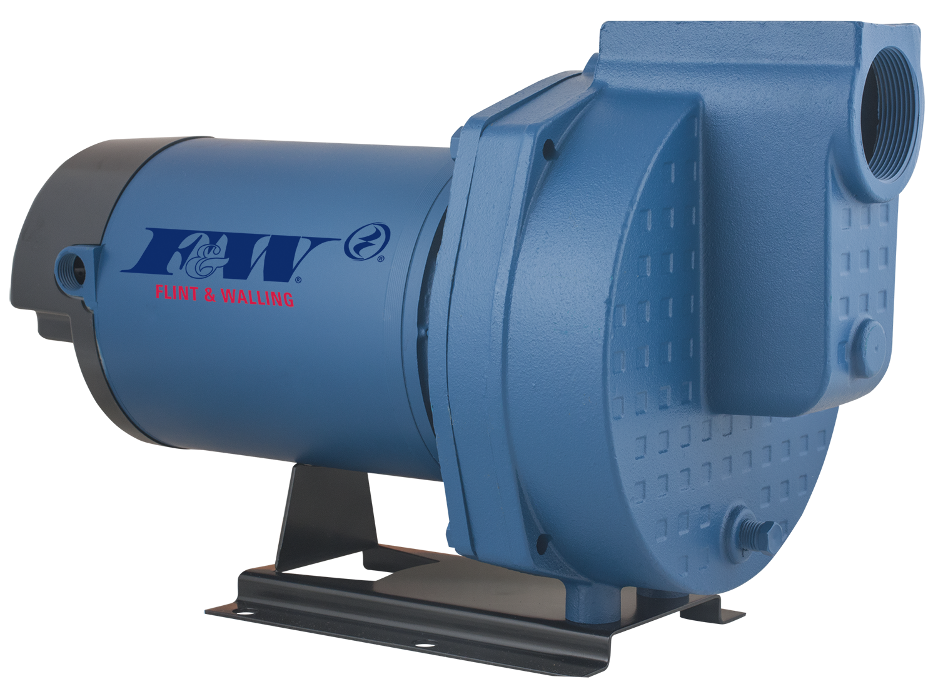
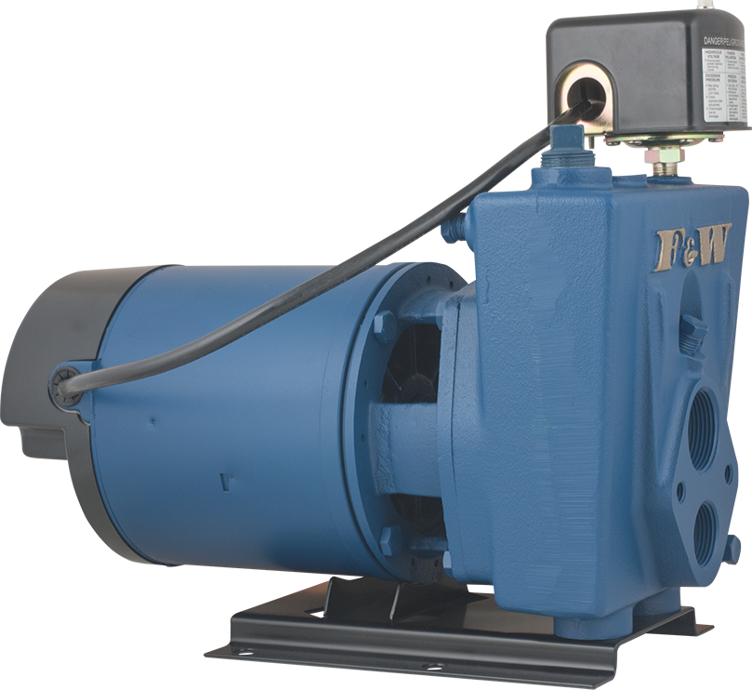
2-Types
JET PUMPS
ABOVE GROUND
CENTRIFUGAL PUMPS

Slide 3



Shallow Well
Deep Well
25 feet
or less
more than 25 feet

Slide 4
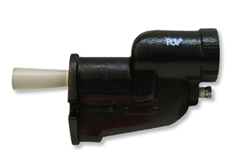
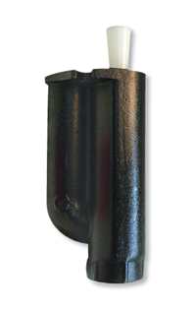
2-Types
Why are they called “Jet” pumps?
JET PUMPS
Shallow Well Jet Pumps
Shallow Well Jet or Ejector
Jet or Ejector
Deep Well Jet Pumps
Deep Well Jet or Ejector

Slide 5
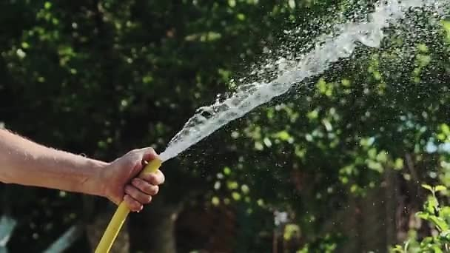
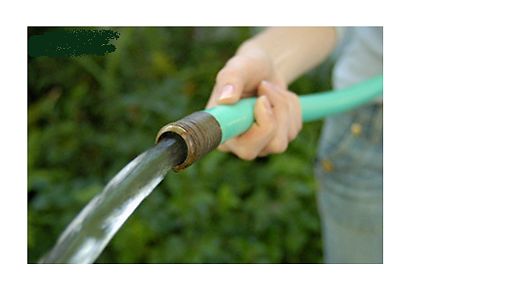
How do they work?
Shallow Well Jet or Ejector
Increase Velocity
Jet or Ejector
Deep Well Jet or Ejector

Slide 6
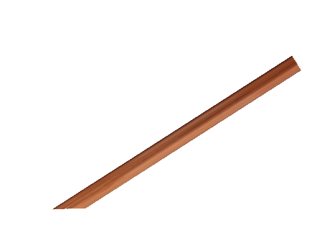

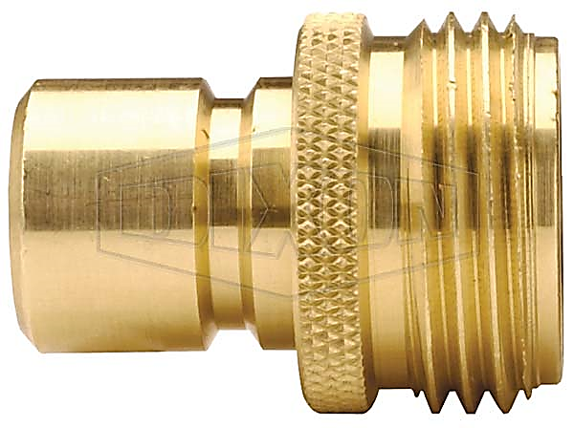

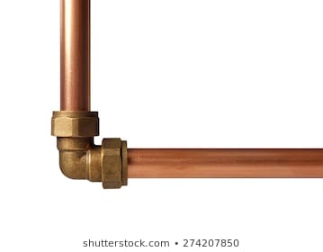

How do they work?
Suction or Vacuum
Shallow Well Jet or Ejector
Jet or Ejector
Increased Velocity
Deep Well Jet or Ejector

Slide 7
How do they work?
SHALLOW WELL JET
DEEP WELL JET
NOZZLE

Slide 8
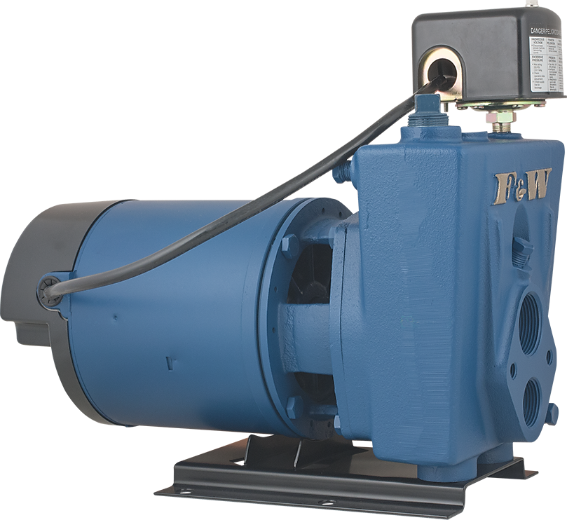
How do they work?
To service
SHALLOW WELL
Suction or Vacuum
From water source
From pump

Slide 9
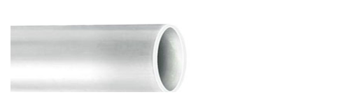
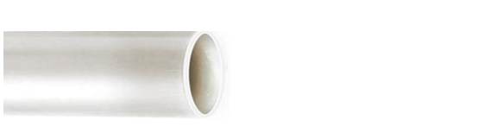
How do they work?
DEEP WELL
Suction or Vacuum
From water source

Slide 10
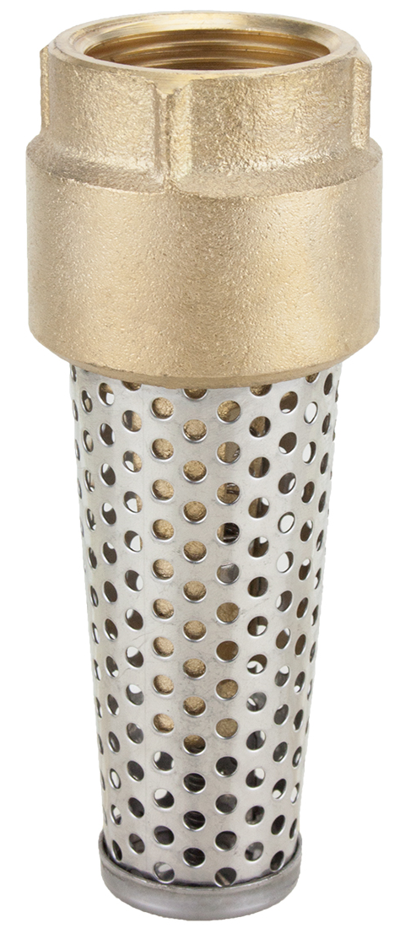
JET PUMPS

Slide 11
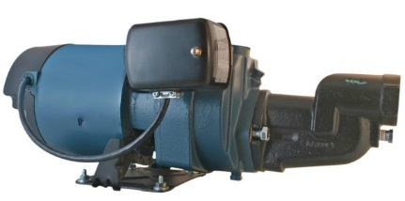
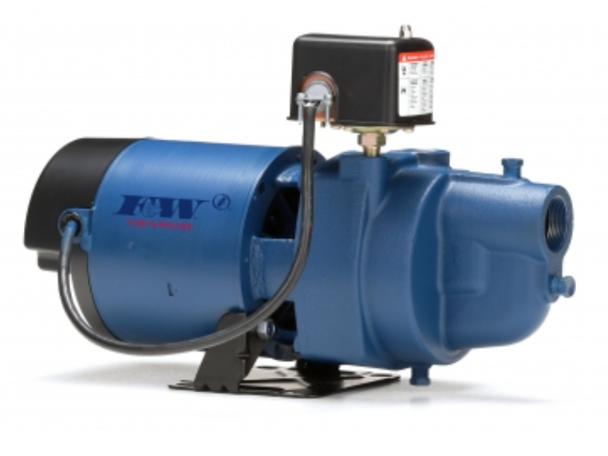
JET PUMPS
Convertible Jets
+ =
Shallow Well Jet Pump
+ =
Deep Well Jet Pump
Shallow Well Only

Slide 12
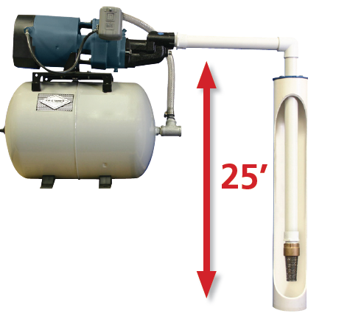
What do you mean?
SHALLOW WELL
DEEP WELL
Single pipe ‘Shallow Well’ jet pumps – 25’ or less to water

Slide 13
What do you mean?
SHALLOW WELL
DEEP WELL
Single pipe ‘Shallow Well’ jet pumps – 25’ or less to water

Slide 14
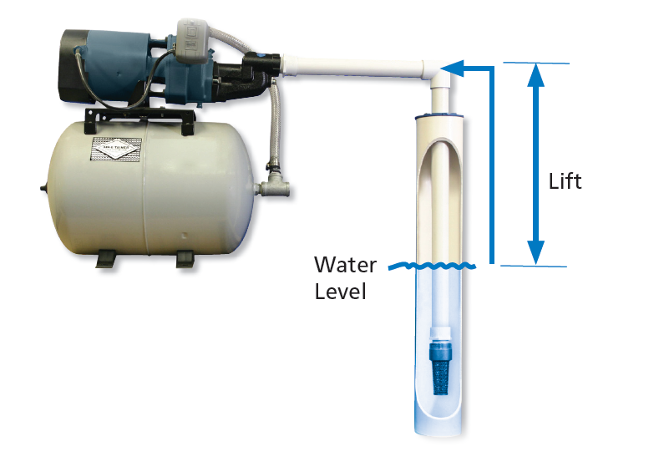
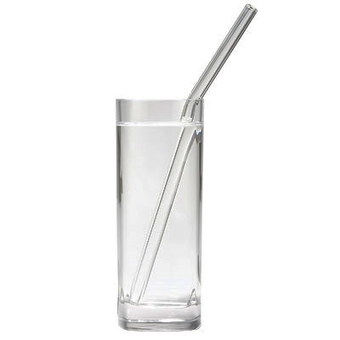
What do you mean?
SHALLOW WELL
DEEP WELL
Lift
Water level

Slide 15
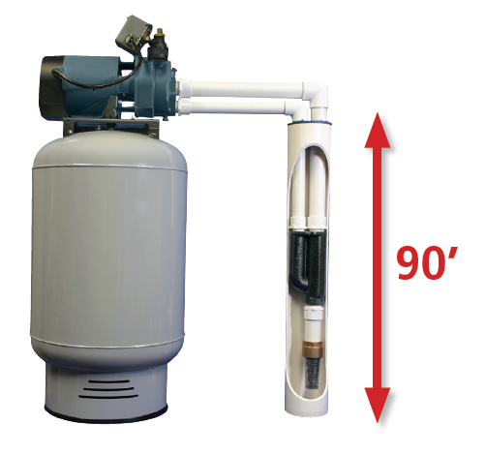
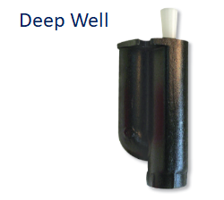
What do you mean?
SHALLOW WELL
DEEP WELL
Two pipe ‘Deep Well’ jet pumps – sized with proper ejector (referred to as a jet) can lift water up to 90’.

Slide 16
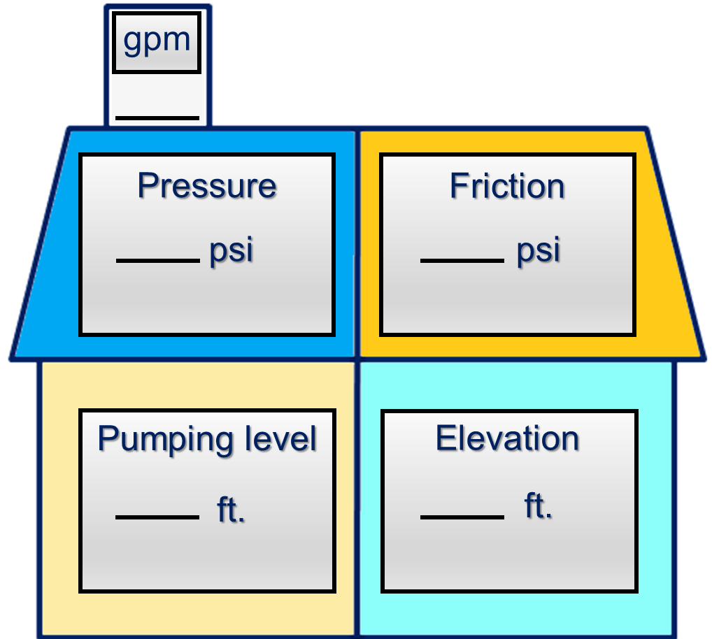






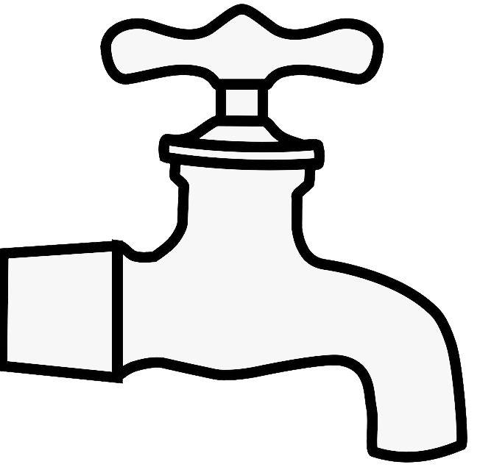
Zone 4
Home Water System
Fixture Count Method
9
The total number of fixtures in the house should equal the gpm rating of the pump.
Full Bath
● Tub/Shower
● Lavatory
● Toilet
2
1
3
Kitchen
● Sink
● Dishwasher
Laundry Room
● Clothes Washer
2
1
+___
½ Bath
● Lavatory
● Toilet
● Outside Hose Bibb
9
9
fixtures
9
gpm

Slide 17
2-Types
JET PUMPS
ABOVE GROUND
CENTRIFUGAL PUMPS

Slide 18
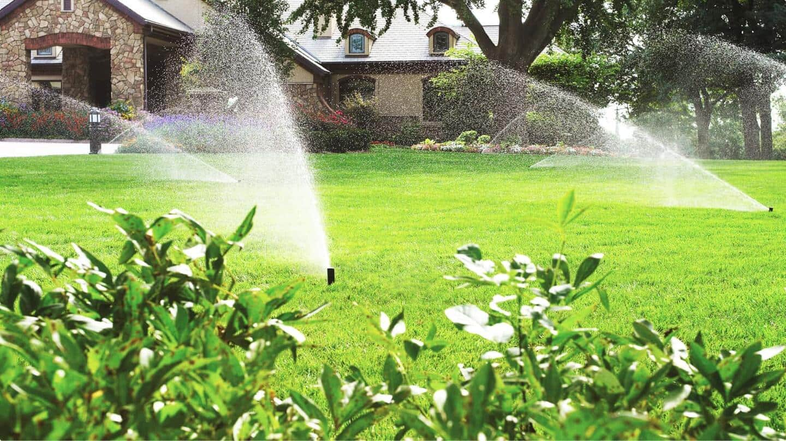
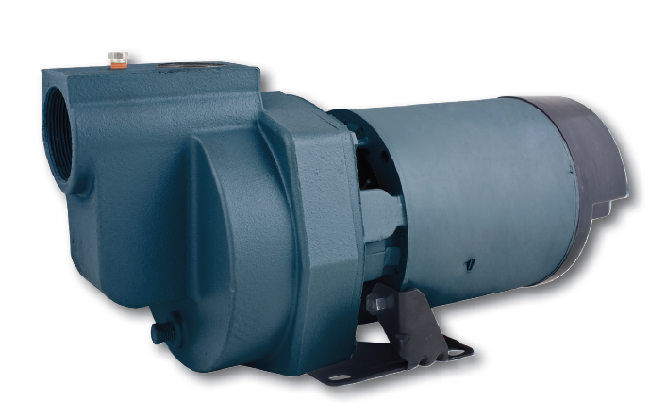
CENTRIFUGAL PUMPS
2-Types
Straight Centrifugal
Self-Priming

Slide 19
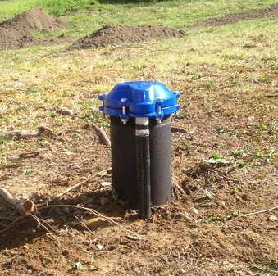
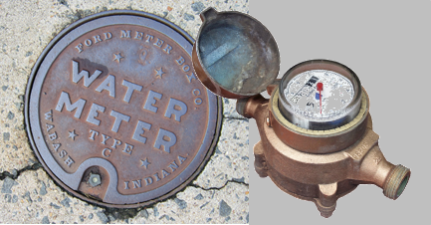
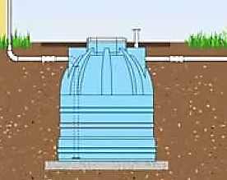
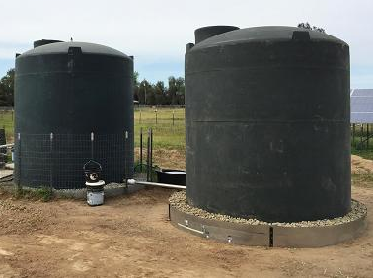

CENTRIFUGAL PUMPS
WATER SOURCES
Drilled Wells
City / Municipal Water Supplies
Below Ground Cisterns
Above Ground Reservoirs
Lakes
Ponds
Rivers / Streams
Lakes Ponds Streams / Rivers

Slide 20

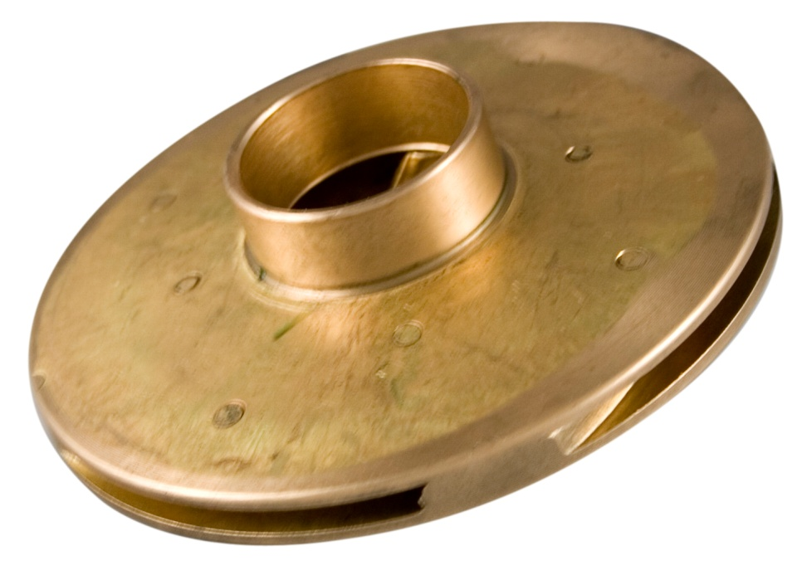
Centrifugal Force
CENTRIFUGAL PUMPS

Slide 21
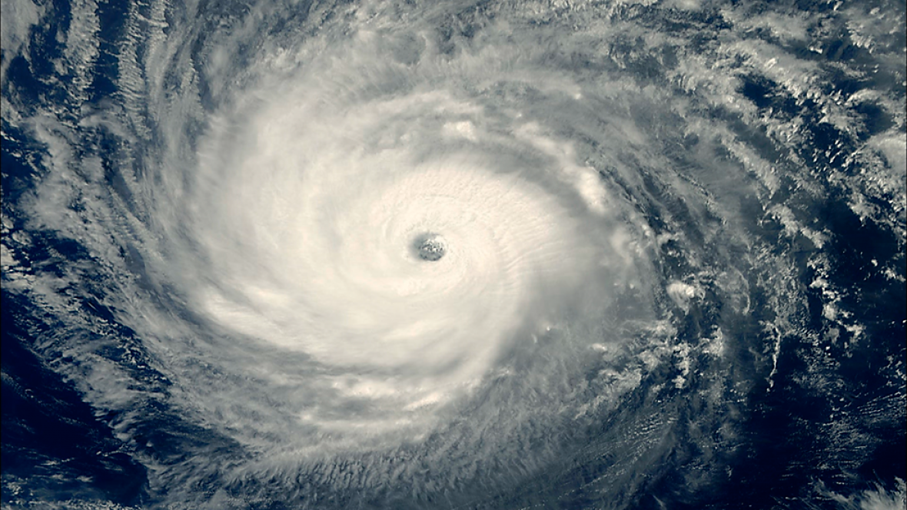
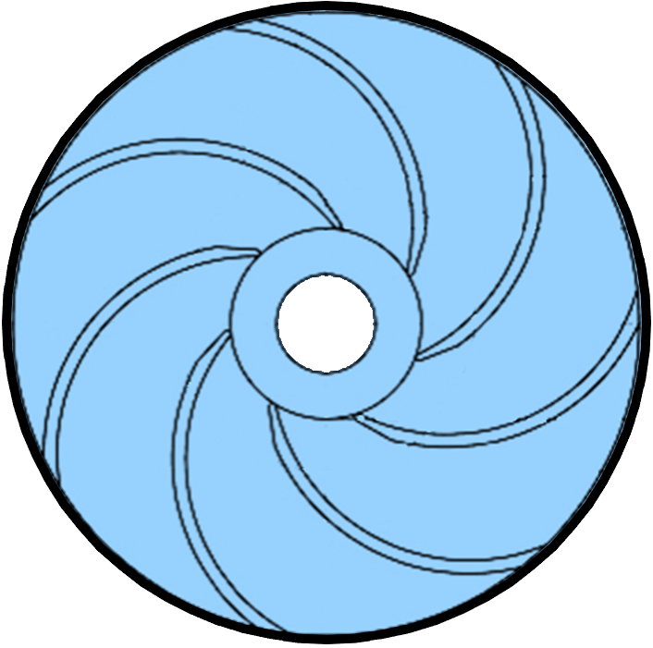

Slide 22
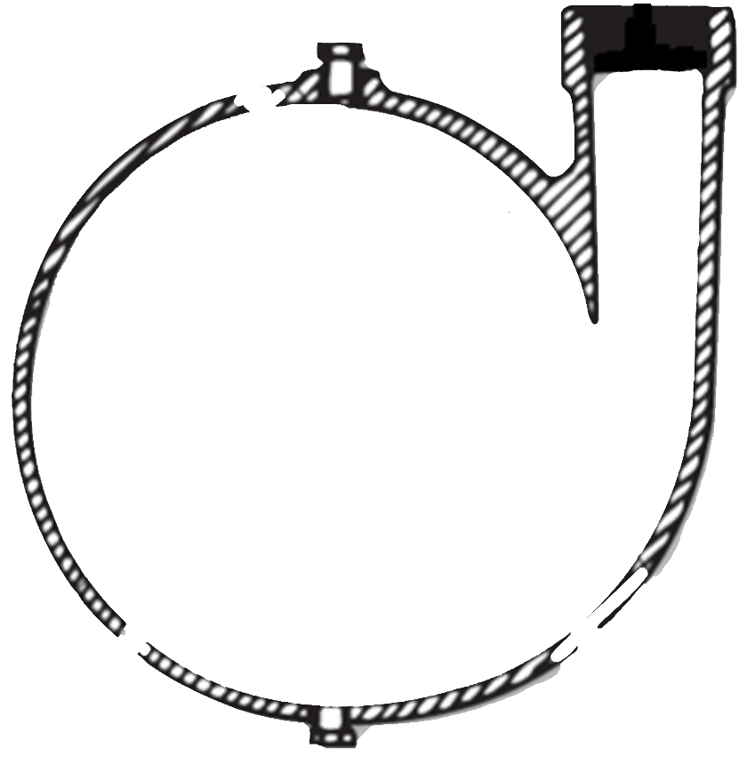

Slide 23
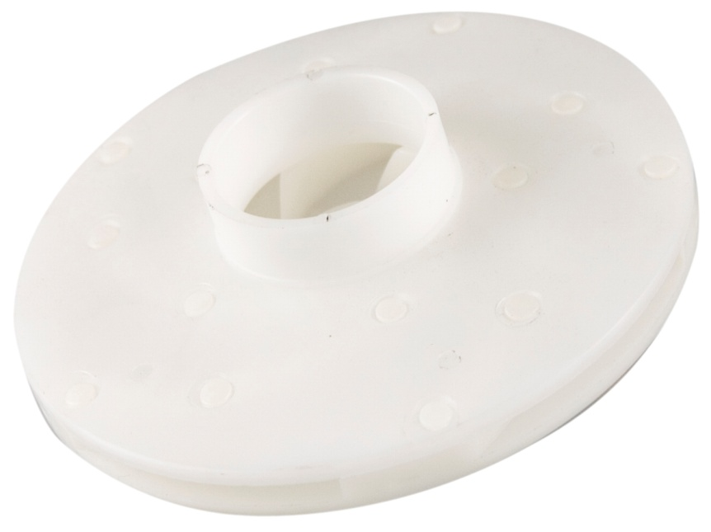
choice of impellers
Injection Molded Plastic
No Lead Brass

Slide 24
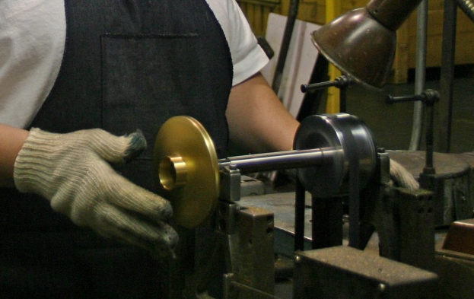
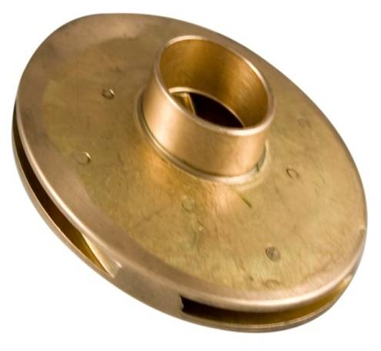

All Impellers are Balanced

Slide 25

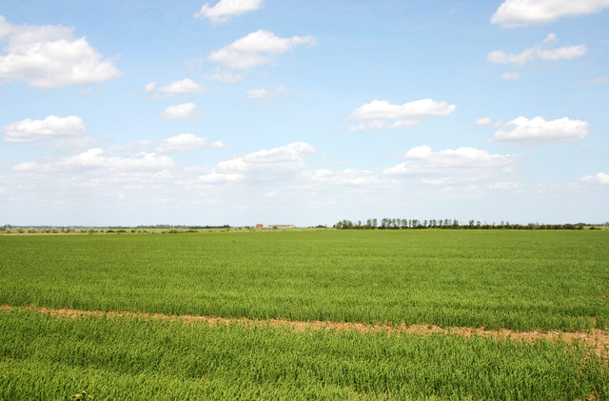
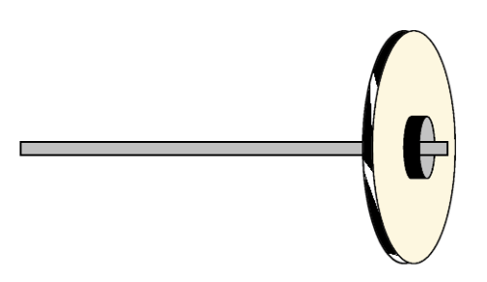
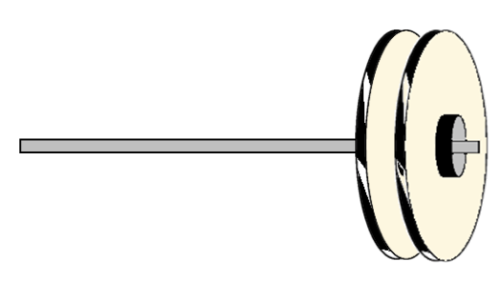
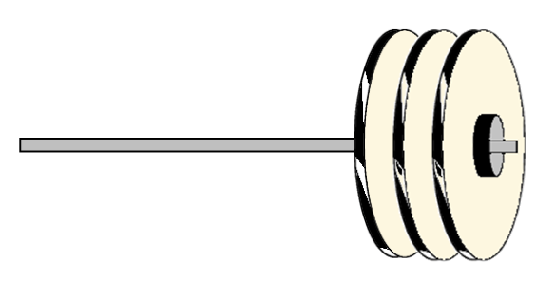
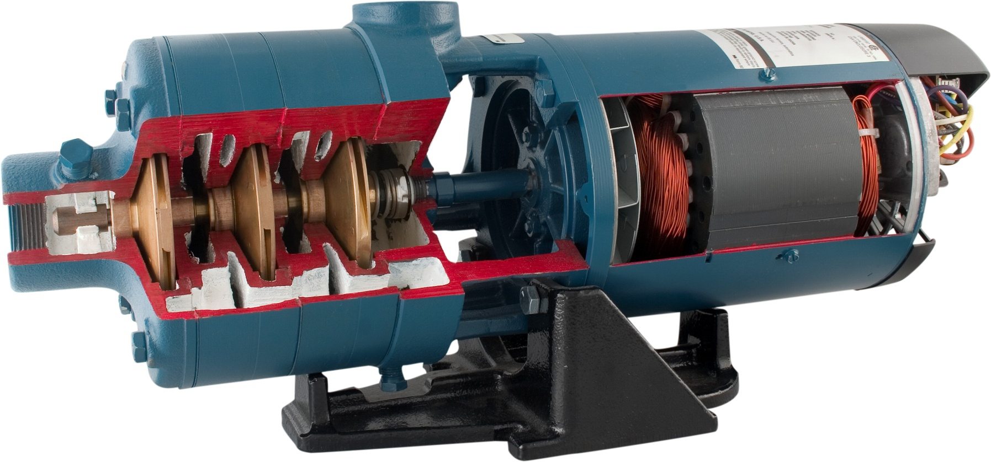
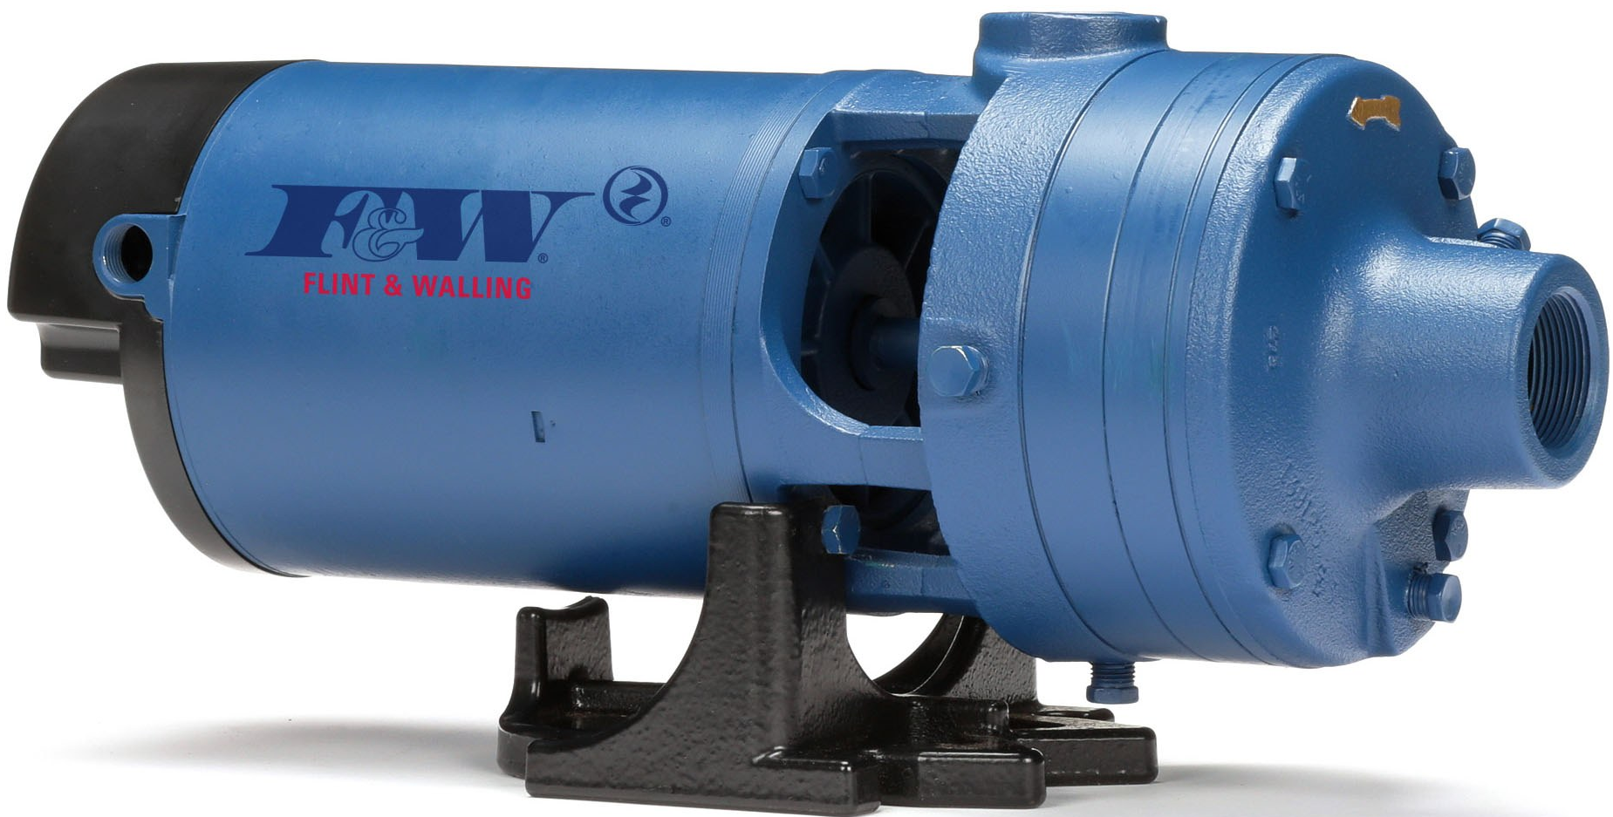
more impellers = more pressure
· single stage
· two stage
· three stage

Slide 26
more impellers = more pressure

Slide 27
CENTRIFUGAL PUMPS
The simplest of all pumps.
Will not remove air – must be primed with water before operation and must stay full of water at all times.
STRAIGHT CENTRIFUGAL

Slide 28
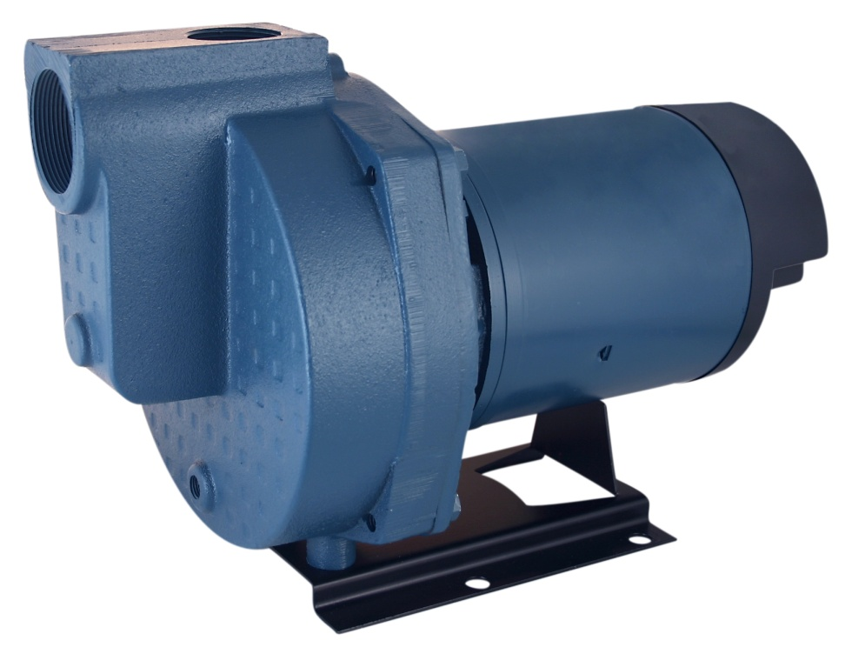
CENTRIFUGAL PUMPS
Self-Primer
Self Priming centrifugal pumps are also referred to as ‘lawn sprinkler pumps’
Although they are ‘self priming’, all pumps need to be primed initially in order to pump water.

Slide 29
…why is it called self-priming?
Self-Primer
Straight Centrifugal

Slide 30
…priming a pump
Priming port
Discharge/Outlet
Suction/Inlet

Slide 31
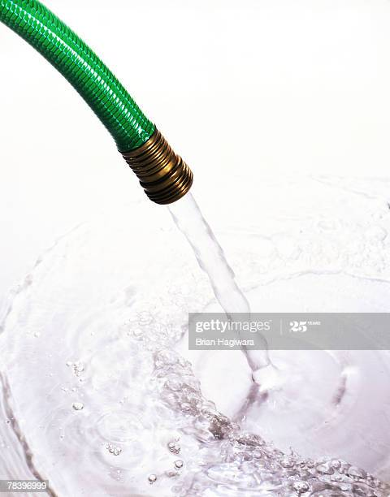
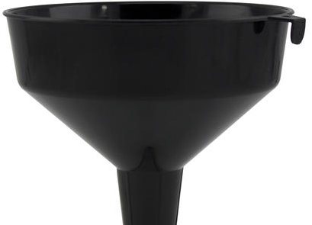
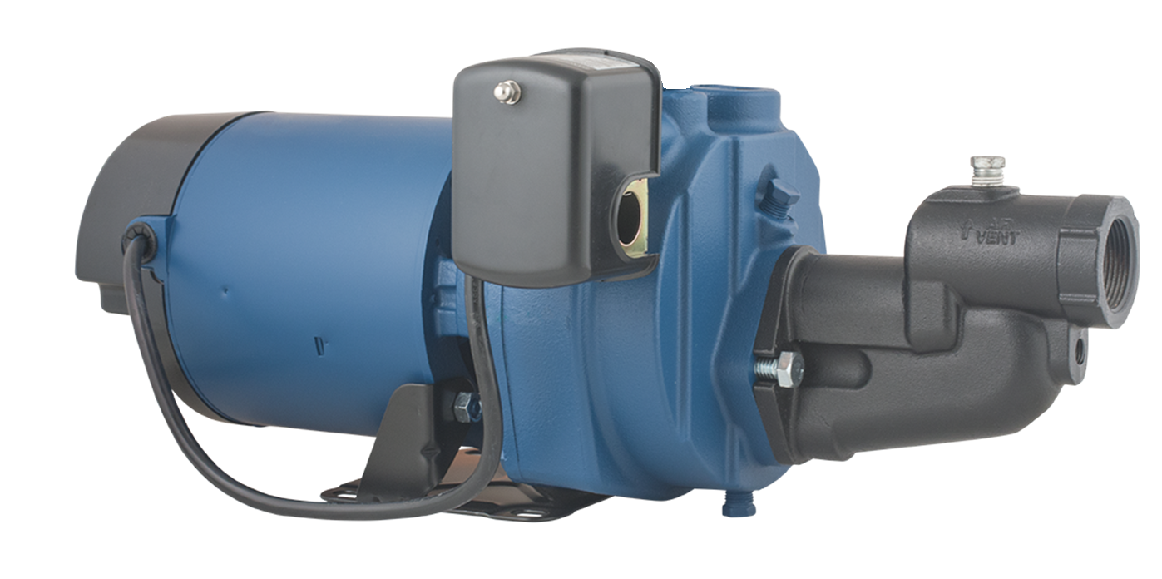
…priming a pump

Slide 32
…priming a pump

Slide 33
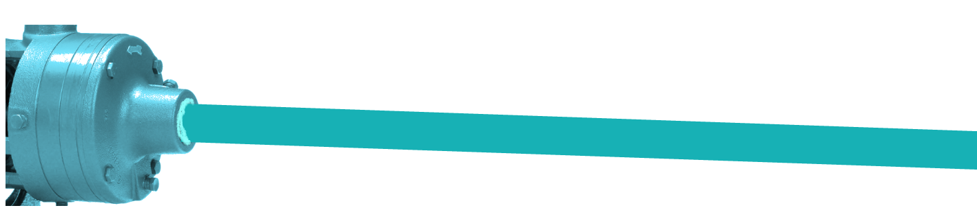
…priming a pump
Pump Body
Suction Pipe
Air pockets / bubbles must be eliminated during this process.
Failure to prime a pump, or for the pump to keep its prime is the #1 cause for initial pump failure.
All jet / centrifugal pumps need to be initially primed with water in order to remove air from the pump and pipe.

Slide 34
Irrigation Pumps 101
thank you
track 2A

