Slide 1

House of Resistance - Subs

Slide 2
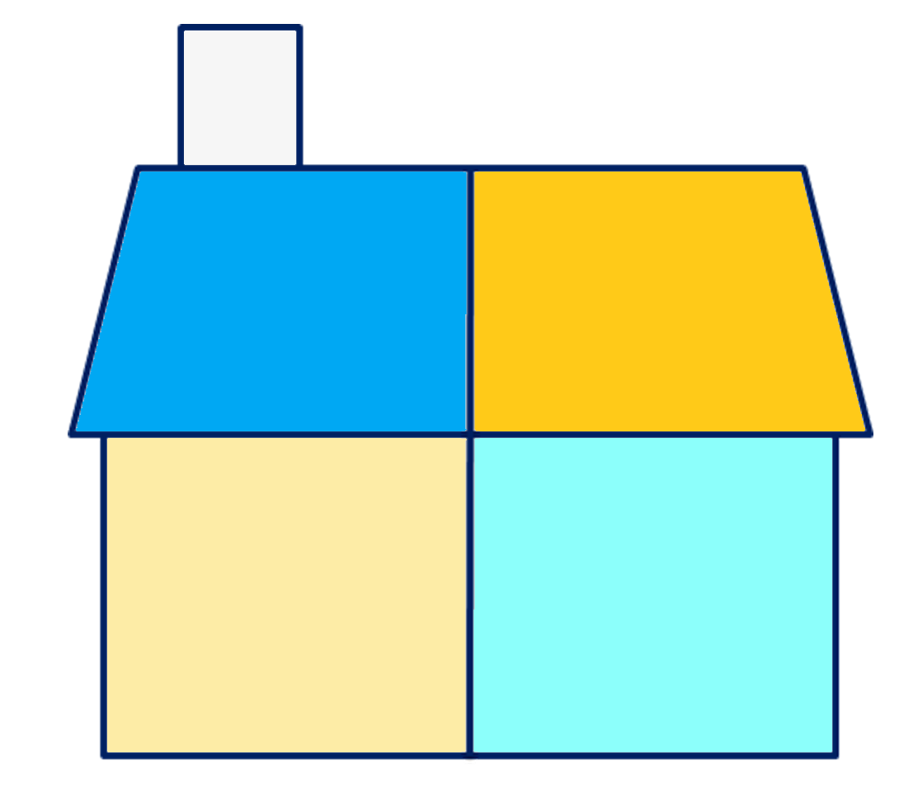
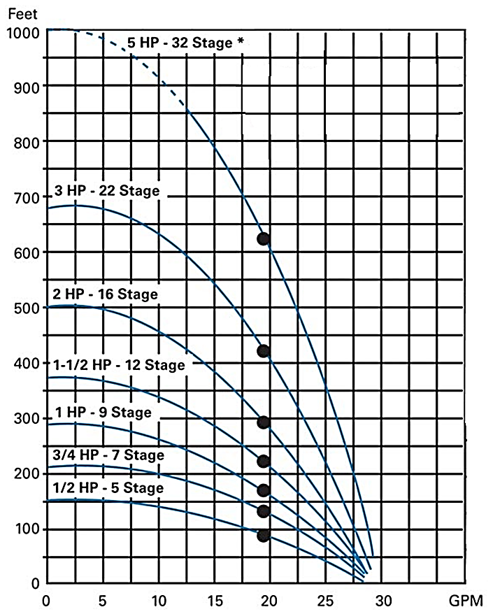
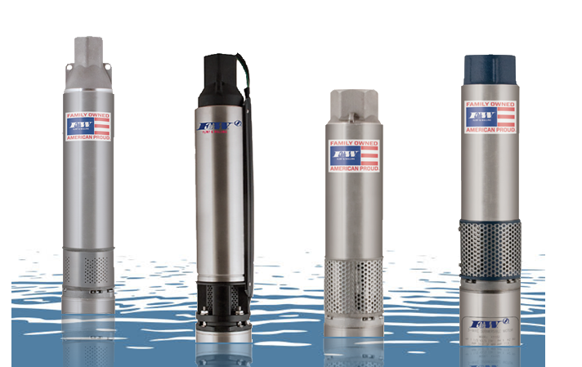
5
Zone 4
things to know to select a pump
gpm
How it works is simple…
fill in five blanks.
As the blanks get filled-in, explanation will be provided for each “room” in the house, so you know what to look for.
Pressure
Friction
psi
psi
(loss)
Pumping level
Elevation
ft.
ft.
dp

Slide 3
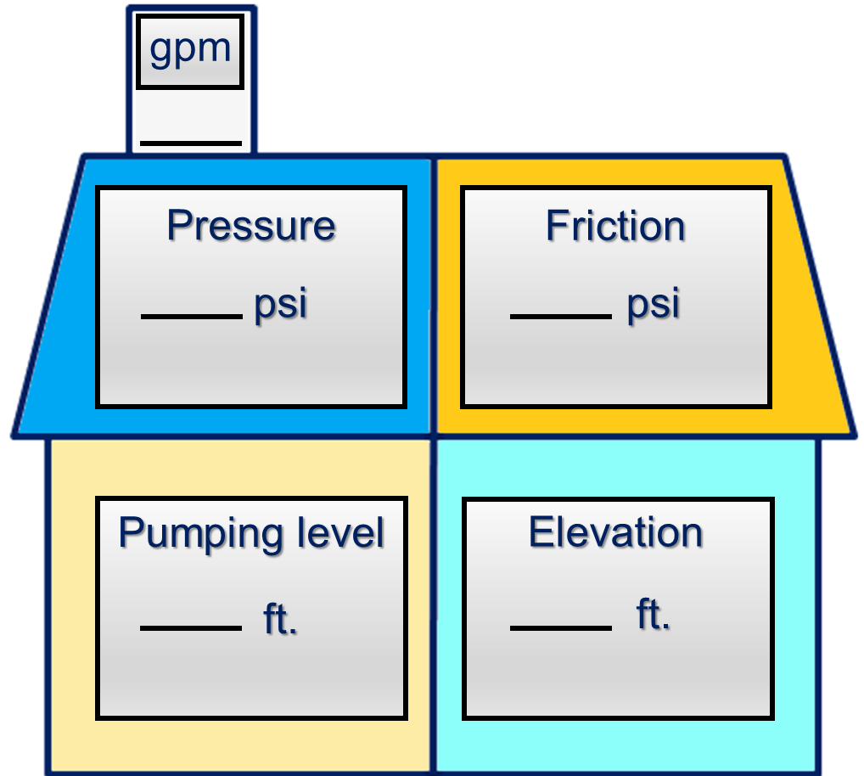
Zone 4
gallons per minute
Represents the maximum flow rate (gpm) required of the pump.
Submersible Pumps can have broad applications
● Home Water System
● Irrigation System
● Home & Irrigation (both)
various applications will determine the maximum flow rate (gpm).

Slide 4


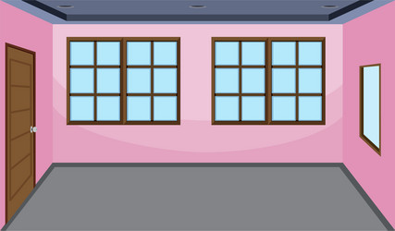



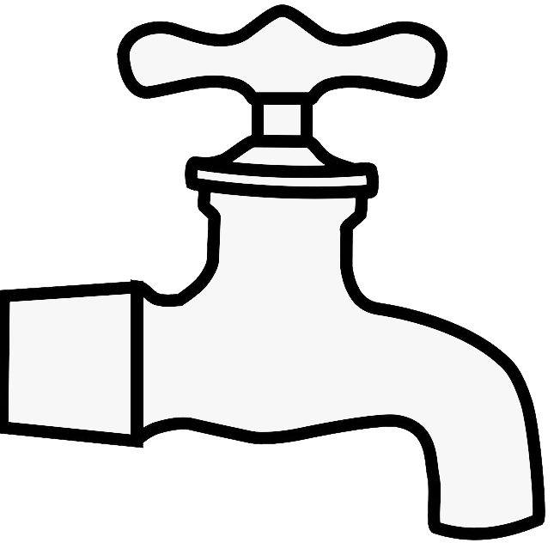
Zone 4
Home Water System
Fixture Count Method
10
The total number of fixtures in the house should equal the gpm rating of the pump.
Full Bath
● Tub/Shower
● Lavatory
● Toilet
2
2
3
Kitchen
● Sink
● Dishwasher
Laundry Room
● Clothes Washer
● Laundry Tub Sink
2
1
+___
½ Bath
● Lavatory
● Toilet
● Outside Hose Bibb
10
total fixtures
10 gpm Maximum Flow Rate

Slide 5
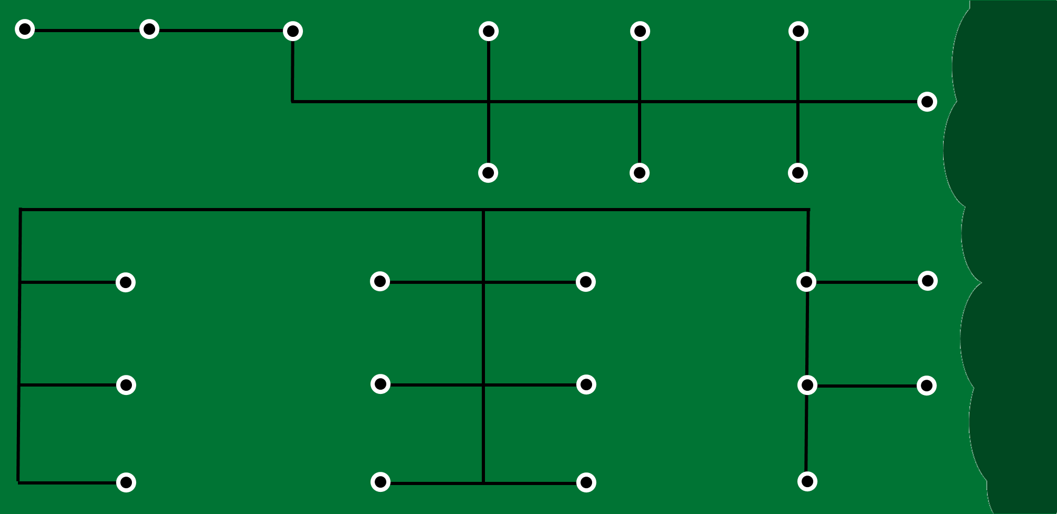




Zone 4
Irrigation System (only)
Zone 5
Zone 4
9 gpm
21 gpm
Maximum Flow Rate
(7 Rotors)
Zone 1
Zone 2
Zone 3
9 gpm
18 gpm
15 gpm

Slide 6
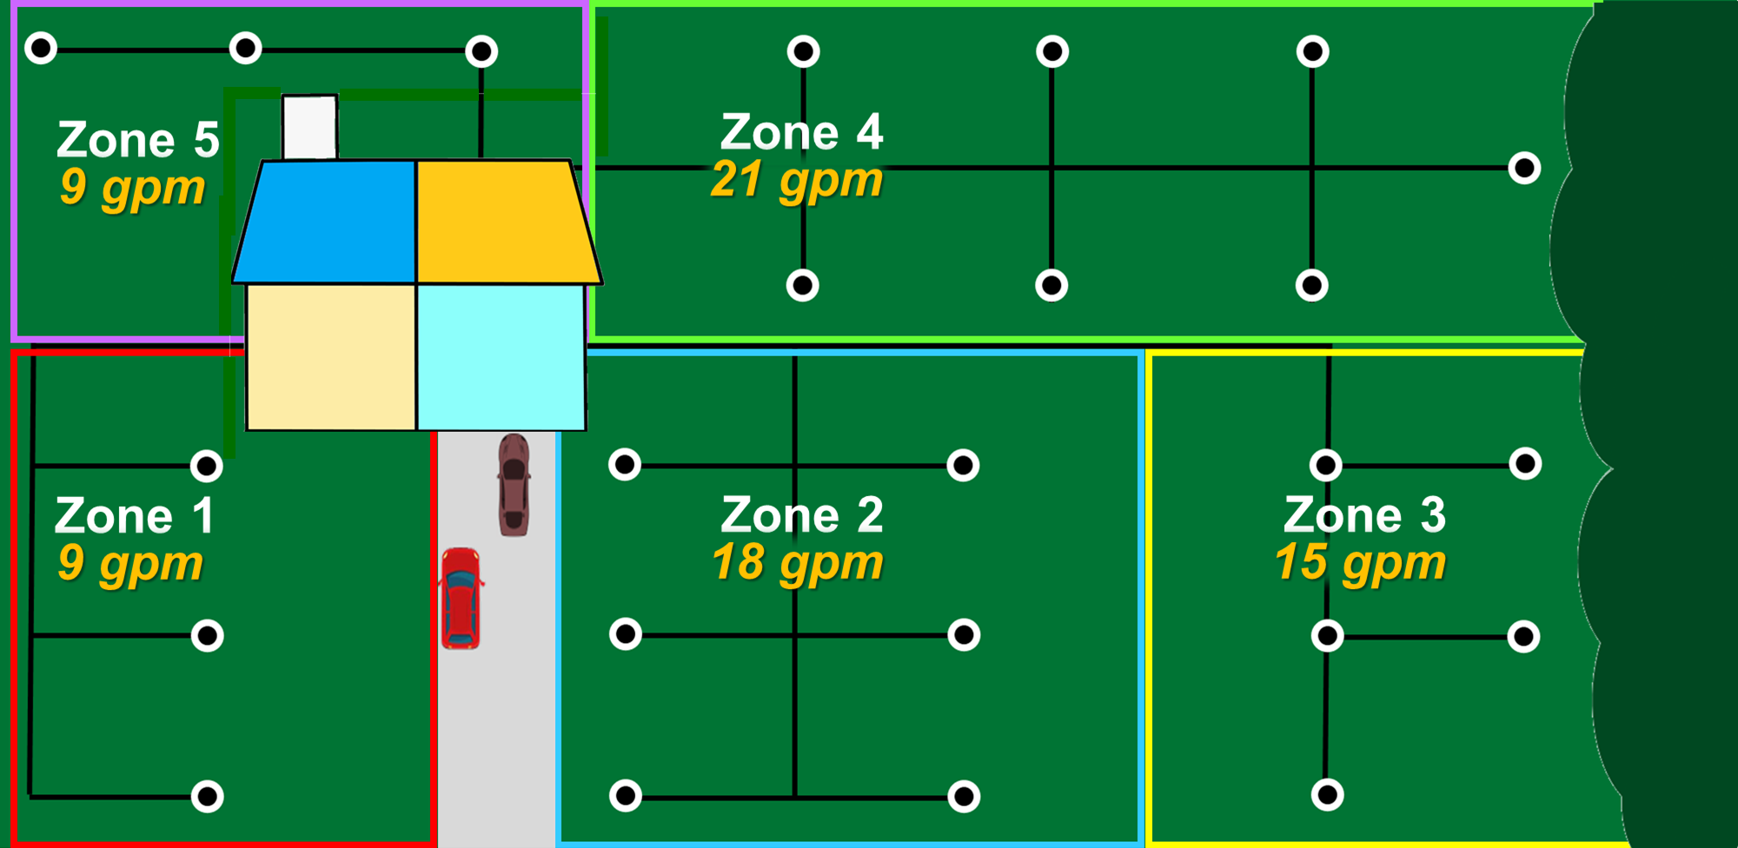

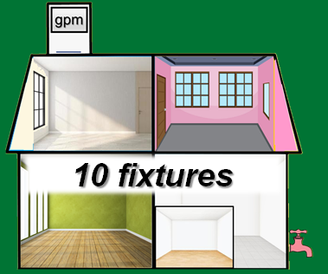
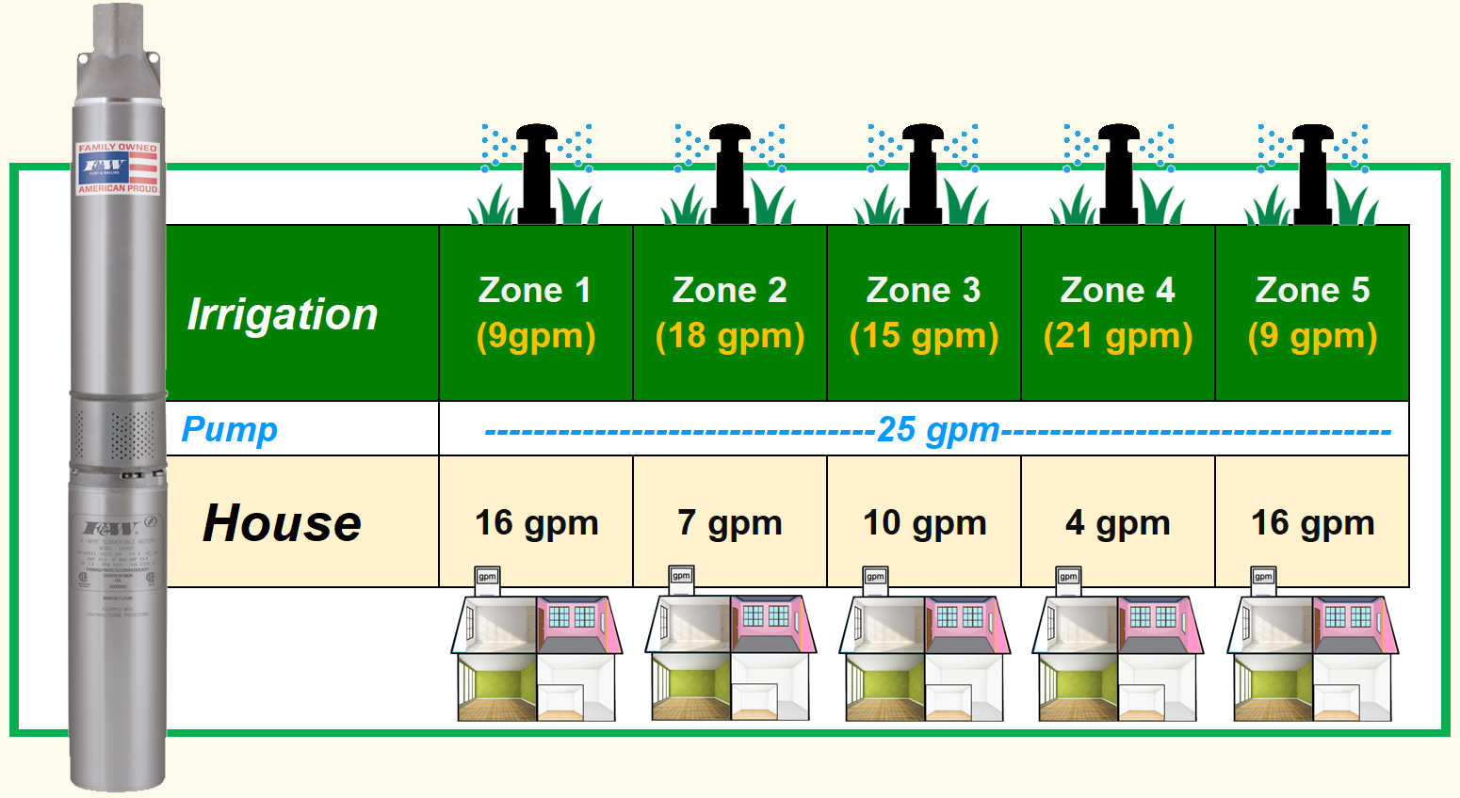
Home Water System and Irrigation
Zone 4
21 gpm
10 gpm
≈25 gpm

Slide 7
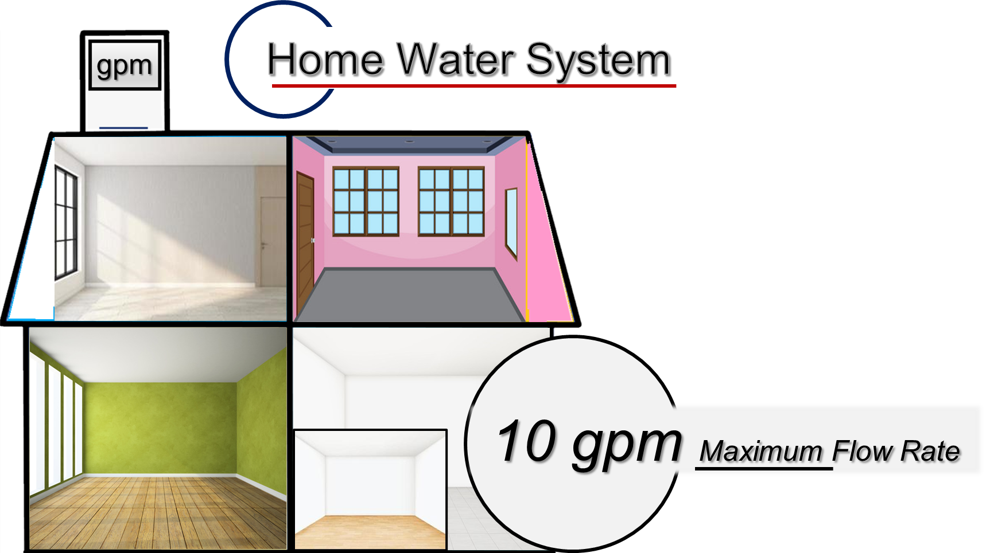
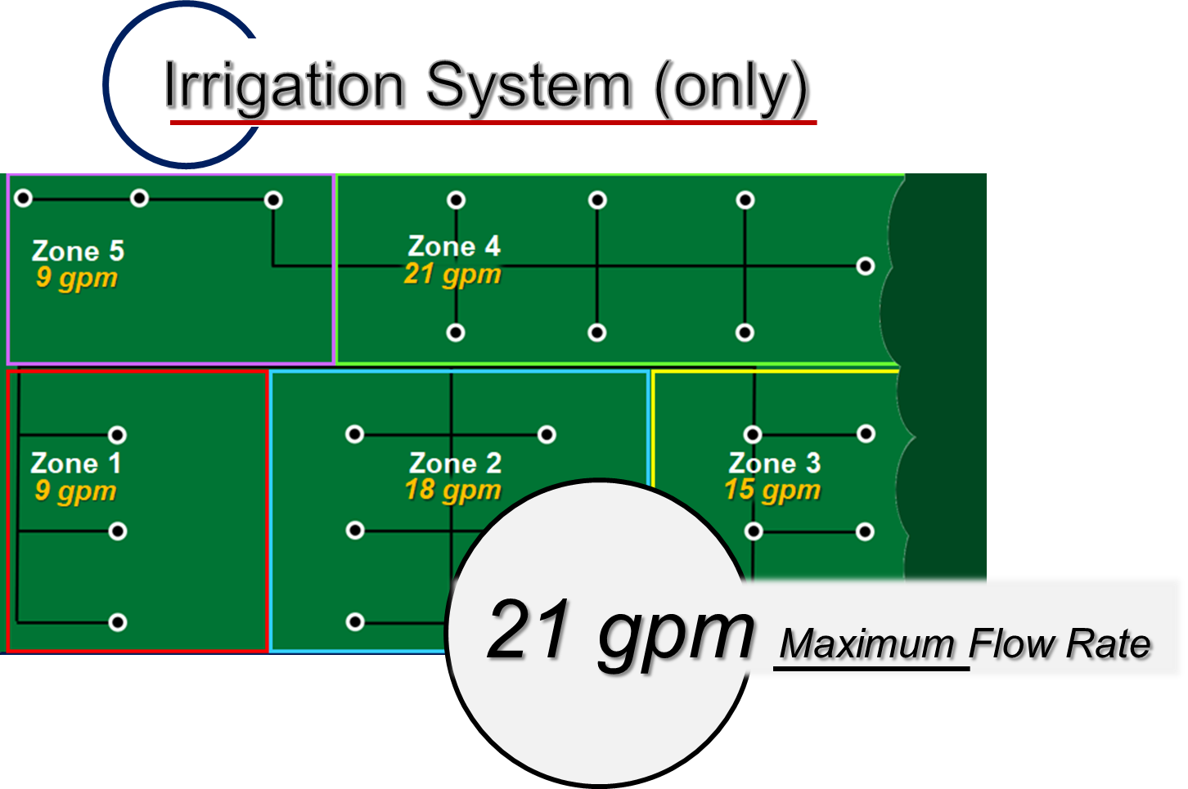
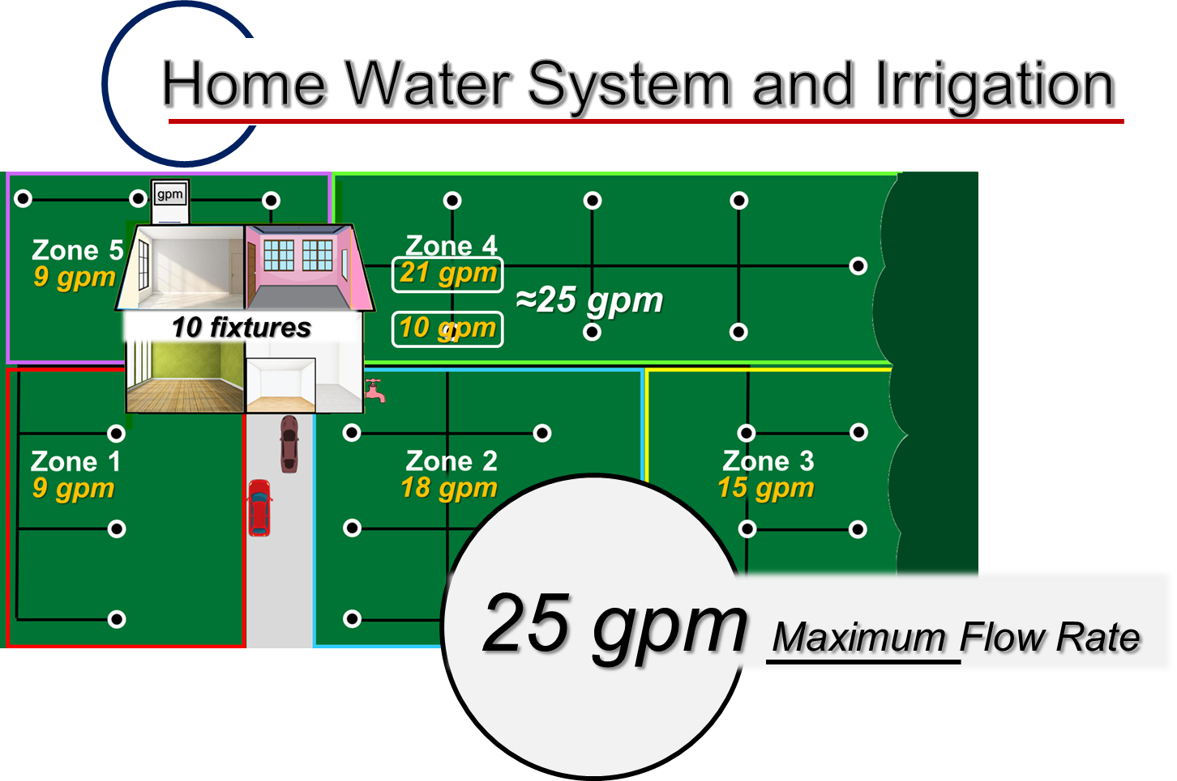
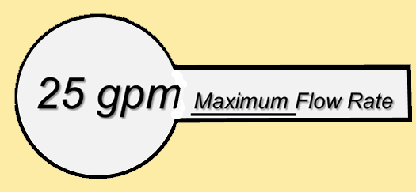
Zone 4
Application

Slide 8

gallons per minute
25

Slide 9

Zone 4
Pressure (psi)
Represents the maximum pressure (psi) required of the pump.
25
50
20psi - 45psi
50psi - 65psi
Irrigation
home water systems

Slide 10
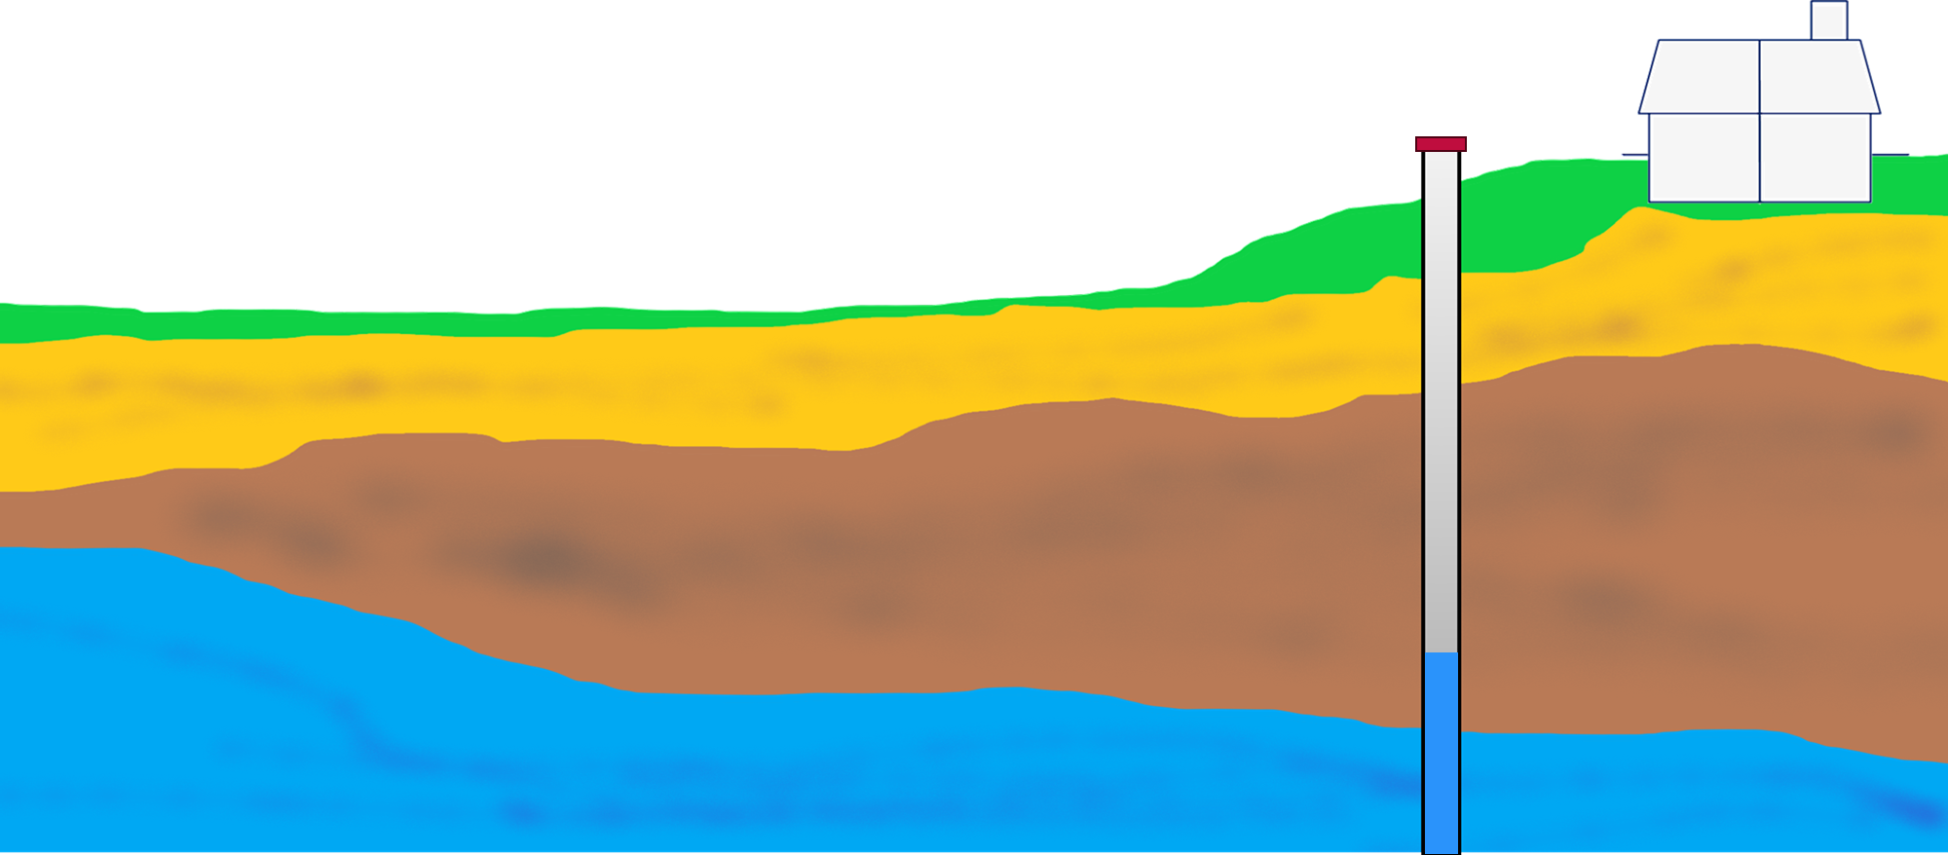

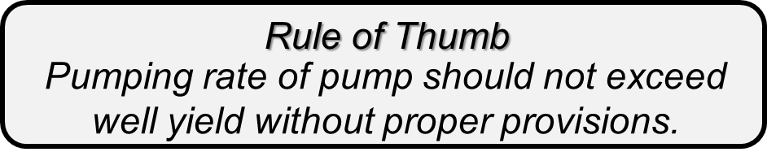
A few things before Pumping Level
Typical well records / logs will include such information as…
25
◦ Well location
◦ Well Diameter
50
◦ Well Depth
◦ Geologic formations
◦ Well Yield (gpm or gph)
◦ Static Water Level

Slide 11
Distance from the surface to water level in well, under non-pumping, undisturbed conditions.
Static Water Level
25
Surface
(ft.)
50
Static Water Level
if less than 25 feet Shallow Well
if more than 25 feet Deep Well

Slide 12



Distance from the surface to water level in well while the pump is running.
Static Water Level
Drawdown (ft.)
25
Surface
50
Static Water Level
Drawdown

Slide 13
Pumping Level
is a portion of the “resistance” that the pump must overcome.
25
Surface
50
58
Where the pump will set.
(ft.)
Pumping Level

Slide 14
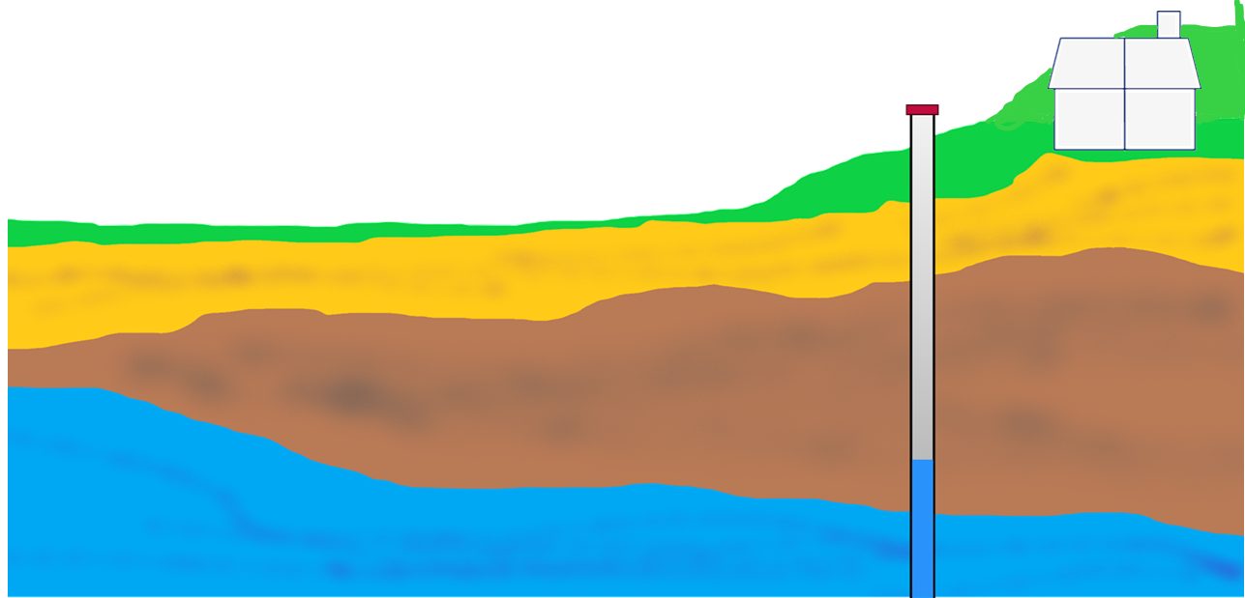

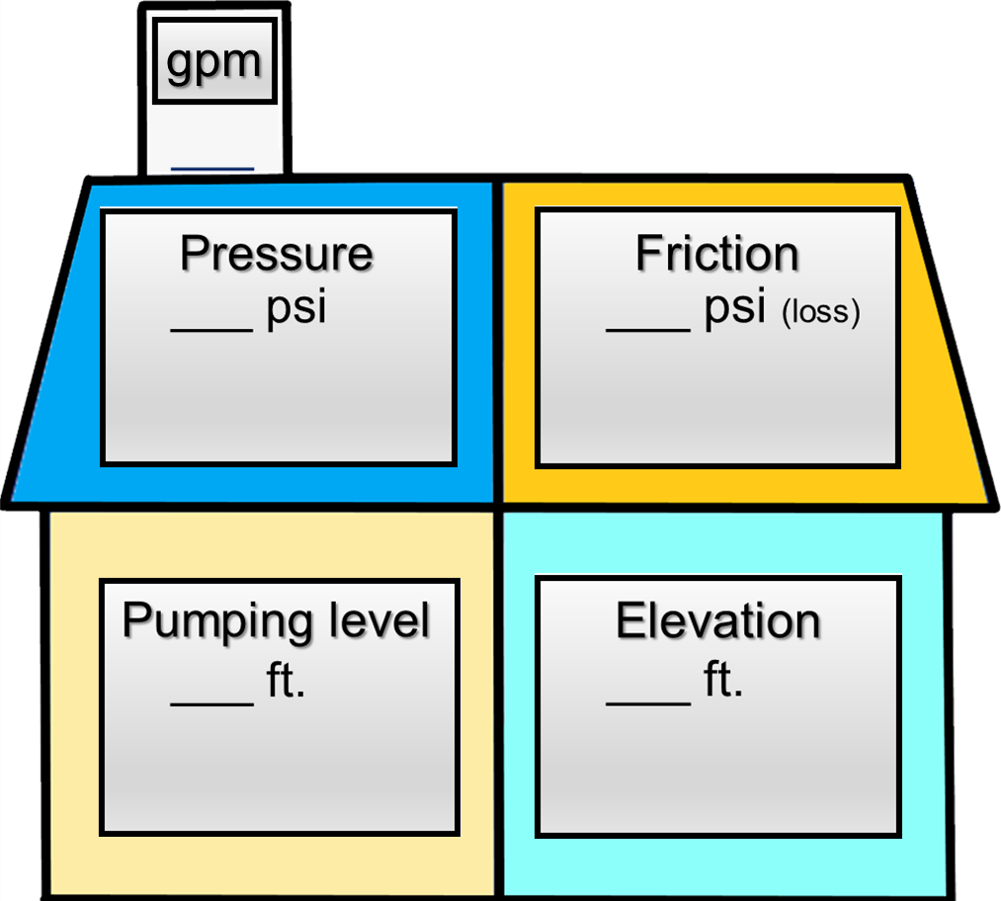

the vertical distance from the surface to the pressure tank.
Elevation (ft.)
the vertical distance from the surface to highest point in the irrigation system
25
Surface
Irrigation System
50
Home Water System
Example: 6 feet
58
6

Slide 15

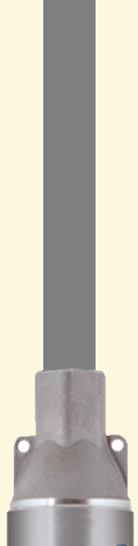
occurs anytime two surfaces pass by one another
Friction – (psi loss)
25
50
To determine how much pressure we’re going lose due to friction
Use Friction Loss Charts to calculate (psi loss)
58
6

Slide 16
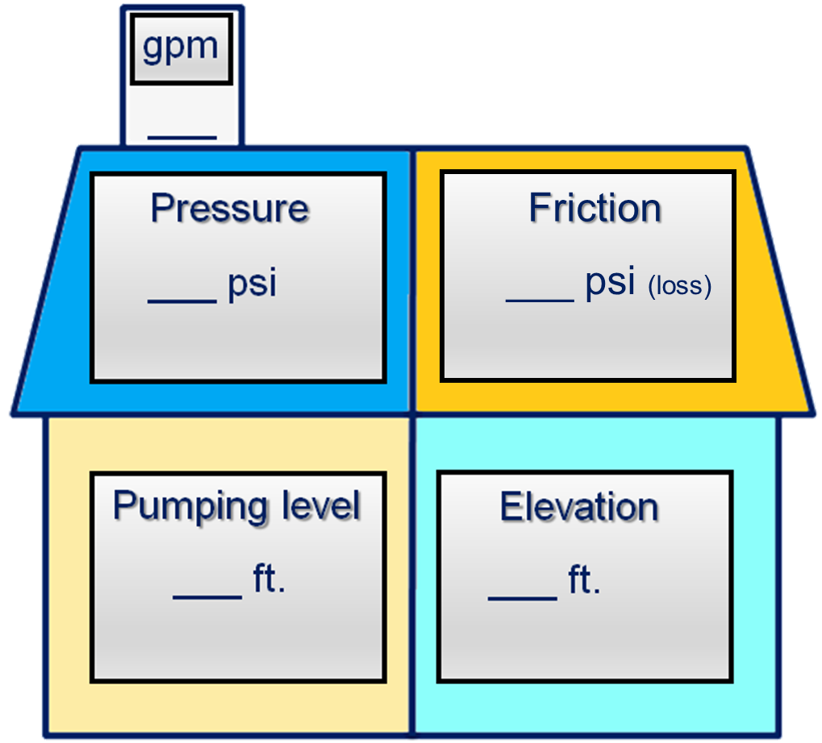
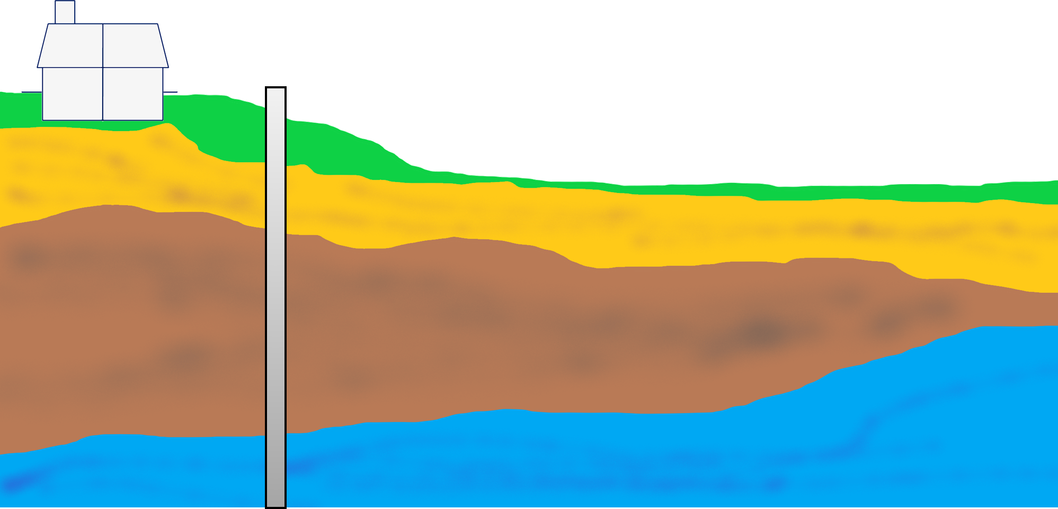
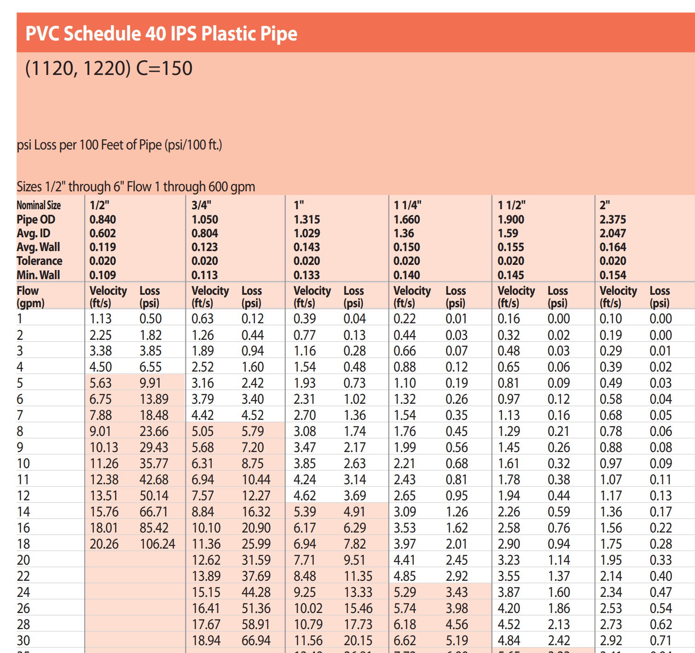
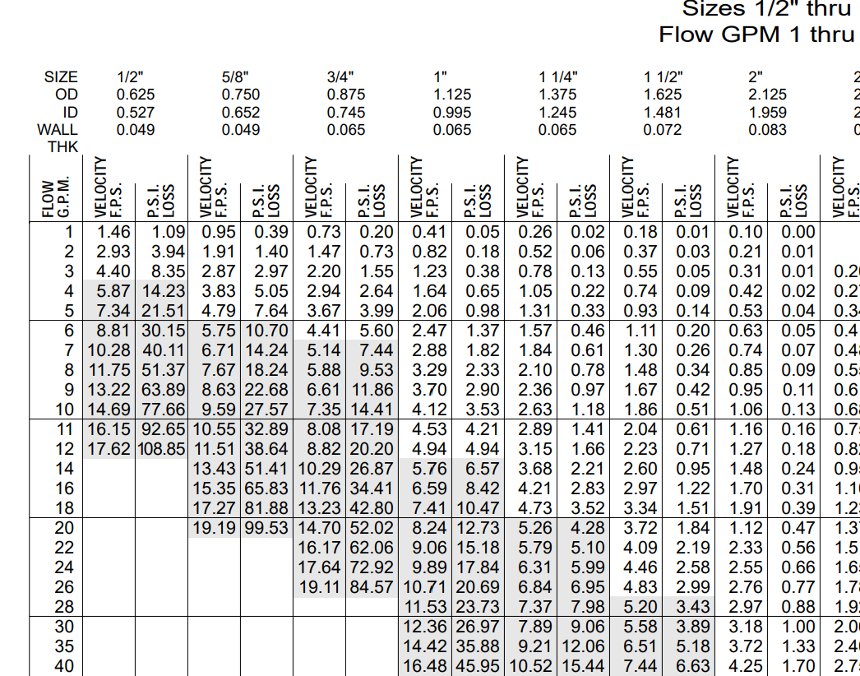
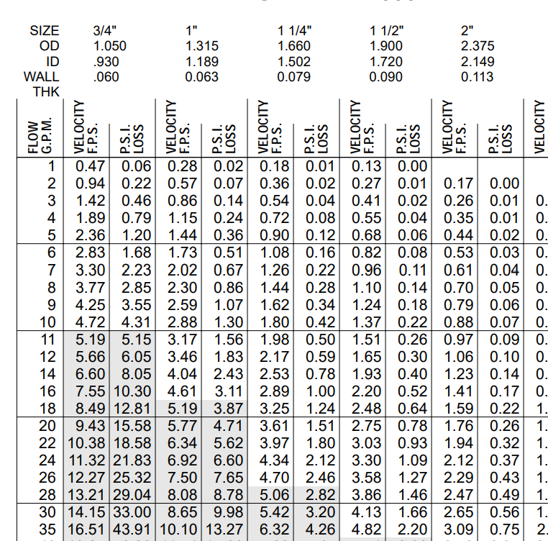
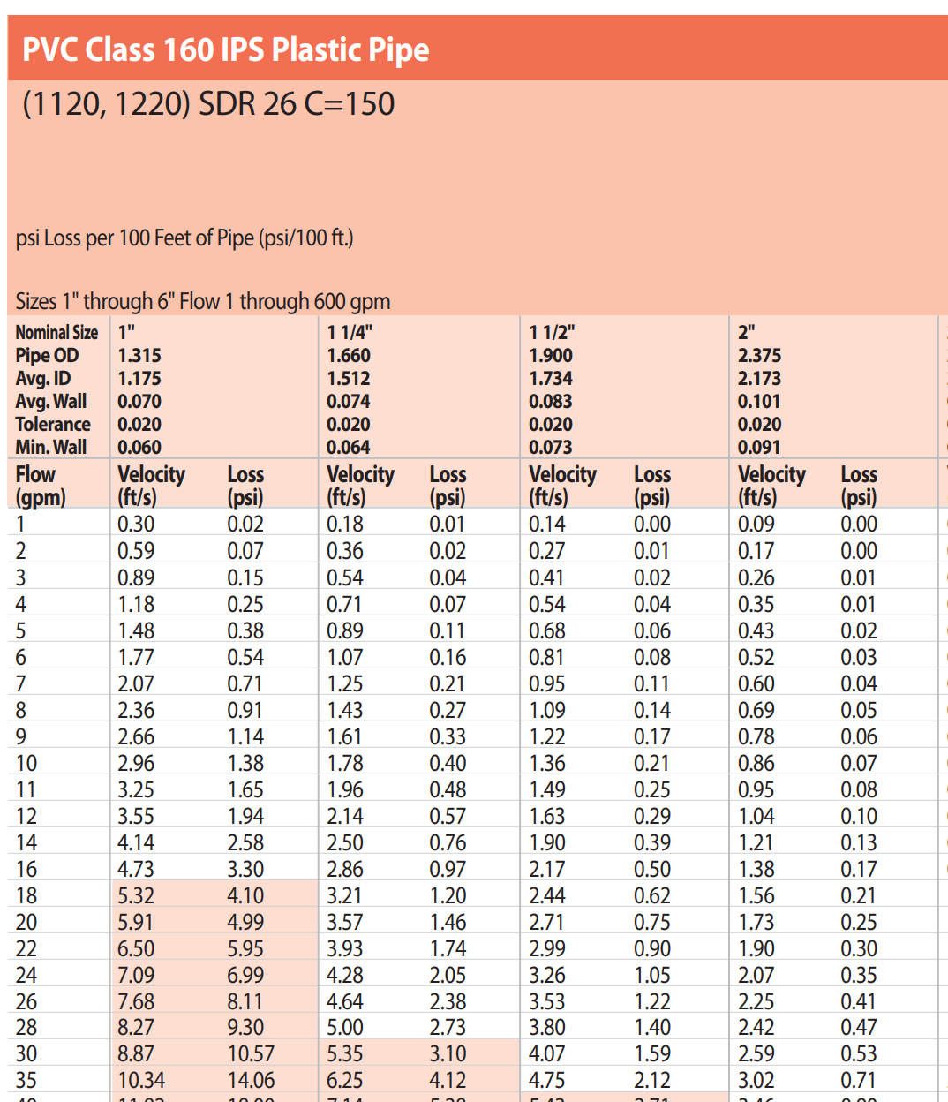
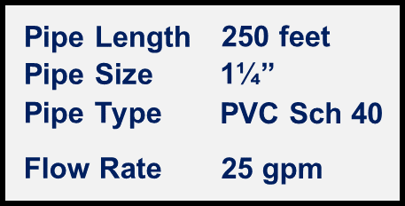

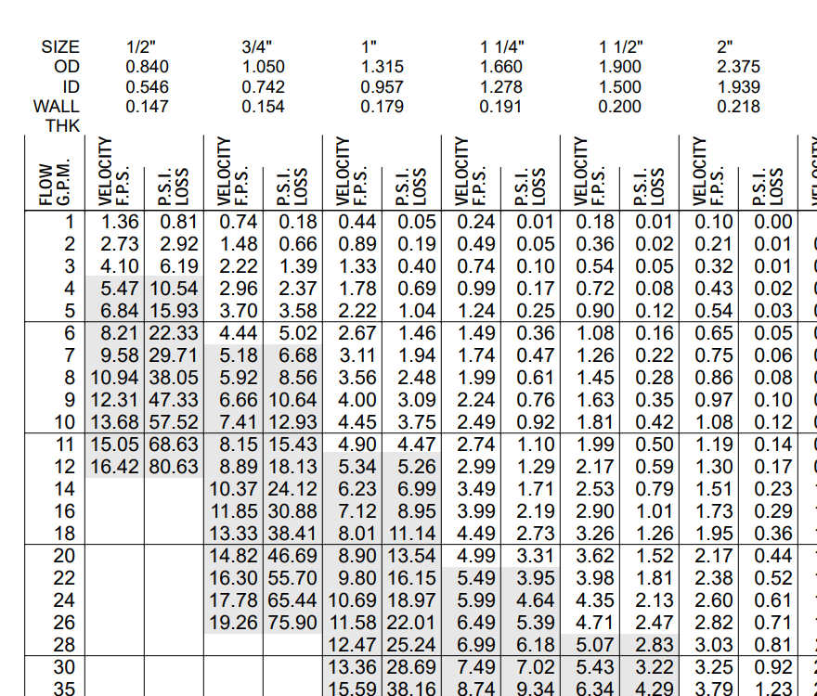
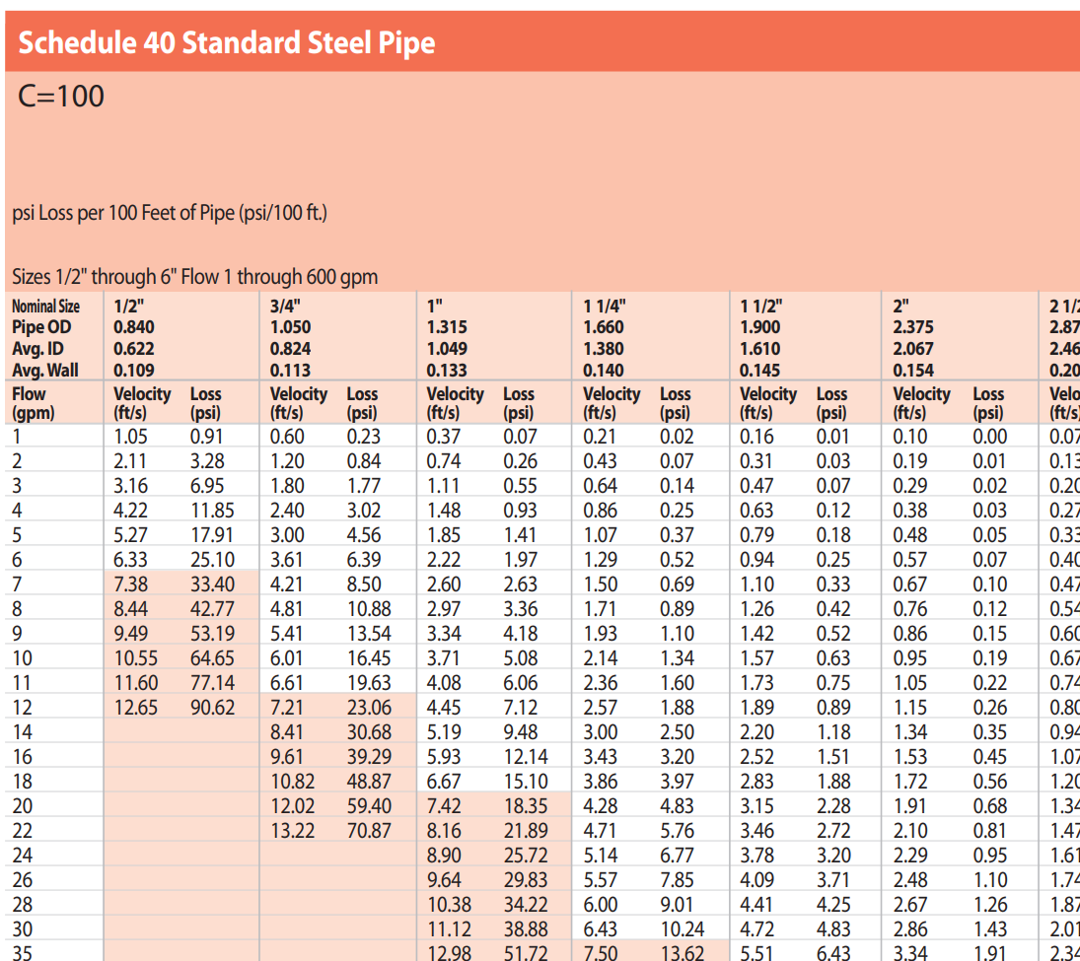
Zone 5 3 Rotors
How to read a Friction Loss chart
25
Zone 4 7 Rotors
what you need to know
Flow Rate
(gpm)
Pipe Length
Pipe Size
Pipe Type
50
50’
100’
150’
200’
250’
300’
350’
400’
500’
0.75”
1.00”
1.25”
1.50”
2.00”
PVC/SCH 40
PVC/SCH 80
PVC/SCH 120
POLY
SDR-21
SDR-26
SCH 40 Steel
25 gpm
Zone 1 3 Rotors
Zone 2 6 Rotors
58
6

Slide 17
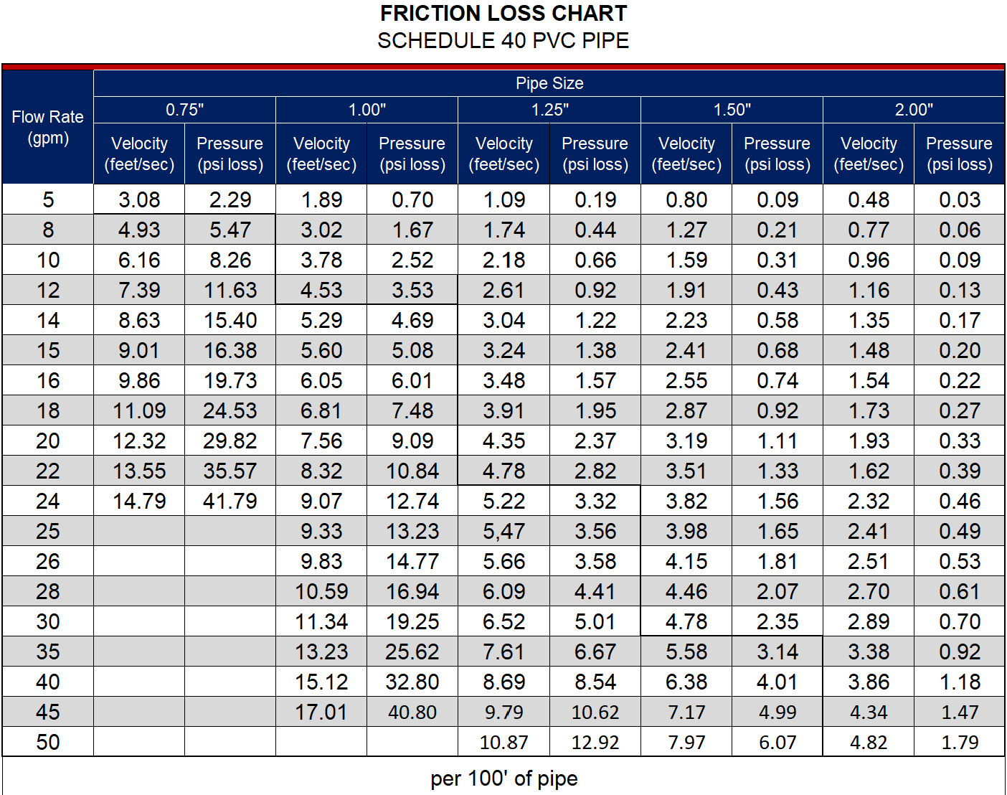
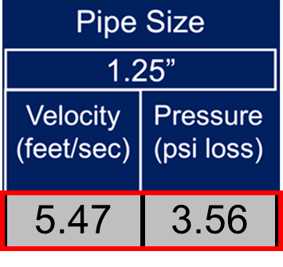
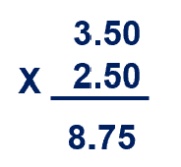
Pipe Type
Flow Rate
(gpm)
Pipe Size
Lose about 3½ psi per 100 ft. of 1¼” pipe
Velocity
(feet/sec)
Pressure
(psi loss)
Lose about 9 psi in 250 feet of 1¼” pipe
25 gpm flowing through 1.25” pipe, will move at a speed of 5.47 feet per second, per 100’ of pipe
25 gpm flowing through 1.25” pipe, will lose 3.56 psi per 100’ of pipe
Friction Loss
9 psi

Slide 18
Friction – (psi loss)
25
50
9
58
6
Friction Loss
9 psi

Slide 19
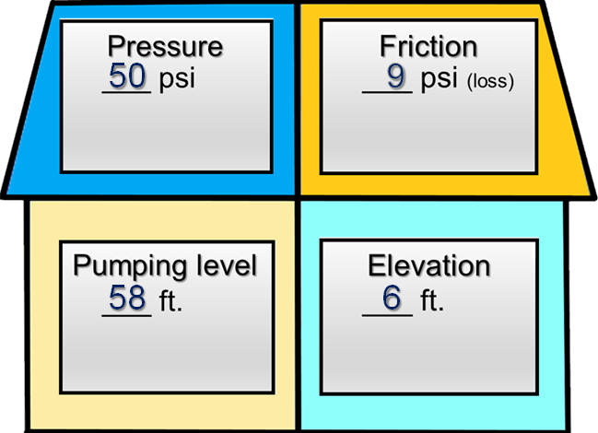


The House contains all the resistance that the pump will need to overcome
25
50
9
Convert pressure (psi) to feet (ft.)
Add up the total number of feet in house.
58
6

Slide 20
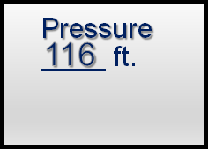
The House contains all the resistance that the pump will need to overcome
Converting Pressure (psi) to Feet (ft)
x 2.31=
25
50
9
50 X 2.31 =
115.5 (116 ft.)
58
6

Slide 21
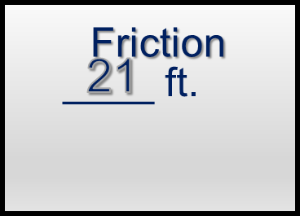
Converting Pressure (psi) to Feet (ft)
x 2.31=
25
50
9
9 X 2.31 =
20.79 (21 ft.)
58
6

Slide 22

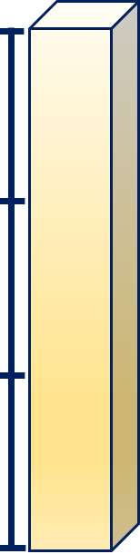
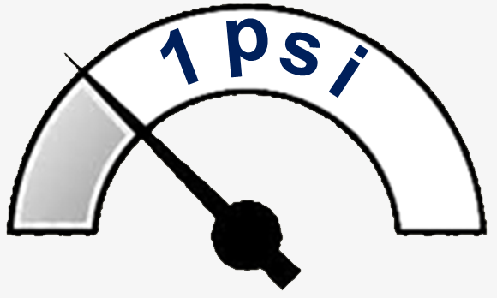
Why x 2.31 ?
25
3 ft
2.31 feet
2 ft
to convert feet to psi
x .433
____ feet x .433 = psi
58
6
1 ft
(116 x .433 = 50.01 psi)
1 psi

Slide 23
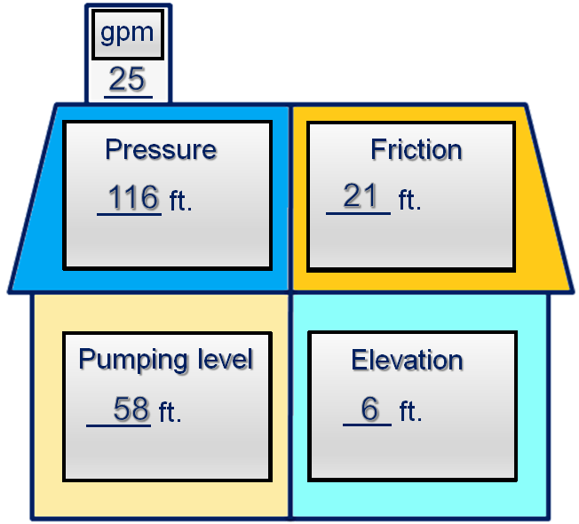
add-up the rooms
Pressure
116 ft.
Pumping level
58 ft.
Elevation
6 ft.
+________
Friction
21 ft.
Total
201 ft.

Slide 24
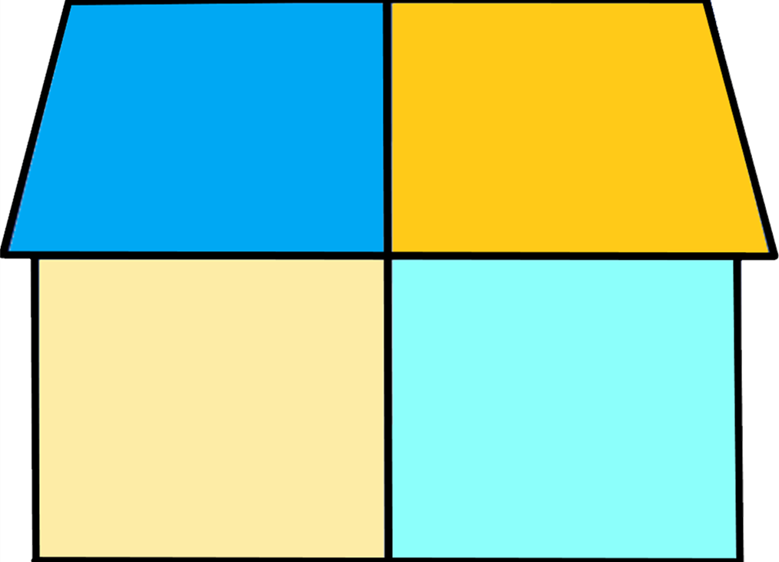
these two numbers
add-up the rooms
25
Gallons per minute
Pressure
116 ft.
Pumping level
58 ft.
Elevation
6 ft.
+________
Friction
21 ft.
Total
201 ft.
Feet

Slide 25

these two numbers
25
Gallons per minute
Are all you need to read a pump curve and size the pump!
a.k.a.
Gallons per minute
Total Dynamic Head
(TDH)
Feet
As your applications change, the house will always provide you with the two numbers.
201 ft.
Feet

Slide 26
How to read a pump curve
these two numbers
Gallons per minute
Feet

Slide 27
How to read a pump curve
Gallons per minute
Feet

Slide 28
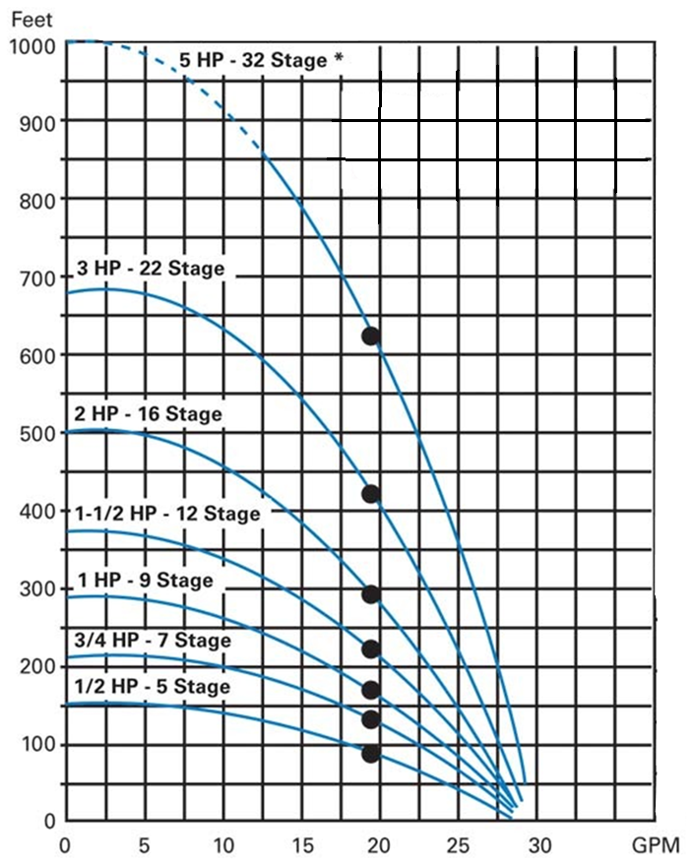
How to read a pump curve
Feet (ft.)
gallons per minute (gpm)

Slide 29
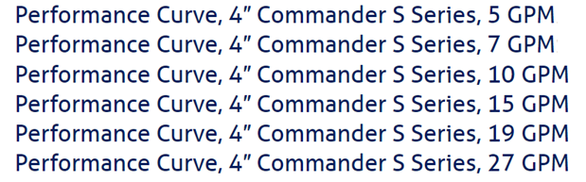
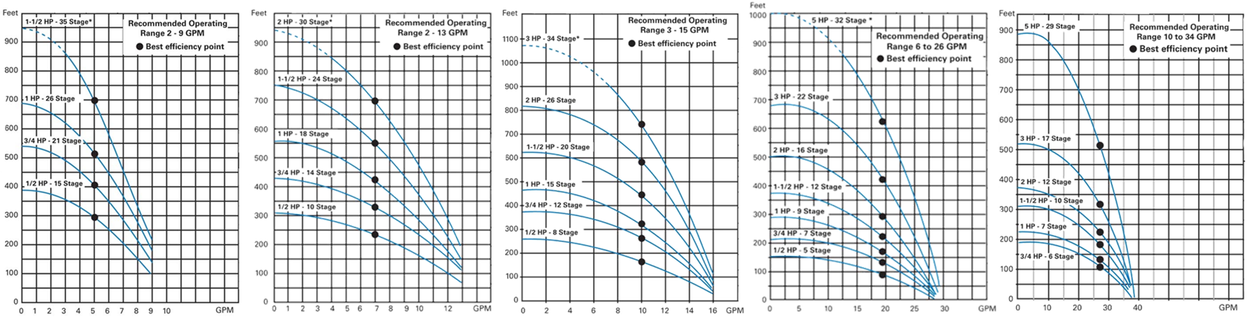
How to read a pump curve
Overload the pump
Overload the motor

Slide 30
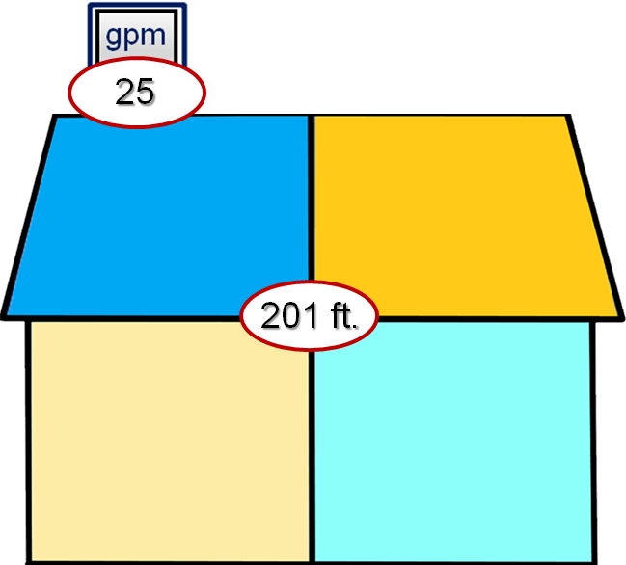
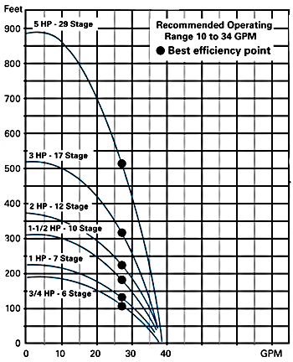
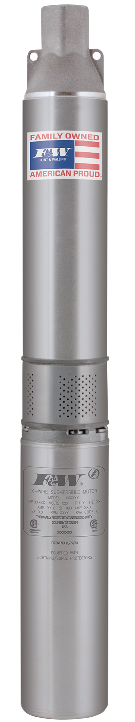
How to read a pump curve
1½ hp 27gpm Sub
25 gpm @ 201’
2hp 27gpm Sub
29 gpm @ 201’
resistance

Slide 31

How to read a pump curve
2hp 27gpm Sub
25 gpm @ 250’
resistance

Slide 32

How to read a pump curve

Slide 33
How to read a pump curve
2hp 19gpm Sub
17 gpm @ 350’

Slide 34
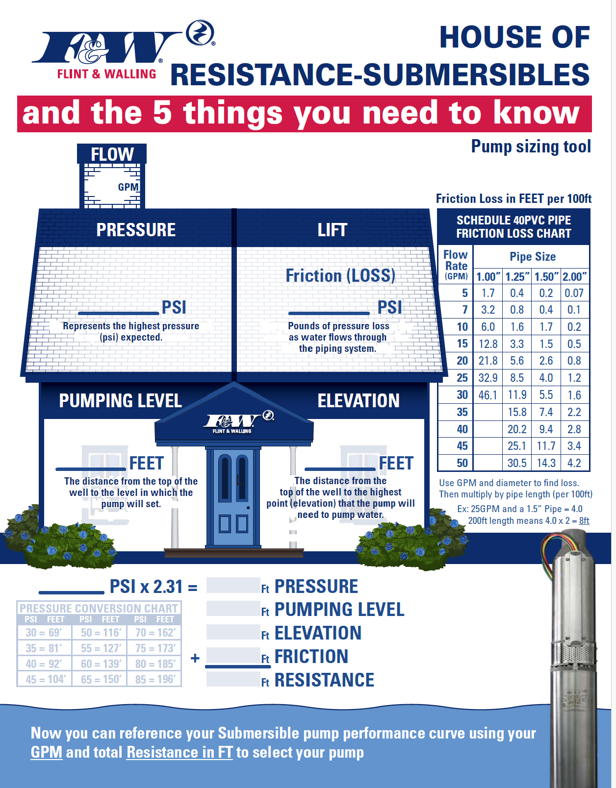
Zone 4
House of Resistance - Subs
…a non-traditional way to pump sizing
so there you have it…
dp

Slide 35
subscribe
https://www.youtube.com/@flintandwalling

