Slide 1

House of Resistance - Centrifugals
track 2C

Slide 2
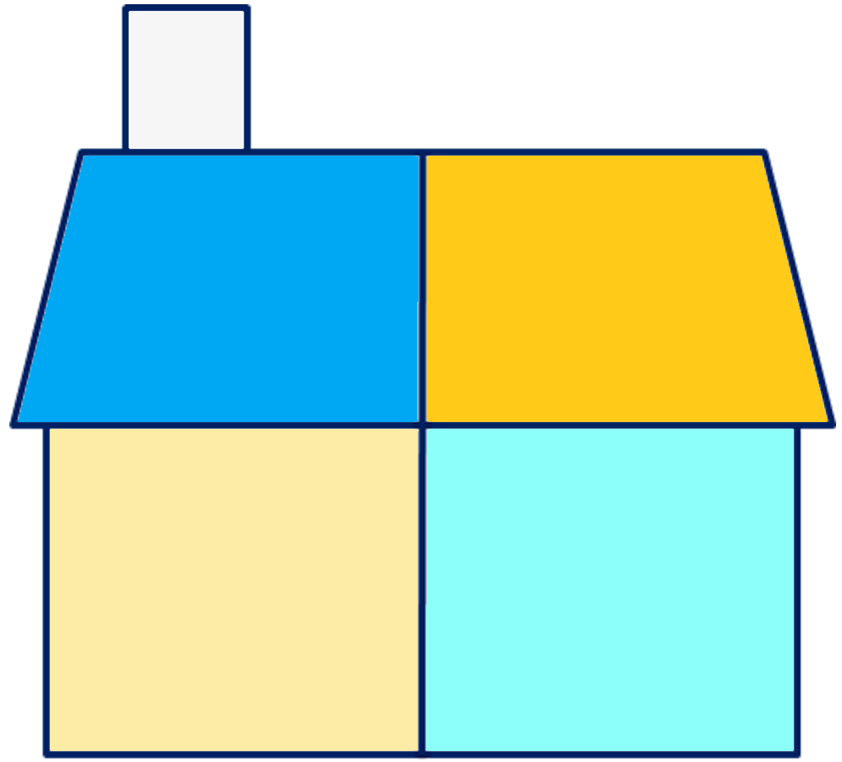
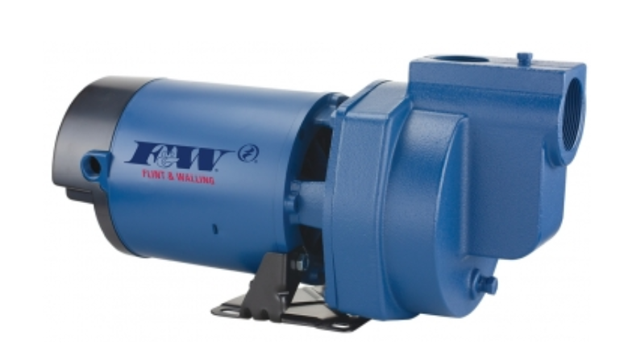
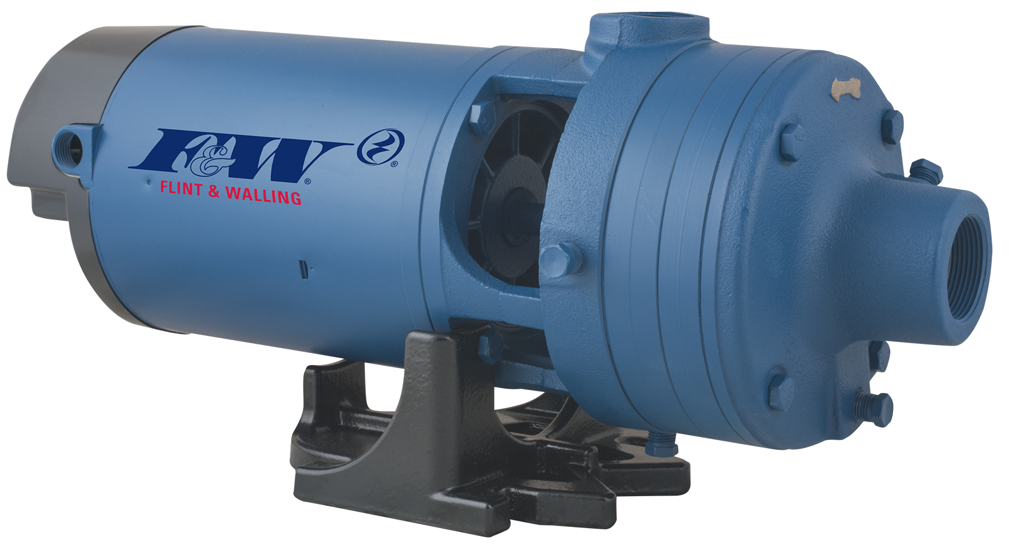

House of Resistance - Centrifugals
and Jets
2025
virtual training

Slide 3
5
things to know to select a pump
gpm
How it works is simple…
fill in five blanks.
___
explanation will be provided for each topic in the house, as the blanks get filled-in.
Pressure
Friction
___ psi
___ psi (loss)
Lift
Elevation
___ ft.
___ ft.

Slide 4
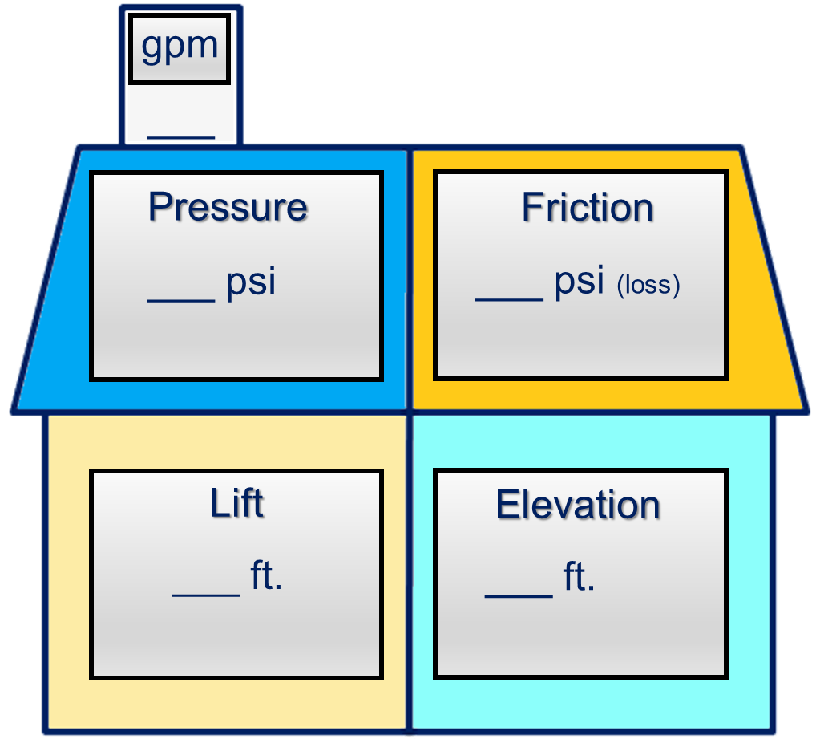
gallons per minute
Represents the maximum flow rate (gpm) required of the pump.
Pump will be sized to the zone(s) that have the greatest demand for water in gpm.

Slide 5
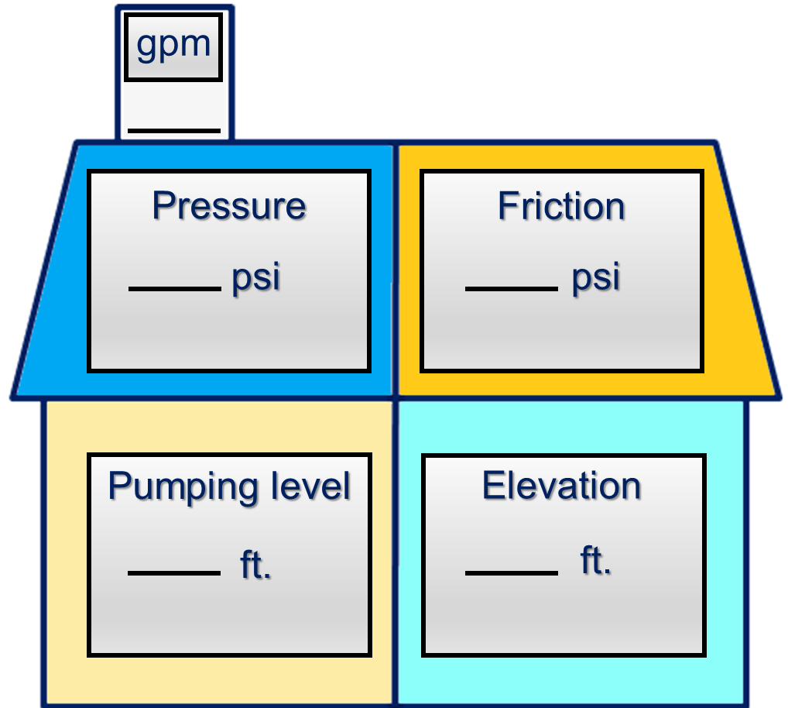


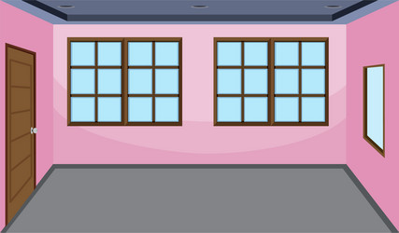



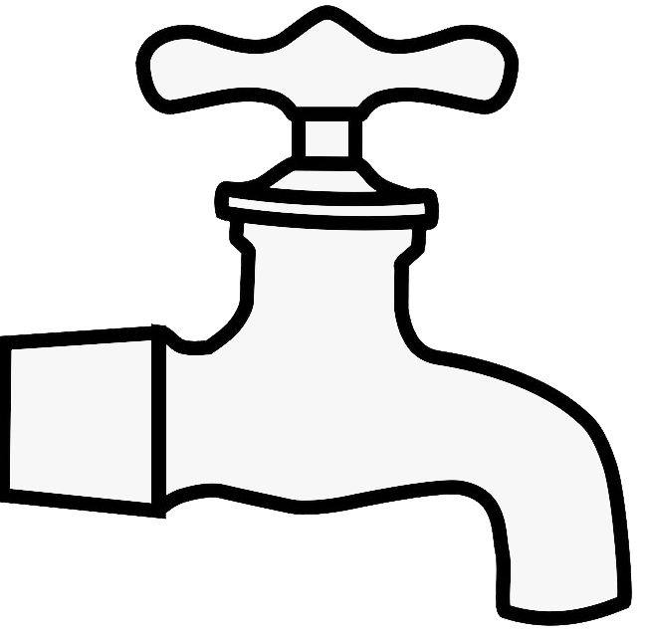
Zone 4
Home Water System
Fixture Count Method
9
The total number of fixtures in the house should equal the gpm rating of the pump.
Full Bath
● Tub/Shower
● Lavatory
● Toilet
2
1
3
Kitchen
● Sink
● Dishwasher
Laundry Room
● Clothes Washer
2
1
+___
½ Bath
● Lavatory
● Toilet
● Outside Hose Bibb
9
9
fixtures
9
gpm

Slide 6
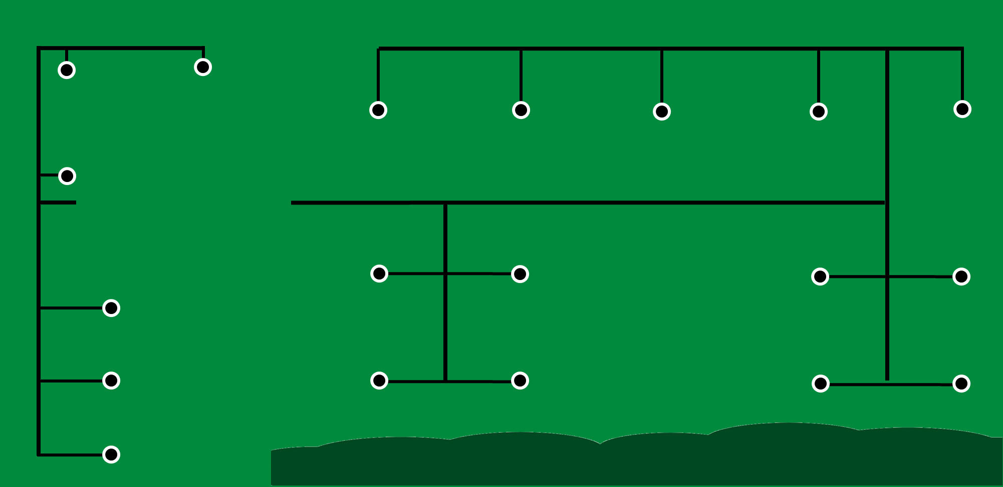



Zone 5
Zone 4
(5 x 3gpm)
15 gpm Maximum Flow Rate
Zone 1
Zone 2
Zone 3
Rotors rated at 3 gpm

Slide 7

Pressure (psi)
Represents the maximum pressure (psi) required of the pump.
15
45
20psi - 45psi
50psi - 65psi
Irrigation
home water systems

Slide 8

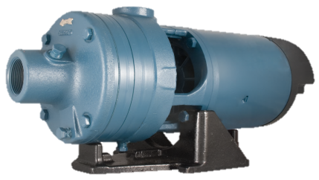

Lift & Elevation
Both expressed as feet.
Vertical Distances Only
15
Elevation – from pump to highest
point in the system
Pressure
Friction
45
Lift – from pump to
water source
___ psi
___ psi (loss)
25 ft.
5
25
5 ft.

Slide 9
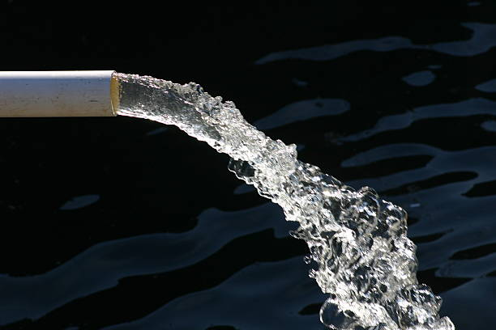
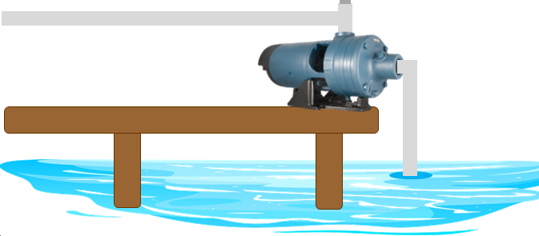
Occurs anytime two surfaces pass by one another.
Friction (psi loss)
15
45
Use Friction Loss Charts to determine (psi loss)
5
25

Slide 10
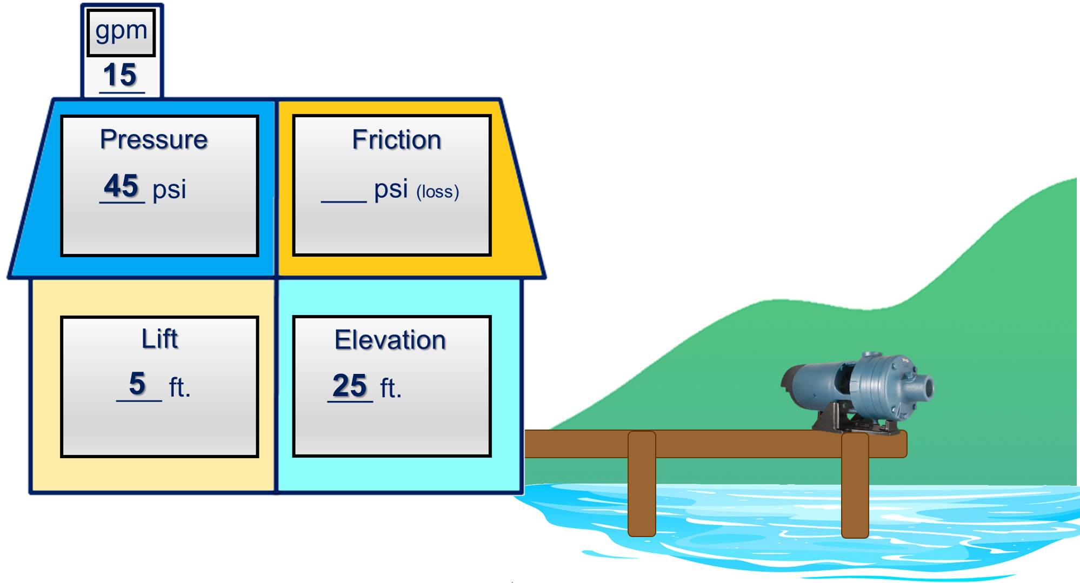
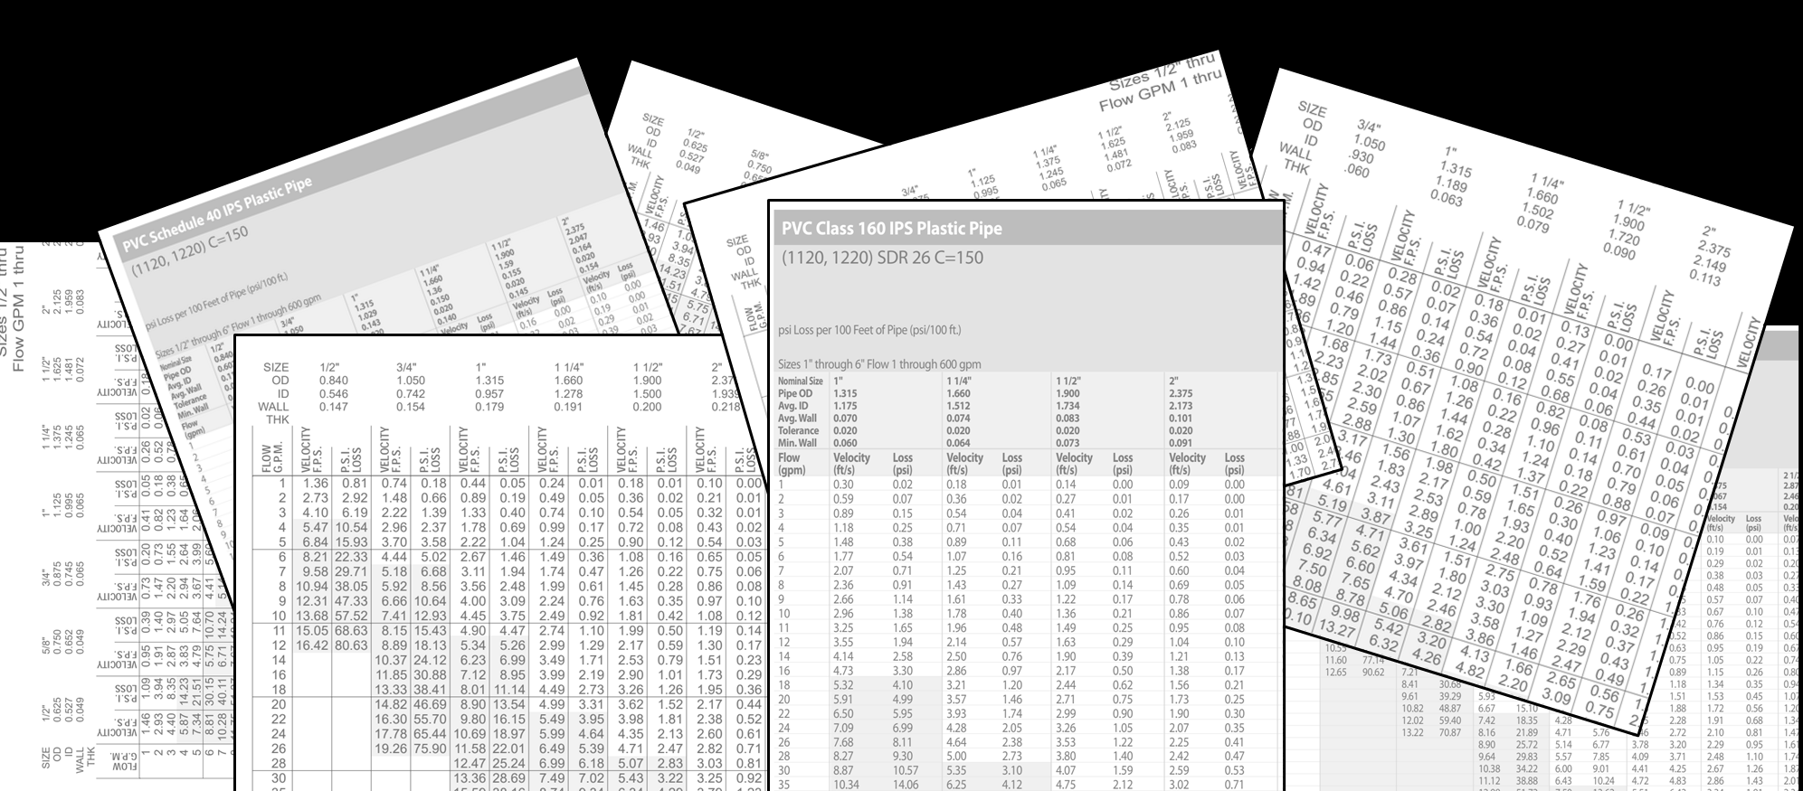
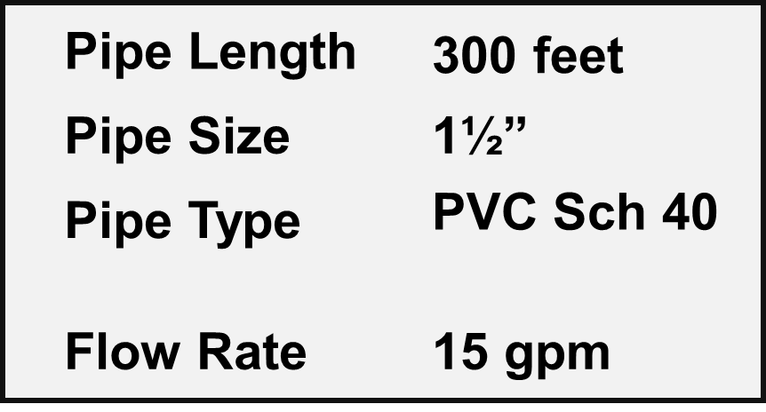

How to read a Friction Loss chart
what you need to know
Flow Rate
(gpm)
Pipe Type
Pipe Size
Pipe Length
50’
100’
150’
200’
250’
300’
350’
400’
500’
PVC/SCH 40
PVC/SCH 80
PVC/SCH 120
POLY
SDR-21
SDR-26
SCH 40 Steel
0.50”
0.75”
1.00”
1.25”
1.50”
2.00”
3.00”
4.00”
15 gpm

Slide 11
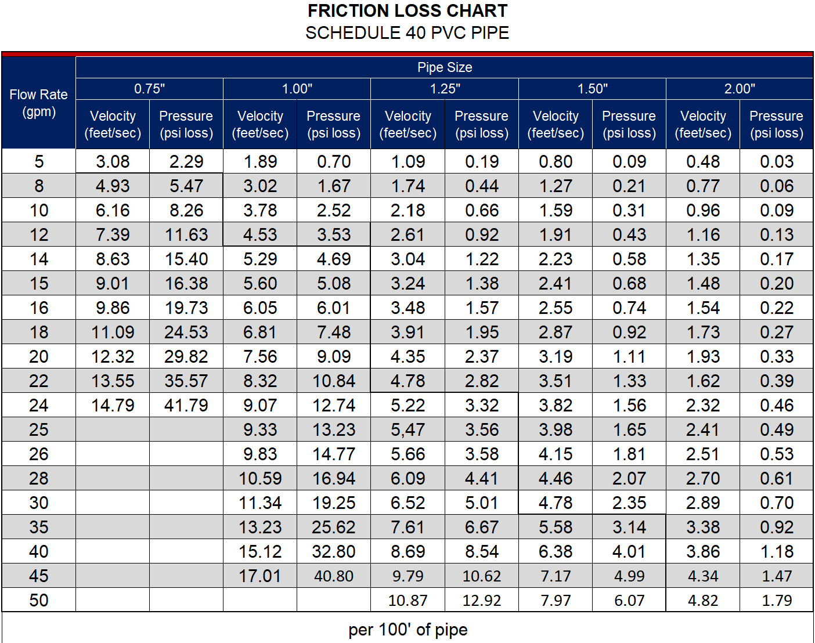
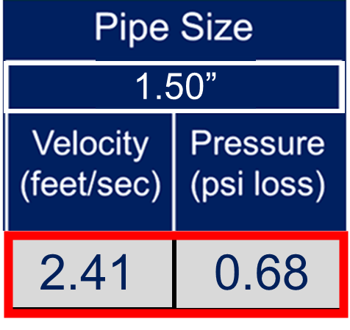
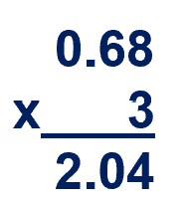
Pipe Type
Flow Rate
(gpm)
Pipe Size
Lose 0.68 psi / 100 ft
Lose 2 psi / 300 ft
Velocity
(feet/sec)
Pressure
(psi loss)
Friction Loss
2 psi
15 gpm flowing through 1.50” pipe, will move at a speed of 2.41 feet per second, per 100’ of pipe
15 gpm flowing through 1.50” pipe, will lose 0.68 psi per 100’ of pipe

Slide 12
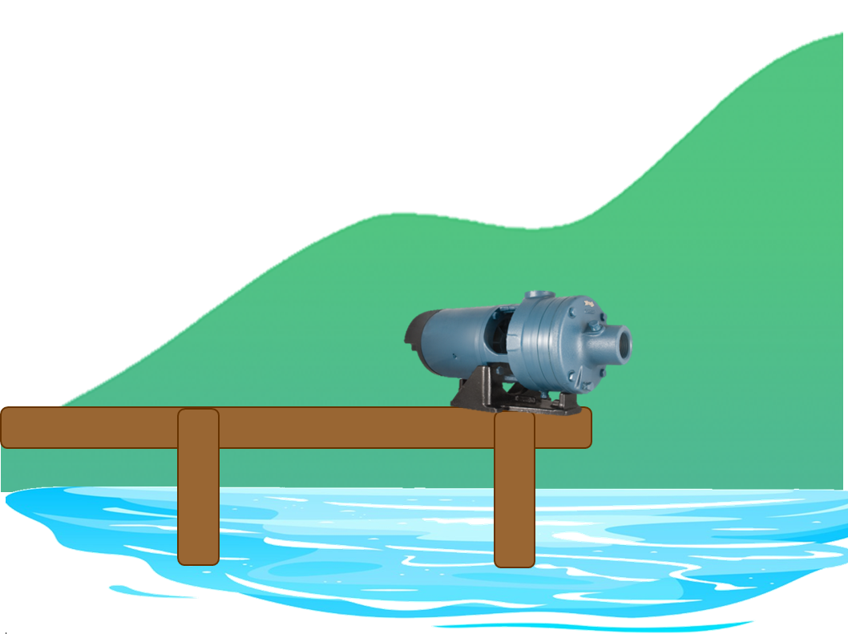
Zone 5 3 Rotors
Friction (psi loss)
15
Zone 4 7 Rotors
45
2
Friction Loss
2 psi
5
25

Slide 13
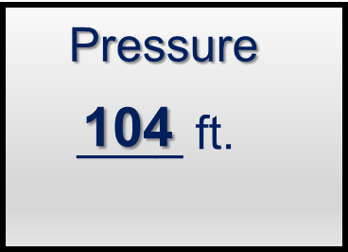
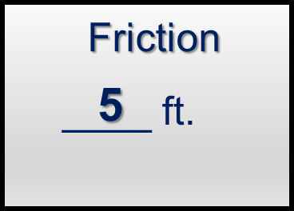
Zone 5 3 Rotors
Convert Pressure (psi) to Feet (ft)
x 2.31=
15
Pressure
Friction
45
psi
2
psi (loss)
45
2
x 2.31
x 2.31
103.95
4.62
104
5
____ ft.
____ ft.
5
25
why is 2.31 the multiplier?

Slide 14
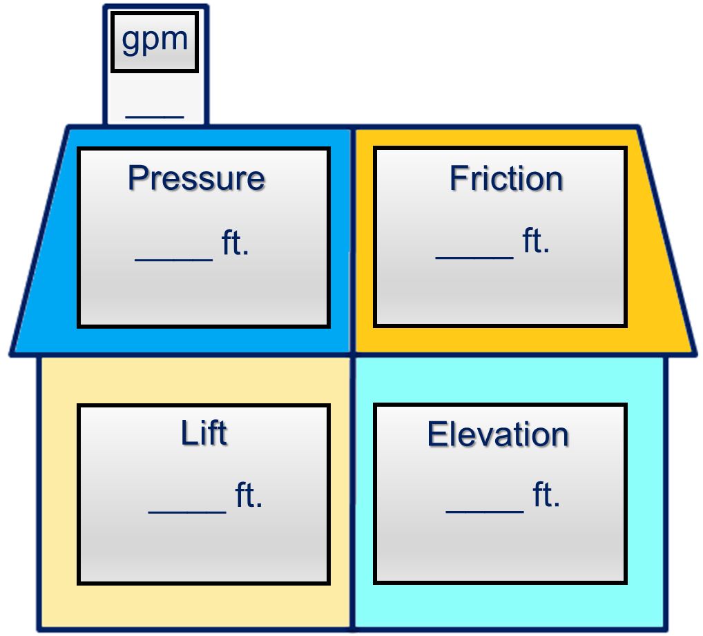

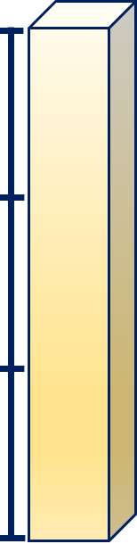
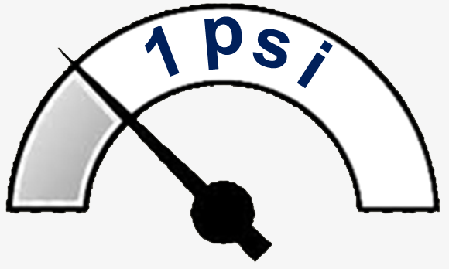
Zone 5 3 Rotors
Convert Pressure (psi) to Feet (ft)
x 2.31=
15
3 ft
to convert feet to psi
x .433
104
5
2.31 feet
____ feet x .433 = psi
2 ft
(104 x .433 = 45.02 psi)
5
25
1 psi = 2.31 ft.
1 ft
1 psi

Slide 15
Zone 5 3 Rotors
House contains resistance that pump must overcome
15
Zone 4 7 Rotors
all blanks are filled-in
104
5
5
25

Slide 16
Zone 5 3 Rotors
Time to total-up the house
15
Zone 4 7 Rotors
Pressure 104
Lift 5
104
5
Elevation 25
Friction 5
+ ___
139 feet
5
25

Slide 17
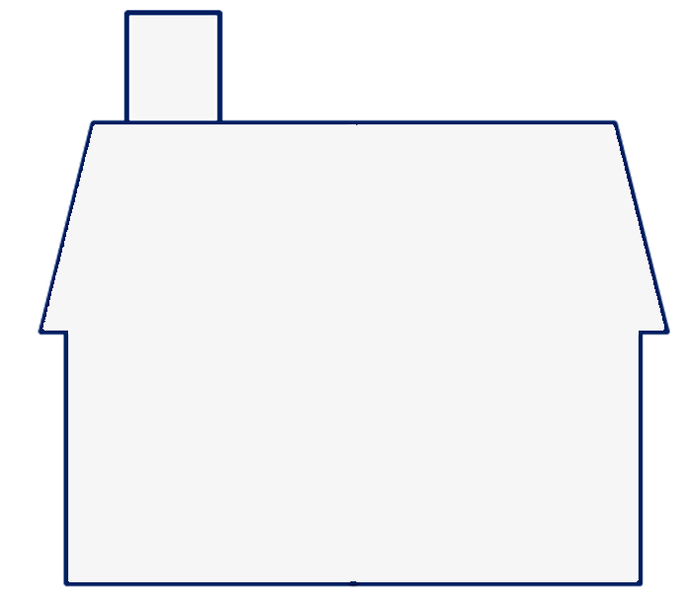
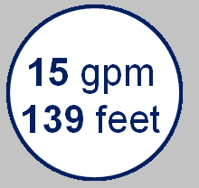
gpm
These two numbers
15
___
we can look at a pump curve and select a pump
Referred to as
Total Dynamic Head (TDH)
139 feet

Slide 18
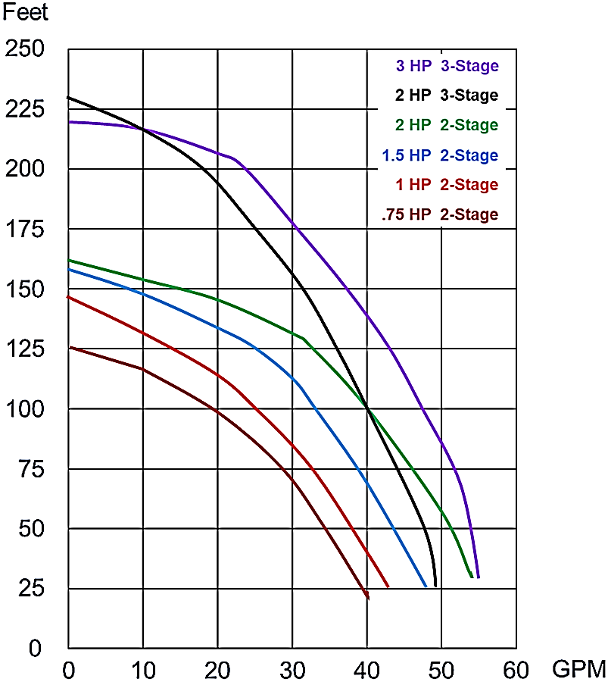
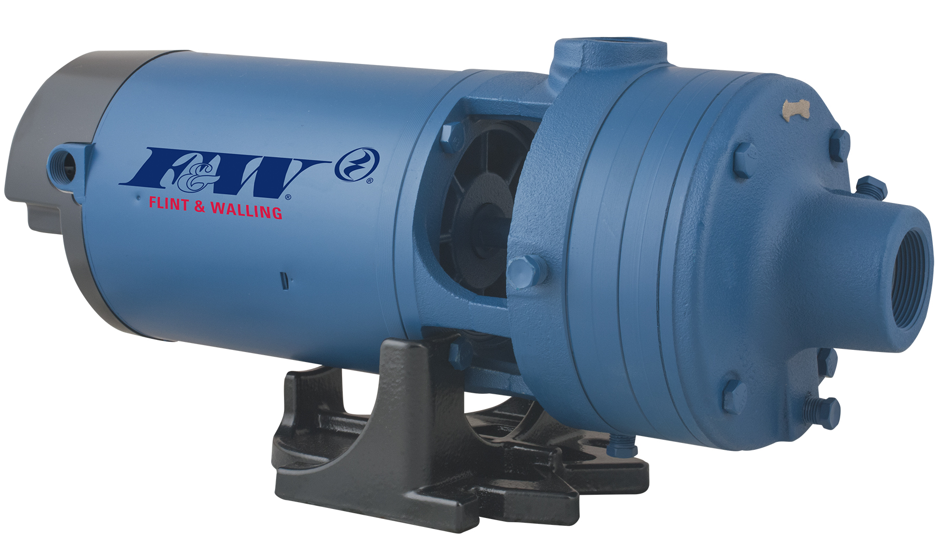
How to read a pump curve
At 139 feet
5 gpm
16 gpm
23 gpm
32 gpm
40 gpm
1½ hp 2-stage

Slide 19
Zone 5 3 Rotors
Time to total-up the house
8 Rotors
25
Zone 4 7 Rotors
50 psi
Pressure 116
Lift 8
116
8
Elevation 18
Friction 8
+ ___
150 feet
8
18

Slide 20
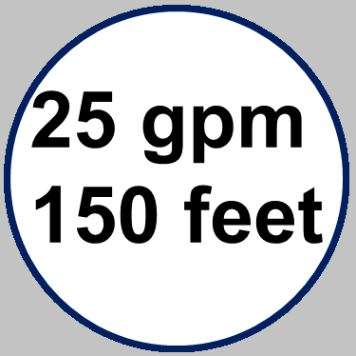
gpm
These two numbers
25
___
At 150 feet
4 gpm
12 gpm
31 gpm
34 gpm
150 feet
2 hp 3-stage

Slide 21
subscribe
https://www.youtube.com/@flintandwalling
track 2B

