Slide 1

High Capacity & Deep-Set Submersible Pumps
track 2C

Slide 2
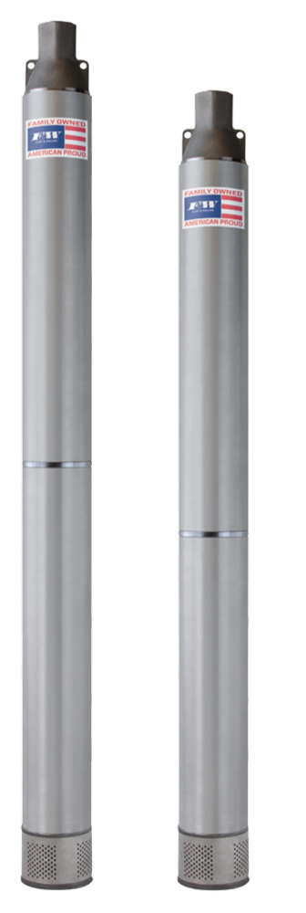
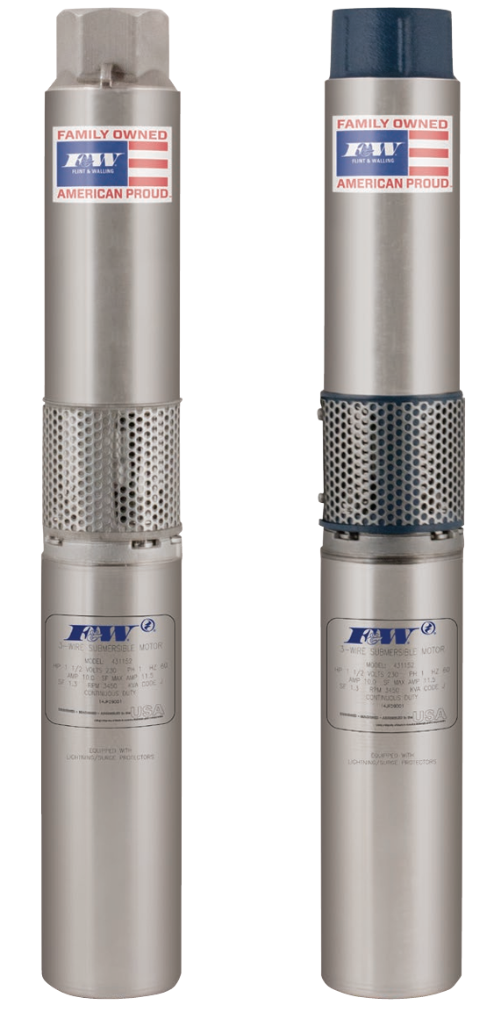
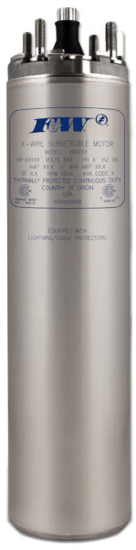
High Capacity
&
Deep-set
4” Submersible Pumps

Slide 3

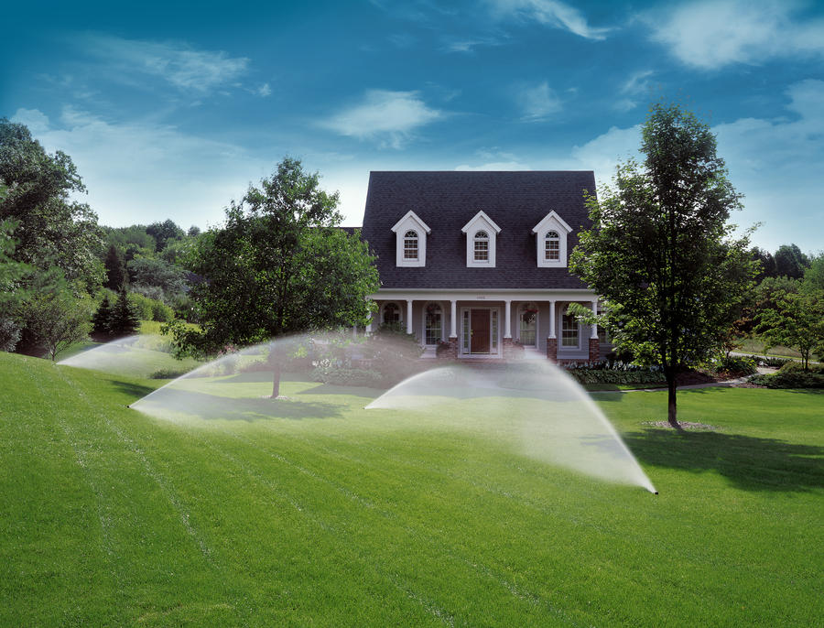
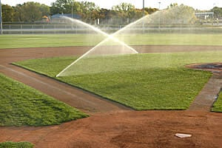
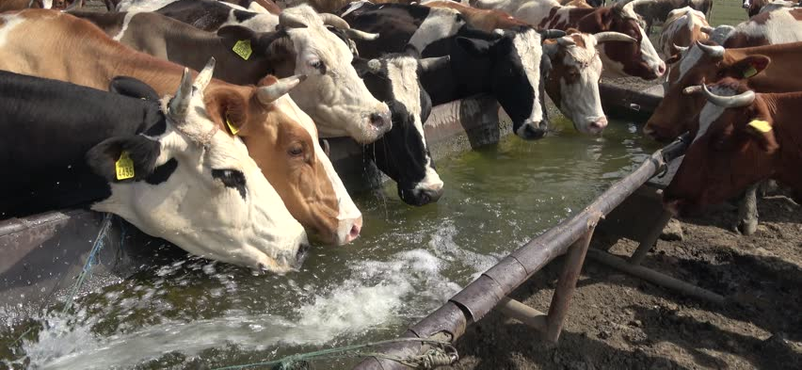
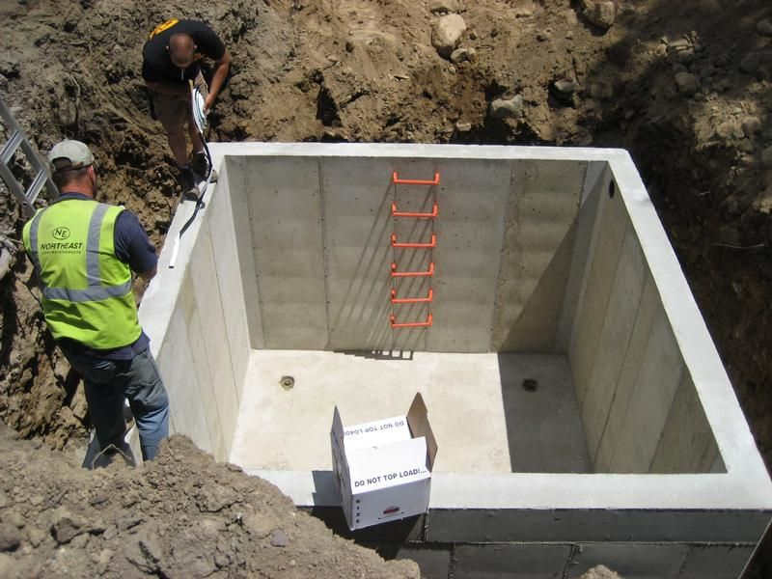
High Capacity
Home & Irrigation
Sporting Fields
Livestock Watering
Underground Cisterns

Slide 4
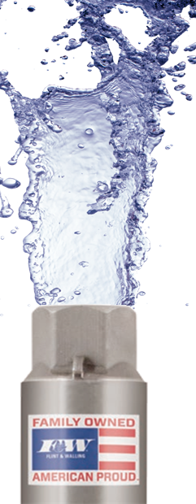
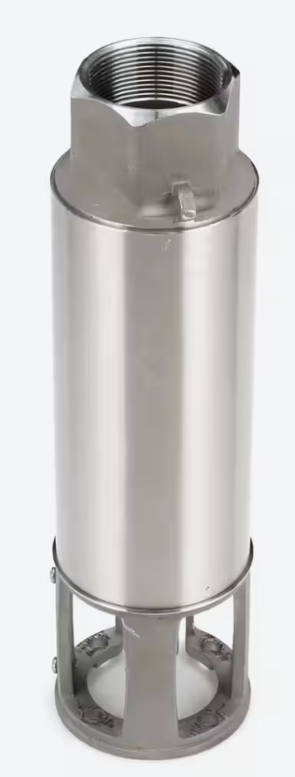
High Capacity
35 gpm
1 HP thru 7½ HP
55 gpm
1½ HP thru 7½ HP
2”
85 gpm
2 HP thru 7½ HP

Slide 5

High Capacity
35 gpm
1 HP thru 7½ HP
Stainless Steel
55 gpm
*Cast Iron
1½ HP thru 7½ HP
85 gpm
2 HP thru 7½ HP
*Cast Iron discharge and motor mount

Slide 6
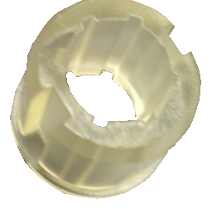
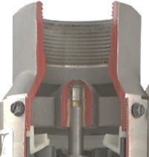
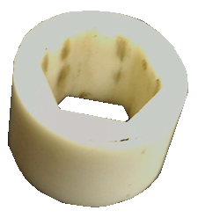

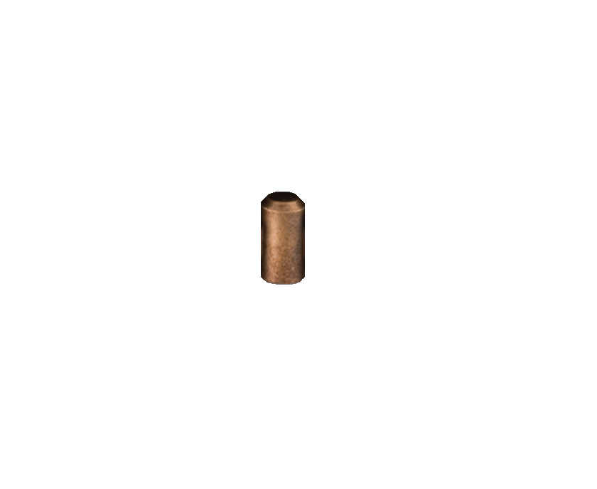

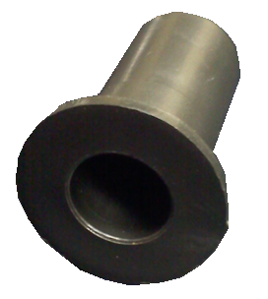
High Capacity
No-lead closed bronze bearing
Sleeve bearing
Discharge Bearing

Slide 7
High Capacity
DISCHARGE PIPING
Install pump with same diameter pipe as the discharge
NOTE: Use of pipe smaller than the size of the
discharge port will restrict the capacity of the
pump and lower its operating performance.

Slide 8
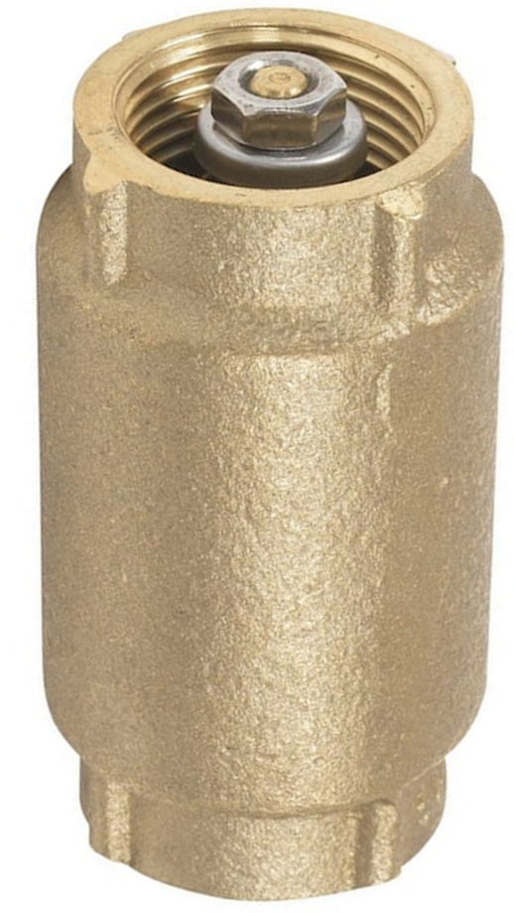
High Capacity
CHECK VALVE
Install a line check valve within 25 feet of the pump.
a. For well depths exceeding 200 feet an
additional check valve should be installed
every 100 feet.
b. An additional check valve should be installed
in the horizontal line between the well top
and the pressure tank.

Slide 9
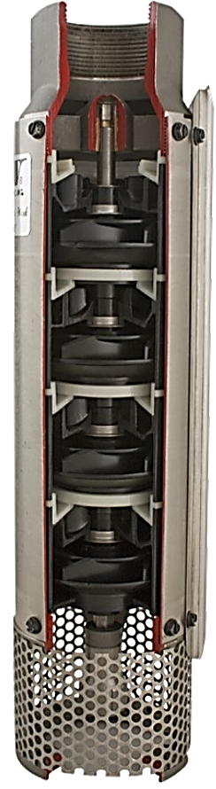
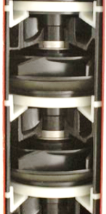



High Capacity
Impeller Design
Loose Tolerances – avoid sand locking
Impellers are balanced
Impellers & Diffusers are dis-similar materials
F&W “Floats” the stack

Slide 10
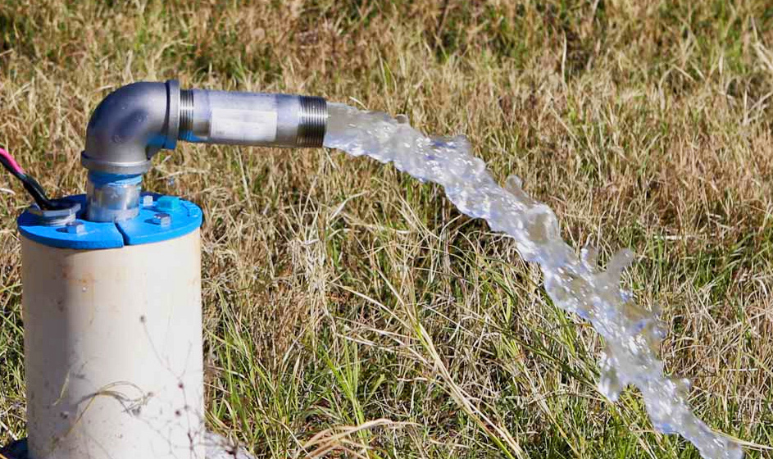
High Capacity
Impeller Design
Stainless Steel Thrust Washers

Slide 11
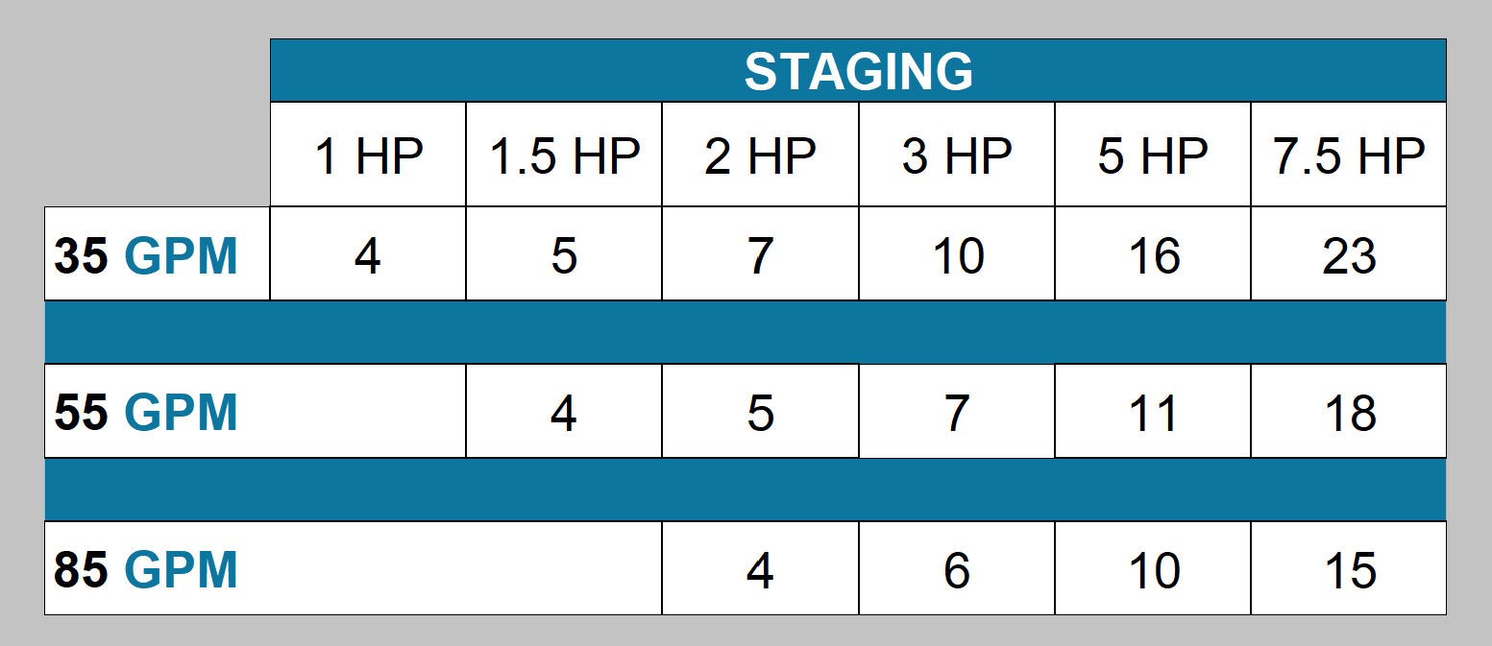
High Capacity

Slide 12
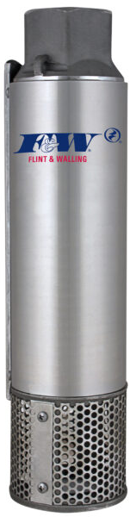
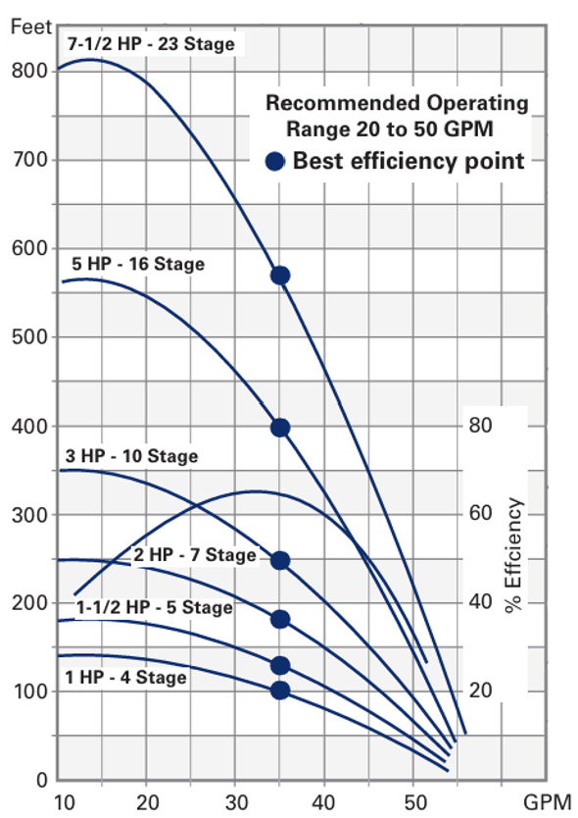
High Capacity
Performance

Slide 13

Deep-set

Slide 14
Deep-set

Slide 15
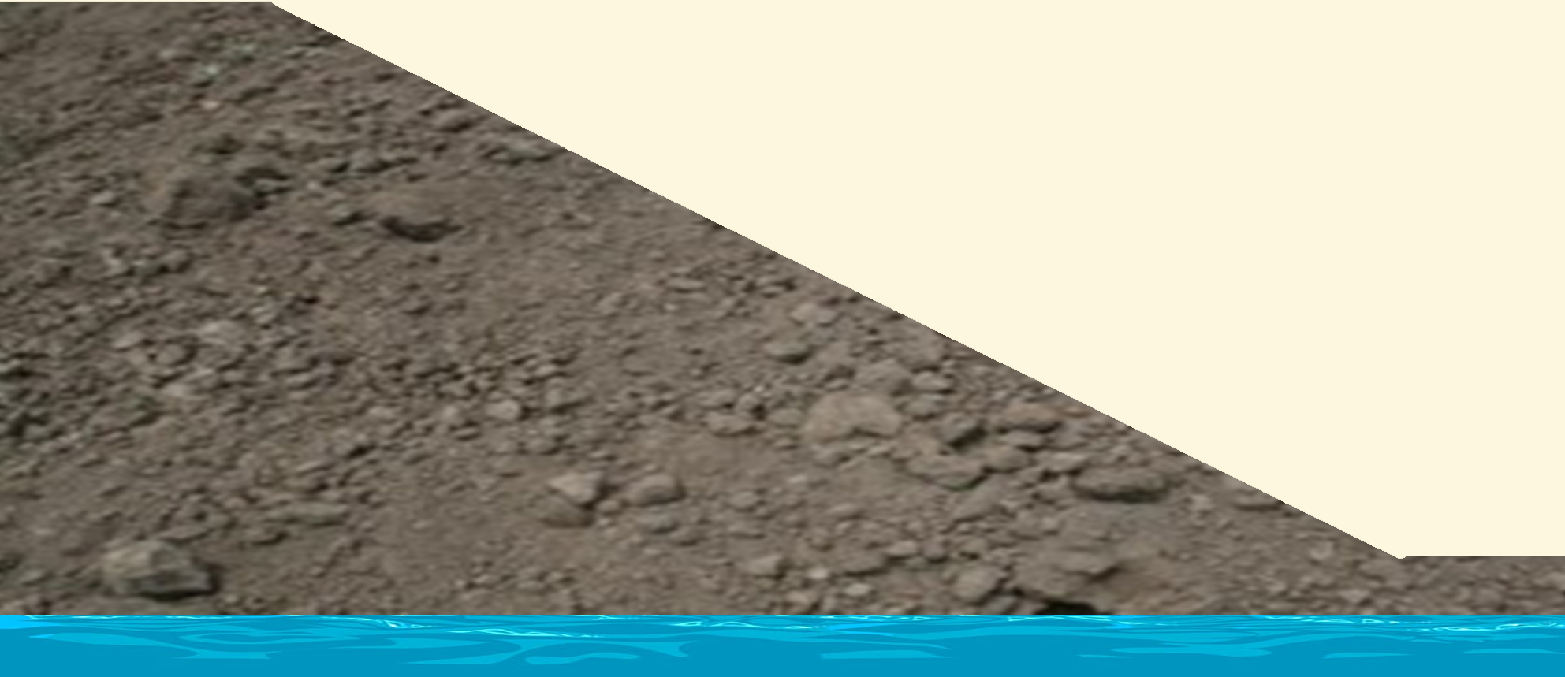
Up to 1500 feet total head
Deep-set

Slide 16
2 HP
5 gpm
3 HP
7 gpm
5 HP
10 gpm
7½ HP
19 gpm
Deep-set
27 gpm

Slide 17
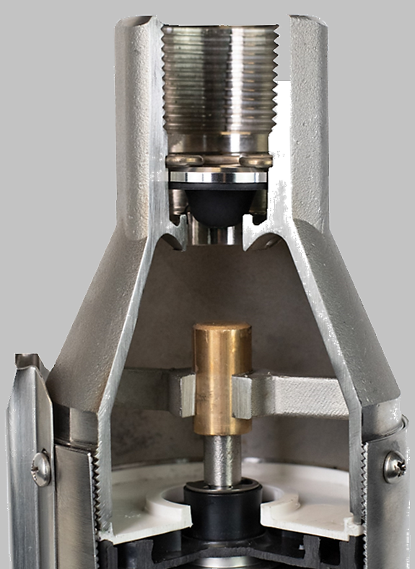
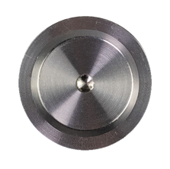
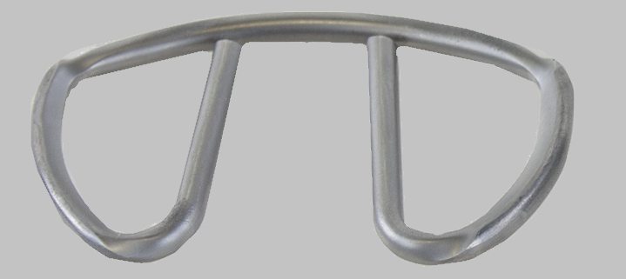
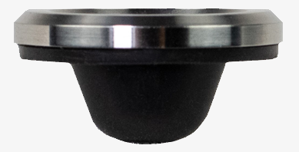
Quality & Longevity

Slide 18
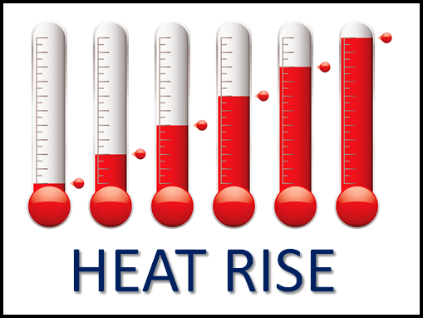
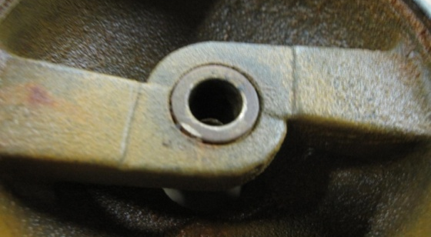
Quality & Longevity

Slide 19
Quality & Longevity

Slide 20
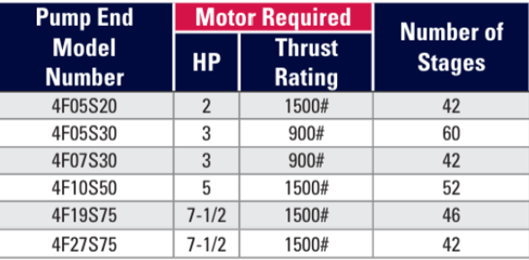
2 HP
5 gpm
3 HP
7 gpm
5 HP
10 gpm
7½ HP
19 gpm
Deep-set
27 gpm

Slide 21
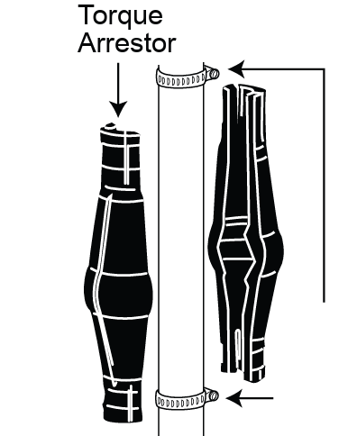
Deep-set

Slide 22
From machine shop through sub-assemblies and final packaging…
any one pump will go through 5-10 quality tiers of inspection.

Slide 23
subscribe
https://www.youtube.com/@flintandwalling

