Slide 1

F&W Submersible Pump Ends

Slide 2
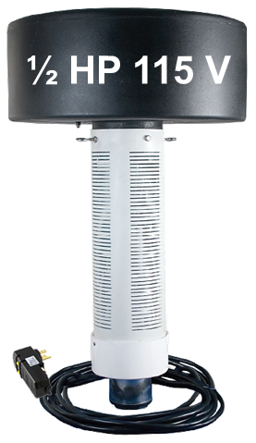
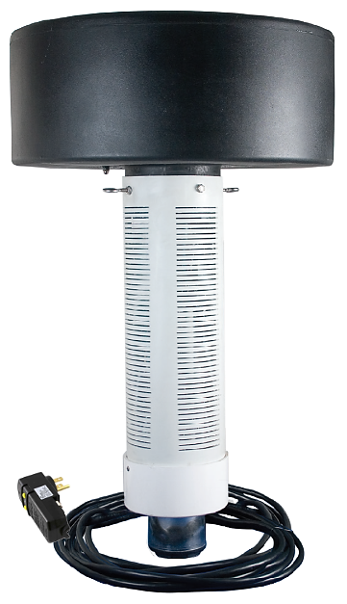
1 HP 230 V
¾ HP 230 V
½ HP 230 V
Added ¾ & 1 hp models
All hp available in 230 volt

Slide 3
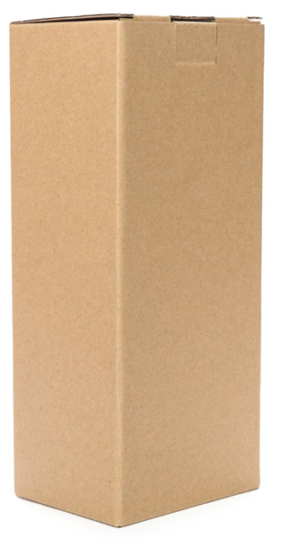
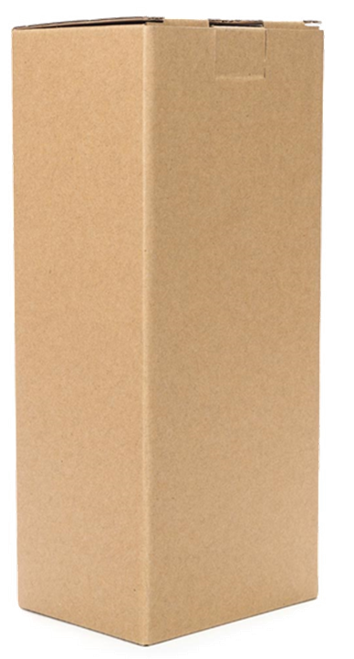
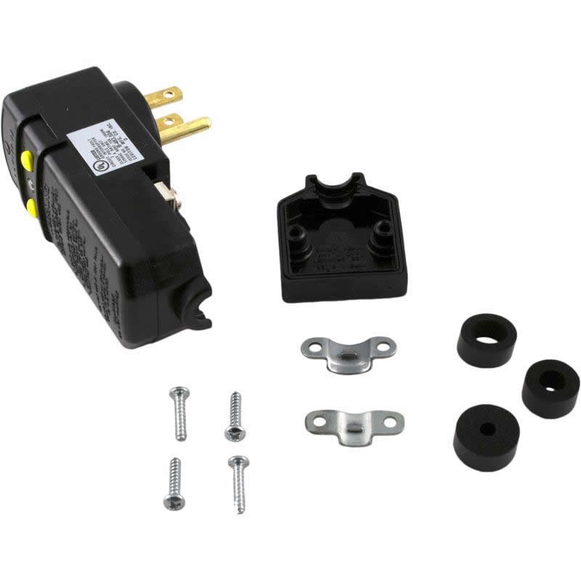
1 HP 230 V
½ HP 115 V
(1) 115 V Model
● Ships with 100’ power cord
attached to the pump with
a 115V GFI
¾ HP 230 V
½ HP 230 V
(3) 230 V Models
● Ships with a Control Center
that is rainproof and lockable.
4 Models available

Slide 4

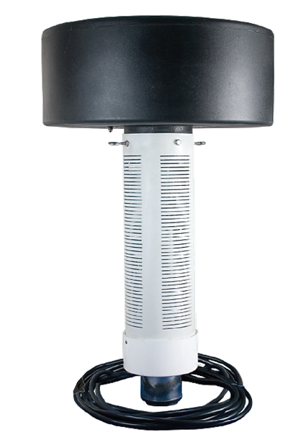
Dimensions by HP
…for perspective as compared to a 6’ person
1 HP
½ HP
20” x 40”
14½” x 32”

Slide 5
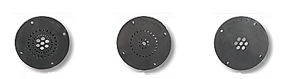
1 HP 230 V
½ HP 115 V
¾ HP 230 V
½ HP 230 V
Three easily interchangeable fountain patterns

Slide 6
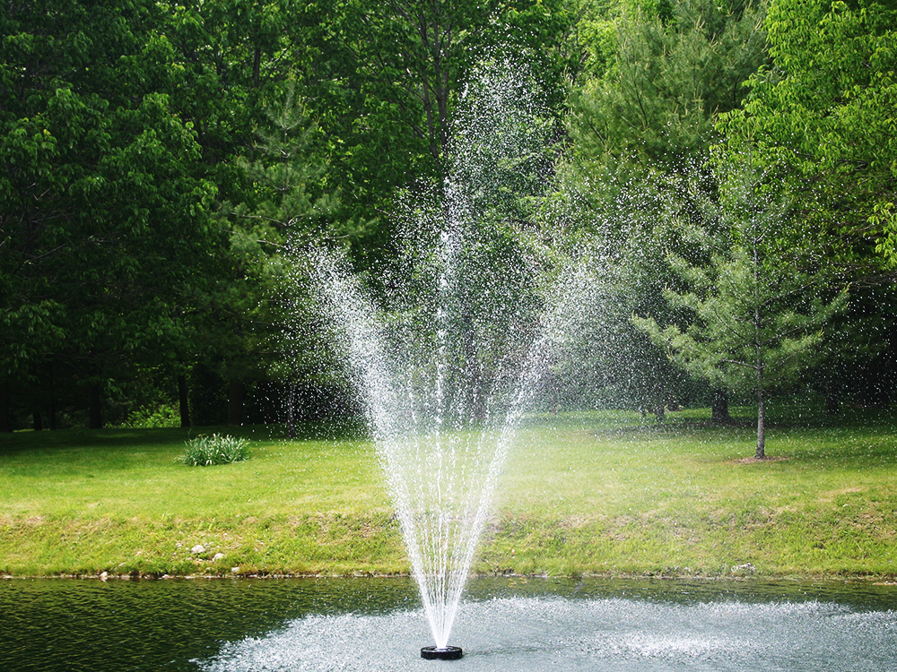

Water Trumpet
a symmetrical inverted bell shape
13’ to 22’
15’ to 35’

Slide 7
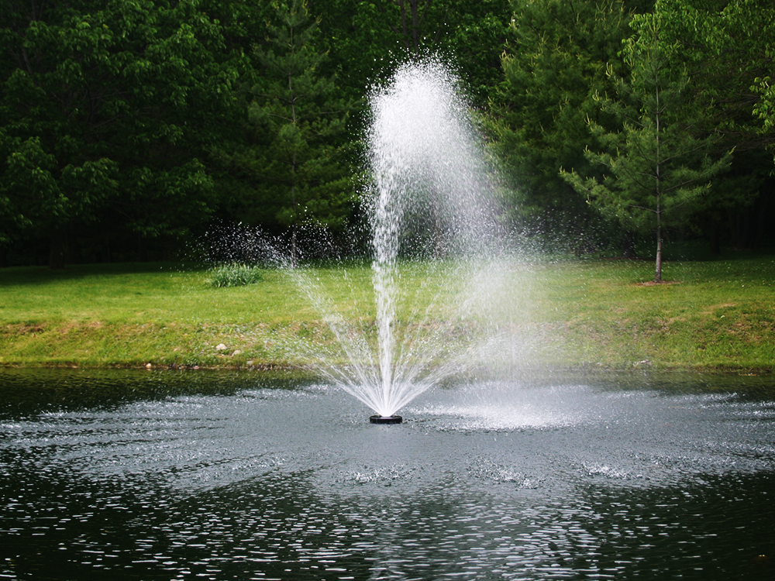

Water Lily
Factory Installed
an eye-catching combination spray
15’ to 24’
30’ to 46’

Slide 8
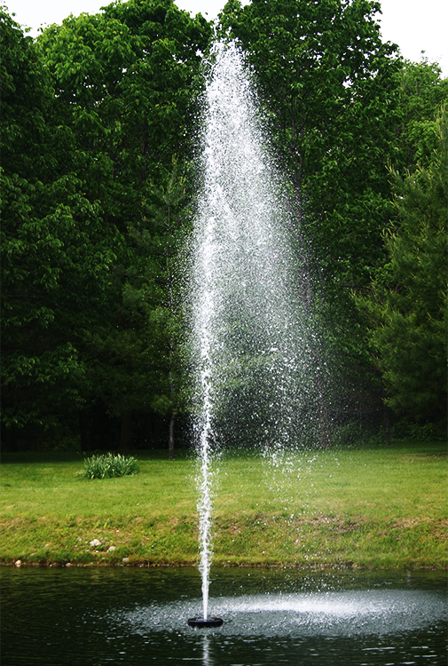

Sky Cannon
a dramatic single plume of water
15’ to 41’
6’ to 10’

Slide 9

Choice with every system
Water Trumpet
Sky Cannon
Water Lily

Slide 10
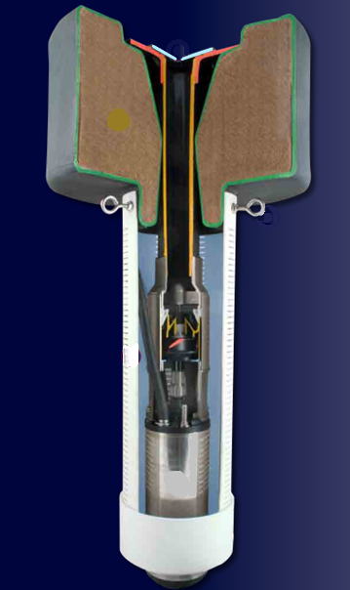
A look at the components…
Interchangeable Nozzle (1 of 3)
Polyethylene, foam filled float
will not waterlog and UV resistant.
Mounting Flange
mounts pump to float
Stainless Steel eye bolts
anchor system / pond bottom or shoreline
mounts intake screen to float
Intake Screen
6” slotted PVC pipe
Hi- Cap, Single stage Pump & Motor Assembly

Slide 11


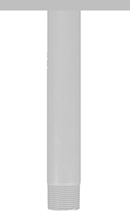
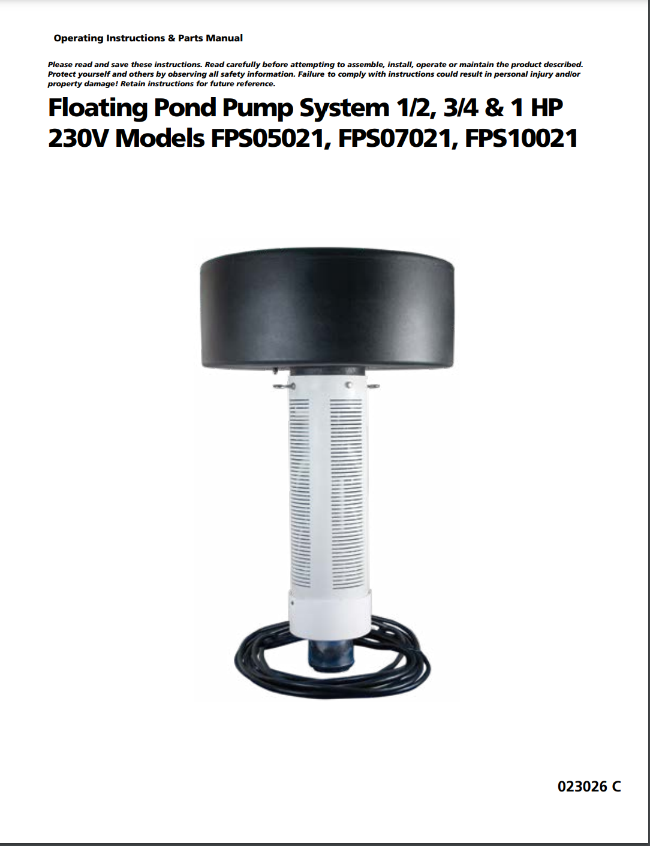
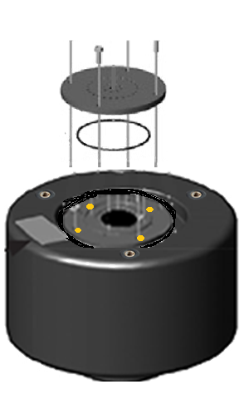
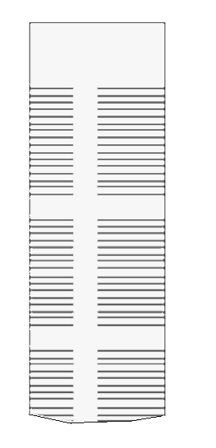
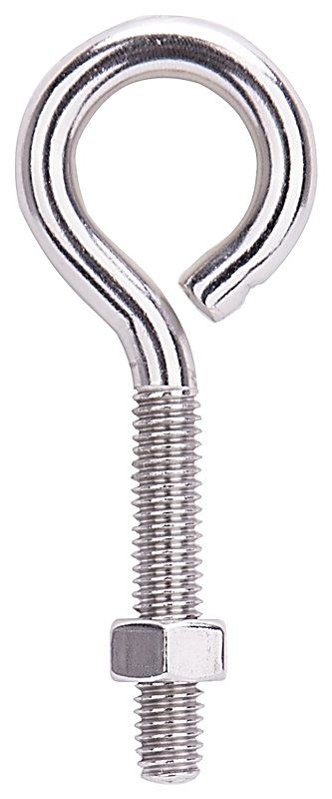
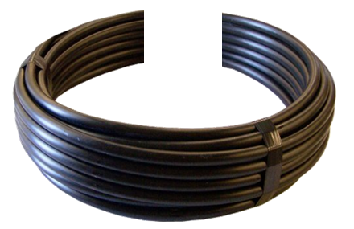
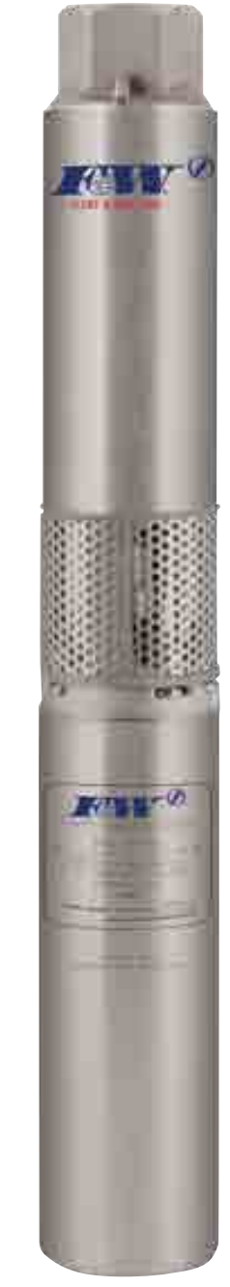
How it all goes together…
Interchangeable Nozzle
Float
Mounting Flange
Stainless Steel eye bolts
Hi-Cap, Single Stage
Pump & Motor
6” Slotted PVC
Intake Screen
Instruction Manual
Pump Cable

Slide 12
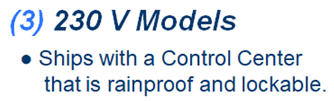
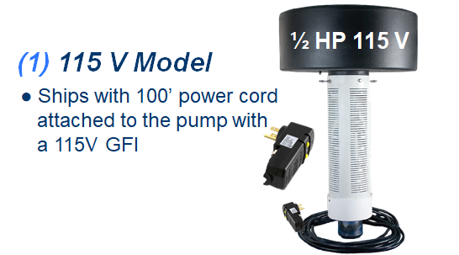
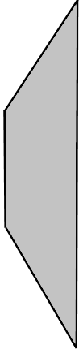
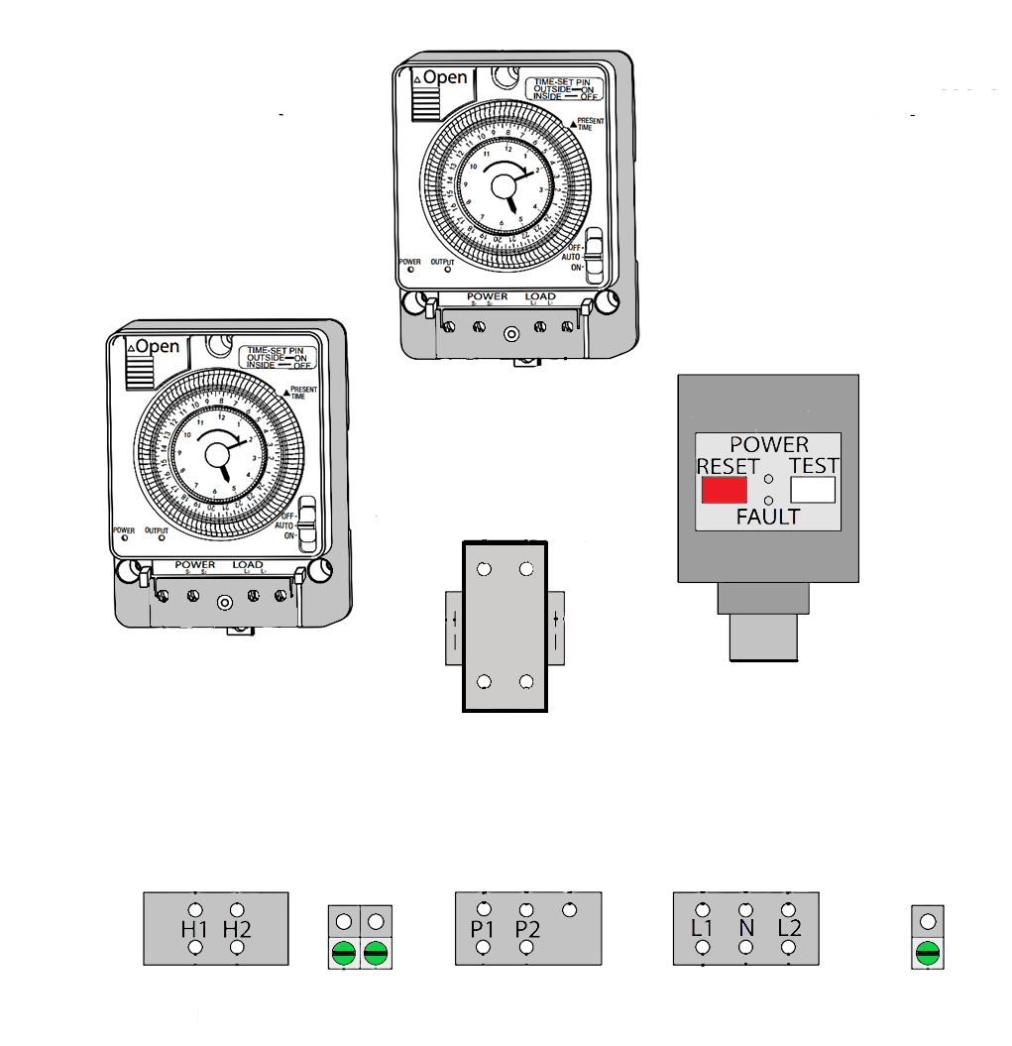
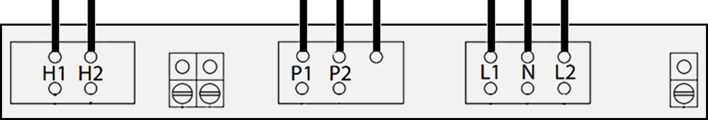
Available Options Next
Light Timer
Pump Timer
Control Panel is Pre-wired
Pump Motor Contactor
Ground Fault Interrupter (GFI)
Terminal Block
To Lights
To Pump
Line Power

Slide 13

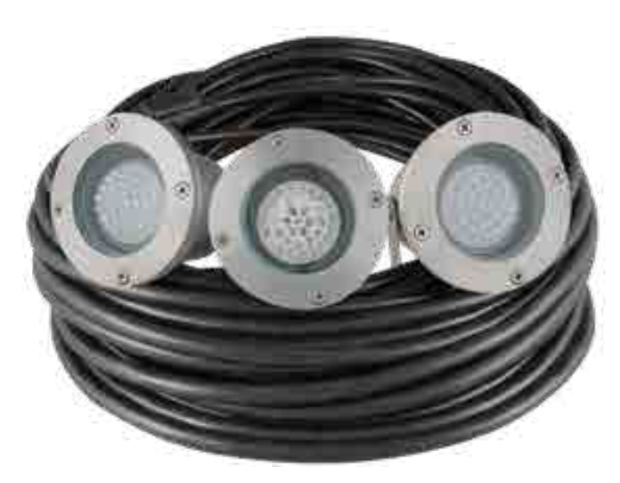
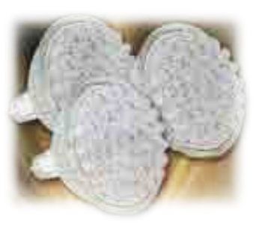
Light up the night with an optional
Available Options
NightBright
System

Slide 14

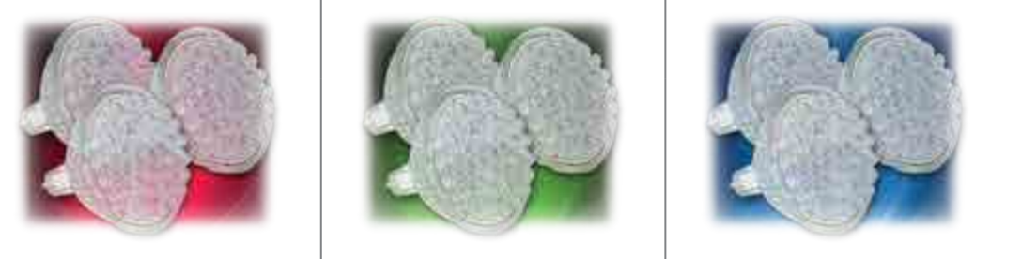
Light up the night with an optional
Available Options
NightBright
System

Slide 15

Light up the night with an optional
Available Options
NightBright
System

Slide 16

Light up the night with an optional
Available Options
NightBright
System

Slide 17
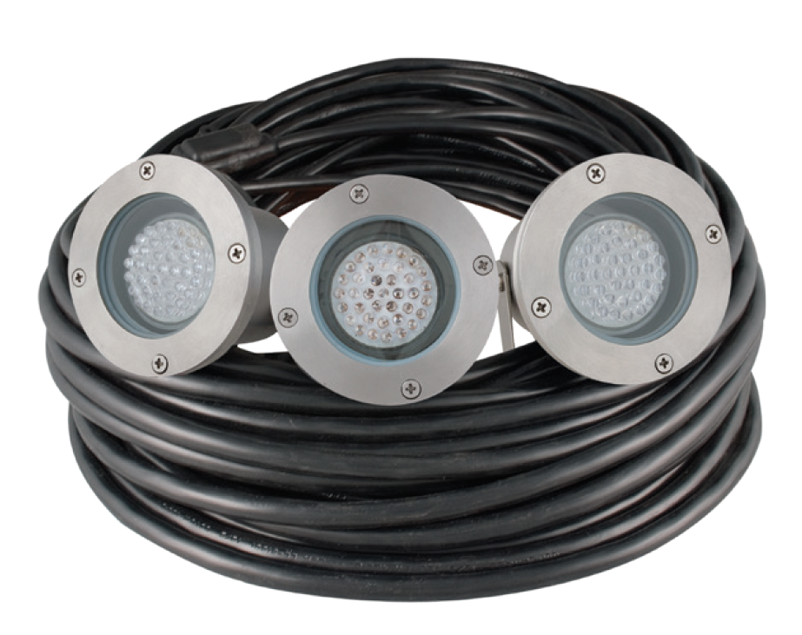
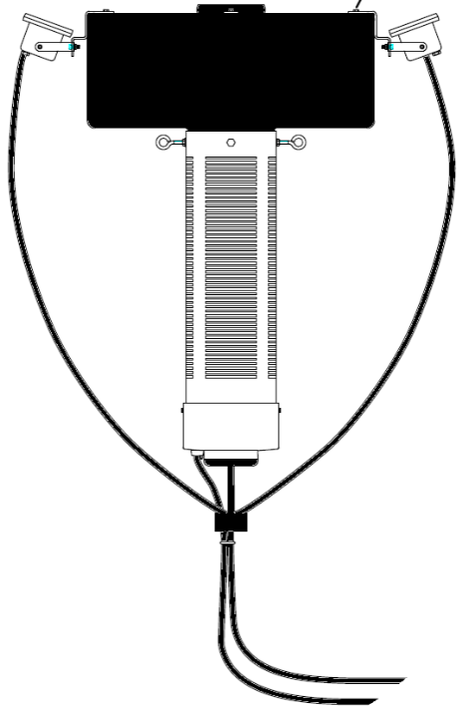
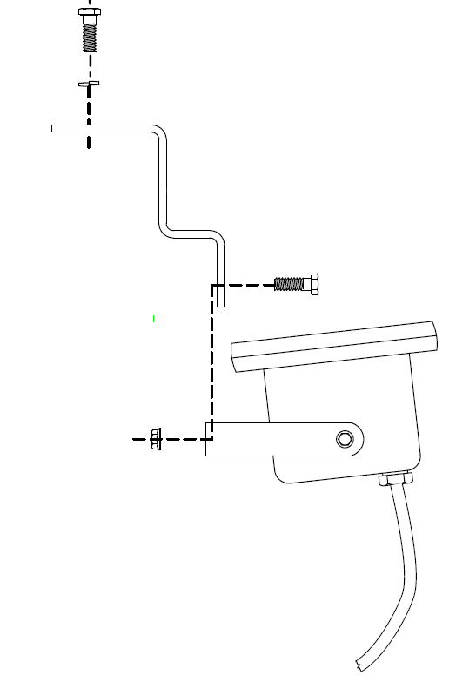



Stainless Steel Pods
FLOAT

Slide 18
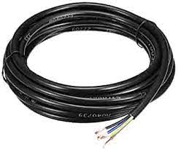
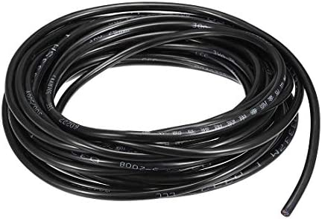
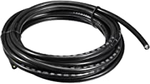
More Available Options
Additional Pump Cable Packages for 230V Fountain Systems
Pump Cable Lengths
100’
150’
14 GA. S00W
50’
12 GA. S00W
Light Cable Lengths
50’
100’
150’
18 GA. S00W

Slide 19
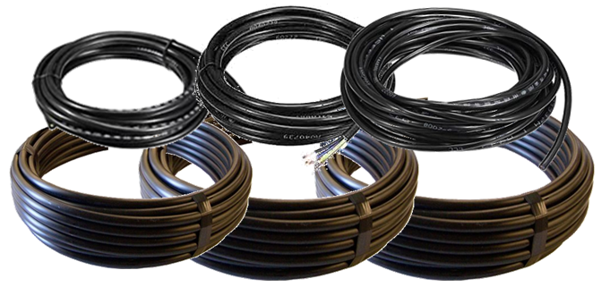
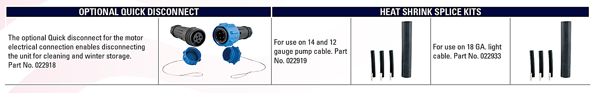
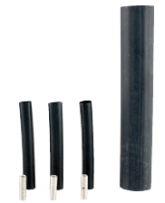
More Available Options
Cable Packages include
Quick-disconnect
for the motor electrical connection, enables disconnecting the unit for cleaning and winter storage.
022919 heat shrink splice kit
14 & 12 GA
022933 heat shrink splice kit
18 GA

Slide 20
More Available Options
NightBright
System
Three (3) 120V White LED Lamps
Optional colors (in sets of 3)
Red
Green
Blue

Slide 21


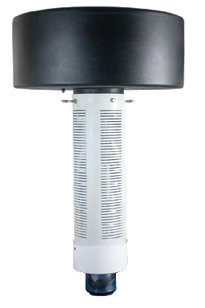



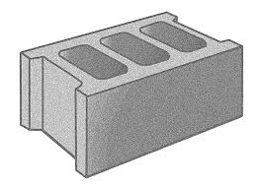
Minimum depth of 5 feet
Select wire sizes by hp & feet
Nozzle selection chart
Anchoring the fountain
Testing the GFI
Setting Timers
5’minimum

Slide 22
Minimum depth of 5 feet
Select wire sizes by hp & feet
Nozzle selection chart
Anchoring the fountain
Testing the GFI
Setting Timers
115V model /
100’ pump cable
230V models /
250’ pump cable

Slide 23
Minimum depth of 5 feet
Select wire sizes by hp & feet
Nozzle selection chart
Anchoring the fountain
Testing the GFI
Setting Timers
115V model / 100’
230V models / 250’
clean surface

Slide 24
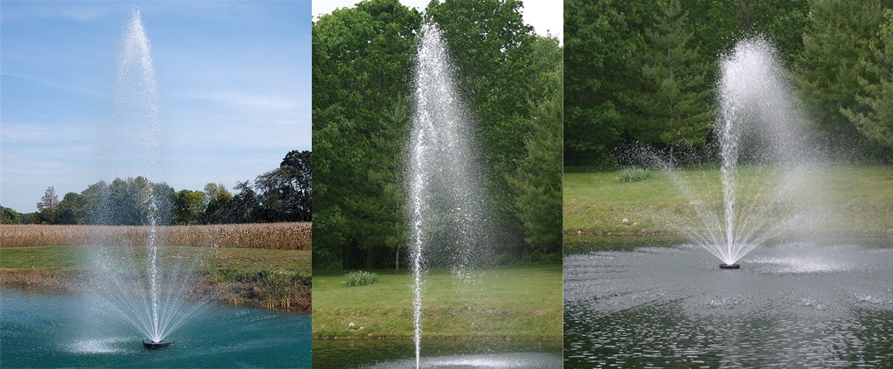
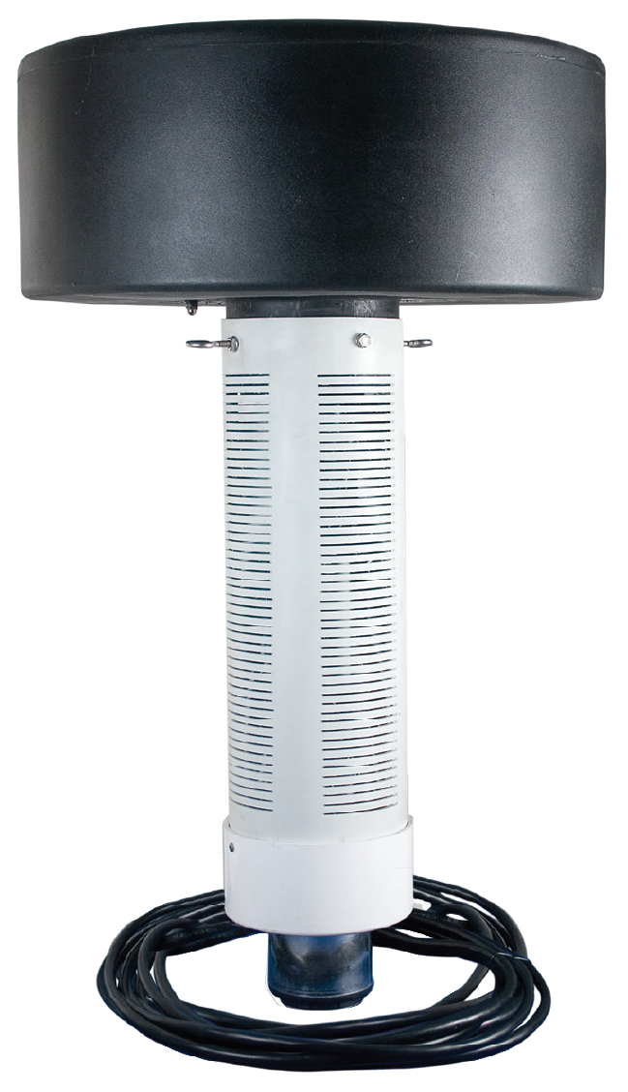
● Private residential ponds
● Apartment complexes
● Industrial Centers
● Golf Courses
● Waterscapes
● City Parks
Beautiful Waterscapes

Slide 25
subscribe
https://www.youtube.com/@flintandwalling
track 2B

